Slide 1
WA Market reform program
REAL Time Market Forum – Meeting 1
24 OCTOBER 2016

Slide 2
AGENDA
Welcome and confirm agenda
Wholesale workstream and participant engagement
Introduction to real time dispatch
Dispatch and pricing
Lunch
Bidding and offers
Market information
Wholesale market systems
Next meeting and closing

Slide 3
Wholesale workstream and participant engagement

Slide 4
WAMRP structure

Slide 5
Wholesale WorkStream Overview
WAMRP Wholesale Workstream
Energy and Ancillary Services Markets
Settlements and Prudentials
RCM Phase 3
Real Time Markets
Day Ahead Market (STEM)
RC Auction

Slide 6
Workstream objectives
Project | Objective
Real time markets | Introduce energy and ancillary services real time markets with 5 minute dispatch and pricing subject network security constraints
Day ahead market | Implement system changes to allow STEM to be integrated with new real time markets
RCM Phase 3 | Implement changes associated with transitional arrangements for RCM to become effective 1 October 2017
RC Auction | Establish an auction process for the procurement of reserve capacity
Settlement and Prudentials | Implement new settlement and prudential processes for WA markets which leverage NEM systems and processes

Slide 7
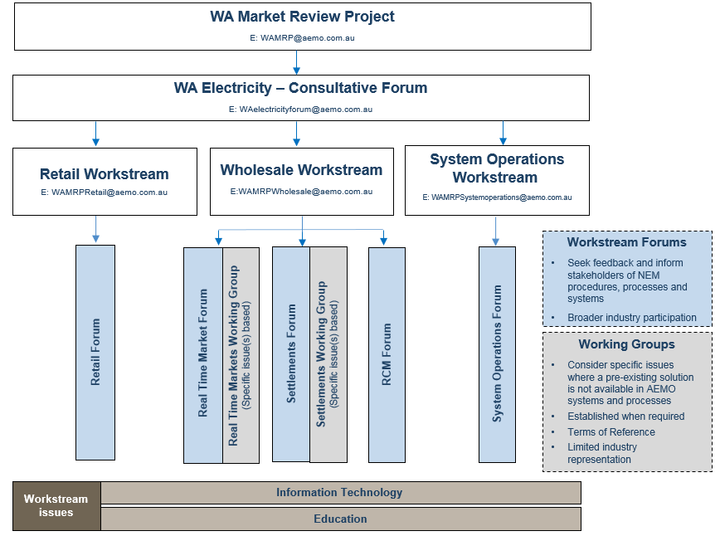
Stakeholder engagement approach

Slide 8
Purpose of the forum
Provide introductory information to participants on AEMO’s processes and systems used in the NEM
Share AEMO’s thoughts on approach and design, to assist participants in developing their work program
Assist participants in providing input to the Energy Market Operations and Processes Consultation Group
Meeting schedule:
  24 October
  22 November
  13 December
  2017: TBC, but targeting monthly until at least June

Slide 9
More Information
Website: http://www.aemo.com.au/Stakeholder-Consultation/Industry-forums-and-working-groups/WA-Forums/WAMRP-Real-Time-Market-Forum
Email: WAMRPWholesale@aemo.com.au
Phone:
  Chris Muffett (02) 8884 5317
  Brian Nelson (02) 9239 9132
  Basilisa Choi (02) 9239 9116
  Michael Sanders (02) 9239 9115
  Phil Hayes (02) 8884 5367

Slide 10
Introduction to real time dispatch

Slide 11
Session Objectives
Spot Market
  Market design principles
  AEMO responsibilities
  Basics
  Losses & constraints
  Central dispatch and pricing
  Self commitment and decommitment
  Ancillary services
Registration Categories

Slide 12
Spot market

Slide 13
Market design principles
Minimisation of market operator decision making to allow participants the greatest amount of commercial freedom.
Maximum level of market transparency in the interests of efficiency by providing accurate, reliable and timely forecast information.
Technology neutrality.
Consistency between dispatch and pricing.
Equal access for existing and prospective participants.
Competitive arrangement for ancillary services.

Slide 14
AEMO responsibilities
Operate and administer the market.
Establish and publish a register of current participants.
Establish consultation procedures.
Publish performance indicators.

Slide 15
What is the spot market?
The spot market involves:
  Facilities for receipt and processing of bids and offers.
  A centralised dispatch process, including pre-dispatch and spot price forecasts.
  Determination and publication of spot and ancillary services prices.
  Statistics of spot market trading.
  Loss factors.
  Suspension processes.
  Collection and dissemination of information to enable the market to operate efficiently.
The spot market is a mechanism for:
  Balancing electricity supply and demand
  Acquiring ancillary services
  Setting a spot price at each connection point for each trading interval and an ancillary service price for each dispatch interval

Slide 16
terminology
Power system security and reliability
  Security is concerned with operation of the transmission network within its limits under normal conditions and following a contingency.
  Reliability is concerned with ensuring adequate reserves of generation above expected demand.
Dispatch and pricing
  The integration of dispatch instructions and marginal prices
Dispatch interval – a five minute period
Trading interval – a thirty minute period
  Spot prices in a trading interval are determined by averaging the prices for the 6 dispatch intervals in a trading interval
Reference node – a substation which will be the reference point for pricing
  The NEM has regional reference nodes (RRN), and will determine a regional reference price (RRP) at each RRN.

Slide 17
Reference node
WA is to generally follow similar principles for establishing a reference node.
  But there will only be one region.
NEM technical requirements for reference node:
  At a nominated major transmission substation located at or close to the largest load centre.
  All the requirements in the NEM presuppose more than one region, so are not relevant.
Current indications are that the reference node will be at Southern Terminal Station rather than Muja.
  This will result in the price being higher during periods of congestion rather than lower.
  This is deliberate as it signals investment and will tend to reduce the need for constrained-on compensation.

Slide 18
Network losses
The NEM incorporates inter-regional, intra-regional and distribution losses.
  WA will only implement intra-regional and distributions losses. There will be will be one region.
Losses
  Losses occur due to the transfer of electricity between a connection point and the reference node.
  Loss factors notionally describe marginal losses for electricity transmitted between a connection point and a reference node.
A loss factor is used as a price multiplier that can be applied to the reference price to determine the local spot price at a transmission connection point.
The methodology for determining loss factors will be the subject of a later forum.

Slide 19
Regional model
WEM price applies at the Reference Node (RN)
Generator bids (Band MW / Price) are made at their local connection point
Losses
Losses
Losses
RN
Losses
All prices within a region related to RN by fixed (annual) MLF

Slide 20
Network constraints
A network constraint is a model of the network that described limitations on the network to convey electricity.
They are the first line of defence for maintaining power system security.
  A “binding” constraint means a part of the network is being operated at or close to its limit.
  A “violating” constraint means the network is being operated above, or at least too close for comfort to its limit.
  It doesn’t always mean the power system is insecure, but is an indicator of the need to take action.
  Action can include more limiting constraints, directions, contingency plans…
For the market, a binding constraint usually has a pricing impact:
  A facility is constrained-on when the price is below its offer due to a network constraint.
  A facility is constrained-off when the price is above its offer.
  Consistency between dispatch and pricing occurs when the price is consistent with a facility’s offer.

Slide 21

Nem bidding dispatch and pricing
Market
Generators
Scheduled/S-S
Generators
Financial
Contracts
G
G
G
G
Offers
Dispatch
Instructions
Electricity
Flows
Pool
Settlement
Electricity
Flows
Dispatch
Instructions
Market
Customers
R
R
Bids
Scheduled
Demand
End Users

Slide 22
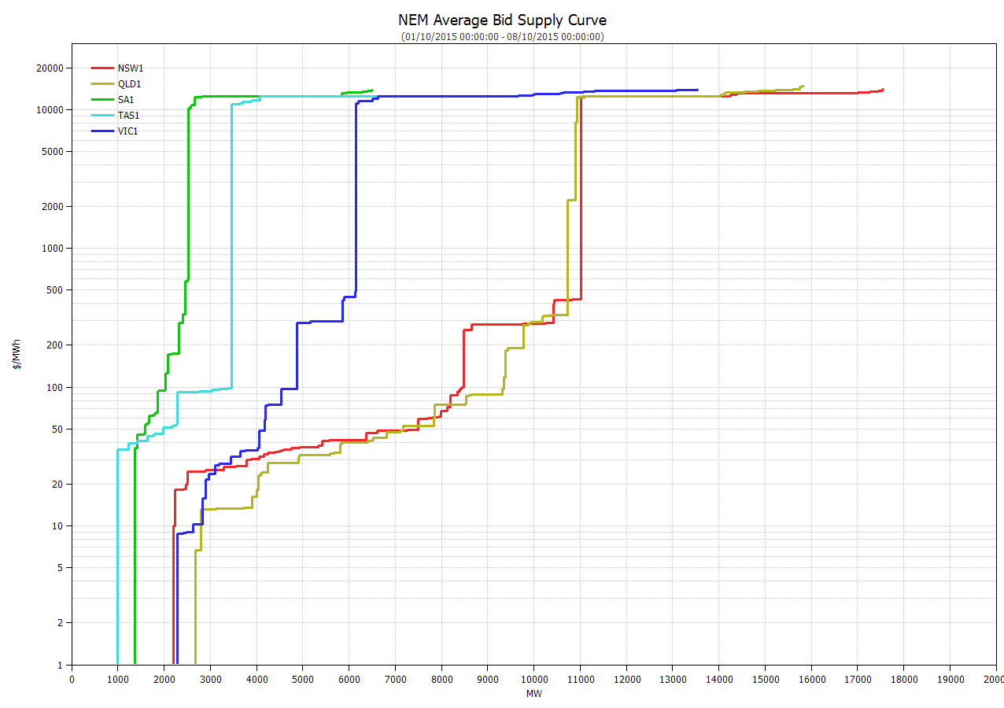
Supply demand curve for dispatch and pricing
Regional supply curve
Includes capacity limits, ramp rate limits as well as bids
May also be limited by network
Forecast regional demand
In effect, assumed to be inelastic
Implied regional prices
May be lower or higher due to inter-regional flows
Importing region price drops, exporting region price rises
NEM is run as a “blind auction” every 5 minutes and prices averaged to produce a 30-minute spot price.

Slide 23
Commitment and decommitment
Outages for plant that receives capacity credits will continue to be approved centrally.
Commitment and decommitment of generation or loads is determined from offers for dispatch.
Two types of commitment
  Slow start units are unable to synchronise and increase generation within 30 minutes of receiving an instruction from AEMO. They must self-commit their units to services.
  Those that are not slow start (sometimes called fast start) may make use of the dispatch inflexibility profile – more commonly called a fast start inflexibility profile (FSIP).
FSIP is discussed in detail later in the presentation.

Slide 24
Ancillary services
The current WEM services of load following and spinning reserve will be replaced by frequency control ancillary services (FCAS).
There are 8 separate services:
  2 regulation services RAISEREG and LOWERREG
    Requires providers to be on remote control from AEMO
  6 contingency services
    Covering 6 second, 60 second and 5 minute timeframes
    Raise and lower services
    Responding to local frequency
In NEM, there are also non-market ancillary services
  System restart
  Network support and control ancillary services

Slide 25
registration

Slide 26
Nem Participant categories
Market Participants
Non-Market Participants
Generator
Market
Generator
Scheduled Generator
Non-Scheduled Generator
Semi-Scheduled Generator
Non-Market
Generator
Scheduled Generator
Non-Scheduled Generator
Semi-Scheduled Generator
Customer
Market Customer
(Retailers & Generation with auxiliary loads)
First-tier Customer
Second-tier Customer
(end-user customers, but optional)
Network Service Provider
Market Network Service Provider
Network Service Provider
Trader
Reallocator
Intending
Special

Slide 27


Questions/Discussions

Slide 28
Dispatch and pricing

Slide 29
Session objective
Bid Process
Dispatch and Pricing
Fast-start unit commitment

Slide 30
Bid Process

Slide 31
Wholesale Electricity Market
Market
Generators
Scheduled/S-S
Generators
Financial
Contracts
G
G
G
G
Offers
Dispatch
Instructions
Electricity
Flows
Pool
Settlement
Electricity
Flows
Dispatch
Instructions
Market
Customers
R
R
Bids
Scheduled
Demand
End Users

Slide 32
Trading Day
Calendar day
00:00
11:00
23:00
01:00
04:00
01:00
02:00
03:00
05:00
07:00
08:00
09:00
10:00
13:00
14:00
15:00
16:00
17:00
18:00
19:00
20:00
21:00
22:00
00:00
02:00
04:00
06:00
12:00
03:00
Trading day start time: expected 8am-8am
Trading Day consists of
    24 hours
    48 Trading Intervals, each 30 minutes
    288 Dispatch Intervals, each 5 minutes

Slide 33
Generator Bid STRUCTURE
Band Price
Price Band | PB1 | PB2 | PB3 | PB4 | PB5 | PB6 | PB7 | PB8 | PB9 | PB10
Price ($/MWh) | -976.50 | -3.60 | 16.59 | 17.58 | 19.53 | 22.46 | 28.32 | 39.06 | 4818.05 | 13671
Band MW
TI | PB1 | PB2 | PB3 | PB4 | PB5 | PB6 | PB7 | PB8 | PB9 | PB10
01 | 0000 | 0280 | 0120 | 0100 | 0160 | 0000 | 0000 | 0000 | 0000 | 0050
02 | 0000 | 0180 | 0120 | 0100 | 0160 | 0000 | 0000 | 0000 | 0100 | 0050
03 | 0000 | 0000 | 0120 | 0100 | 0160 | 0000 | 0000 | 0000 | 0100 | 0230
TI – Trading Interval

Slide 34
Bid price adjustment by MLF
$1/MWh
1.05 MW
Losses
$1.05/MWh
0.05 MW
RRN
1 MW

Slide 35
Generator Bid STRUCTURE
Band Price
Price Band | PB1 | PB2 | PB3 | PB4 | PB5 | PB6 | PB7 | PB8 | PB9 | PB10
Price ($/MWh) | -976.50 | -3.60 | 16.59 | 17.58 | 19.53 | 22.46 | 28.32 | 39.06 | 4818.05 | 13671
-1000
-3.69
16.99
18.00
20.00
23.00
29.00
40.00
4934.00
14000.00
Band MW
TI | PB1 | PB2 | PB3 | PB4 | PB5 | PB6 | PB7 | PB8 | PB9 | PB10
01 | 0000 | 0280 | 0120 | 0100 | 0160 | 0000 | 0000 | 0000 | 0000 | 0050
02 | 0000 | 0180 | 0120 | 0100 | 0160 | 0000 | 0000 | 0000 | 0100 | 0050
03 | 0000 | 0000 | 0120 | 0100 | 0160 | 0000 | 0000 | 0000 | 0100 | 0230
TI – Trading Interval

Slide 36
Dispatch and Pricing

Slide 37
Dispatch & Pricing Principle
    Dispatch Objective
    Maximise value of trade based on value of dispatched bids minus dispatched offers
    Price
    Marginal cost of supply:
    Price of meeting incremental demand change in region

Slide 38
Dispatch & Pricing Process
Inputs
Market
Solver
Outputs
Region Fcast Demand
Generator Offers
Load Bids
Network Constraints
Frequency Control Ancillary Service (FCAS)
Requirements
NEMDE
Linear Program
Co-optimisation
Region Energy Prices
Region FCAS Prices
Unit Energy Targets
Unit FCAS Targets
Semi-scheduled Cap

Slide 39
Interpreting GENERATOR BIDs
Price
($/MWh)
Band 4:
50MW @ $200
Band 3:
100MW @ $60
Band 2:
250MW @ $30
Band 1:
100MW @ -$30
MW

Slide 40
Bidding, Dispatch & THE TREATMENT OF INTRA-REGIONAL LOSSES
G1
If fully dispatched,
G1 expects $ 900
G2 Bid
If fully dispatched, G2 expects $ 1600
“Generated”
Demand 150 MW
Connection Points
TLF_{G1} = 0.9
G1
G2
TLF_{G2} = 0.5
100 MW
@ $9/MWh
200 MW
@ $8/MWh
TLF_{G1}
TLF_{G2}
90 MW
@ $10/MWh
100 MW
@ $16/MWh
RRN
Regional Boundary
C1
C2

Slide 41
EXAMPLE: BID STACK AND Dispatch
Region 1 Demand 1,100 MW
1100 MW
300 MW @ $20
Price = $20/MWh
200 MW @ $5
Objective Function = -$1,050
Objective Function = -$50
Objective Function = -$1,250
Objective Function = -$1,250
Objective Function = $2,950
Objective Function = Total Band Cost
200 MW @ $1
300 MW @ $0
250 MW @ -$5
Generator 1
Generator 2
Generator 3
Generator 4
250 MW @ -$5
200 MW @ $5
200 MW @ $1
300 MW @ $0
250 MW @ $100
300 MW @ $20
300 MW @ $50
200 MW @ $30

Slide 42
Dispatch Price & Spot Price
Dispatch Price
Spot Price
= Price calculated
in the Dispatch
Process
(5 minutes)
= Average of
Dispatch Prices
over half hour period
(30 minutes)
Spot Price is used in Settlement Process

Slide 43
Price revision - NEM
Dispatch infeasibility
Manifestly incorrect input

Slide 44
Pricing under extreme conditions
Administered Pricing
Market Suspension
Market Intervention
Involuntary Load Shedding

Slide 45
Contributors to price spikes
­Shape of the MW bid profile
Rebidding MW within a trading interval
Security constraints – system normal
Security constraints – planned outages
Unplanned outages – line and generator trips
High demands
Low wind generation (high prices)
High wind generation (low prices)
Low ramp rates
Fast start inflexibility profiles

Slide 46
Fast-start unit commitment

Slide 47
Fast Start Inflexibility profile (FSIP)
Generation
Mode 1
Mode 2
Mode 3
Mode 4
Minimum Loading
T1
T2
T3
T4
Time
T1 + T2 ≤ 30 minutes
T1 + T2 + T3 + T4 < 60 minutes
Mode 0 = offline

Slide 48
Fast Start Inflexibility profile (FSIP)
Generation
DI 12:05
DI 12:10
DI 12:15
DI 12:20
DI 12:25
DI 12:30
DI 12:35
Minimum Loading
= 40 MW
T1
T2
T3
T4
Time
= 7 min
= 6 min
= 10 min
= 5 min

Slide 49
Fast start unit committment
NEMDE
1st Pass: Fast Start Commitment Run
Fast start unit commitment status
2nd Pass: Dispatch and Pricing Run

Slide 50
Questions/Discussions

Slide 51
Lunch

Slide 52
Bidding and Offers

Slide 53
Session Objectives
Rules
Implementation
Examples

Slide 54
Rules

Slide 55
Rules 1 – Introduction
Market Rules in NER Chapter 3
  Generating unit offers for dispatch
  Bids for scheduled load
  Dispatch inflexibilities
  Ramp rates
  Spot market operations timetable
  Bid and offer aggregation guidelines
  Equal priced dispatch bids and offers
  Unconstrained intermittent generation forecast
  Rebidding
    Offers, bids and rebids must not be false or misleading

Slide 56
Rules 2 – OFFERS
Scheduled and semi-scheduled generators
  Offer covers all 48 Trading Intervals within a trading day
  Ten price bands: monotonically increasing; lowest price band ≥ MFP; highest price band ≤ MPC; prices referred to RRN by MLF
  Ten volumes: whole MW; “as generated” at generator terminals

Slide 57
Rules 3 – Bids
Scheduled load
Similar to generators, but:
  Normally-on scheduled load: bids are the prices above which you’ll stop consuming
  Normally-off scheduled load: bids are the prices below which you’ll start consuming

Slide 58
Rules 4 – Inflexibilities
Fixed load
Fast start plant
  Dispatch will try to respect inflexibilities in bids
  Otherwise dispatch will be based on price

Slide 59
Implementation

Slide 60
Implementation 1 – Spot Market Timetable
Spot market operations timetable:
    https://www.aemo.com.au/Electricity/National-Electricity-Market-NEM/Security-and-reliability/-/media/545CBC9F45624ED29D5AFB8D3F5AB878.ashx
Bids ≥ 1230 hrs Day - 1: “rebids”:
  Price bands fixed
  Reason required for change

Slide 61
Implementation 2 – Bid File Format
Energy/MNSP/FCAS Bid File Submission:
    http://www.aemo.com.au/Electricity/National-Electricity-Market-NEM/-/media/2F1AF53D585547ABA3C7C7653355E890.ashx
  file name: participant; date; sequence
  layout: start of bid file; start of bid type; start of unit; start of fast start profile; unit limits; unit price bands; unit band availability

Slide 62
Implementation 3 – AEMO Bid Validation
AEMO bid validation checks for:
  blanks
  band price < MFP
  band prices > MPC
  band prices not increasing
  band volumes > max availability
  sum of band volumes < max availability
  rebid, fixed load, low ramp rate with no reason

Slide 63
Examples

Slide 64
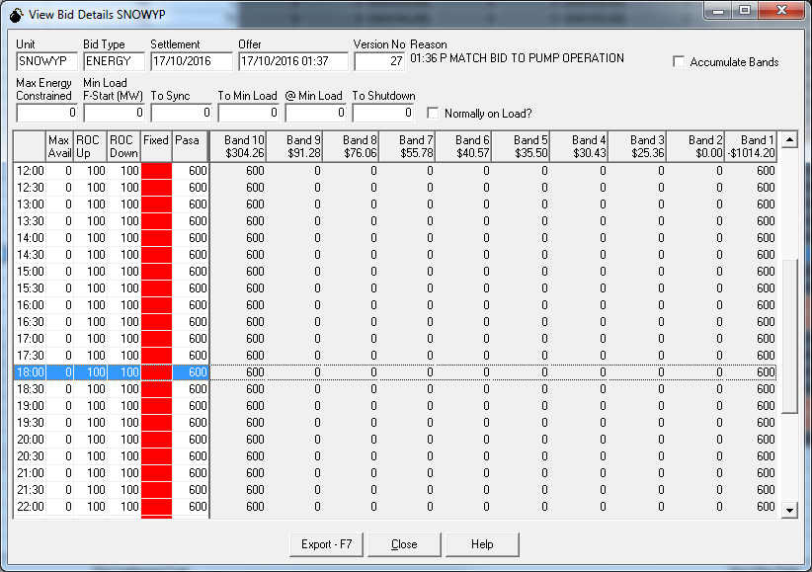
Example 1 – Scheduled Load

Slide 65
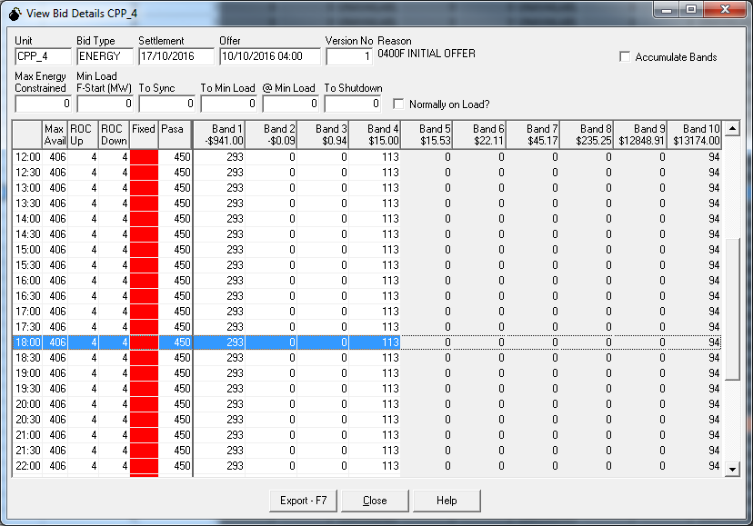
Example 2 – Black Coal
-$1,000/MWh
$15.90/MWh

Slide 66
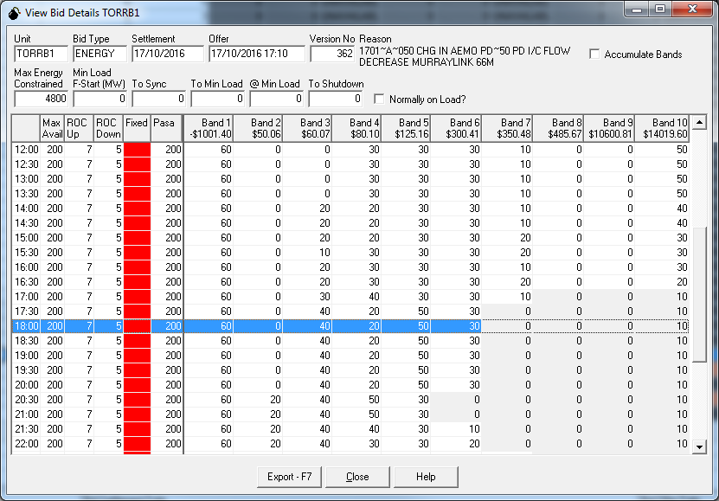
Example 3 – Gas 1
-$1,000/MWh
$300/MWh

Slide 67
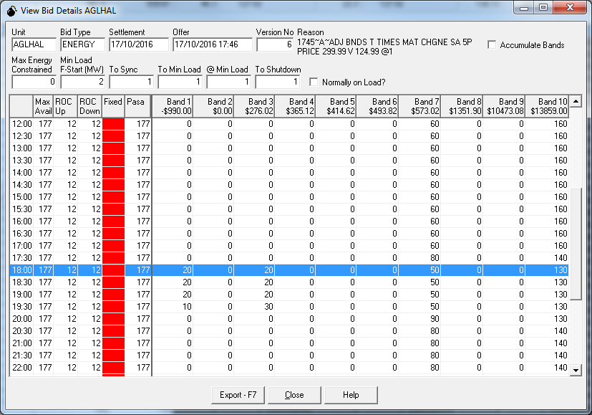
Example 4 – Gas 2
-$1,000/MWh

Slide 68
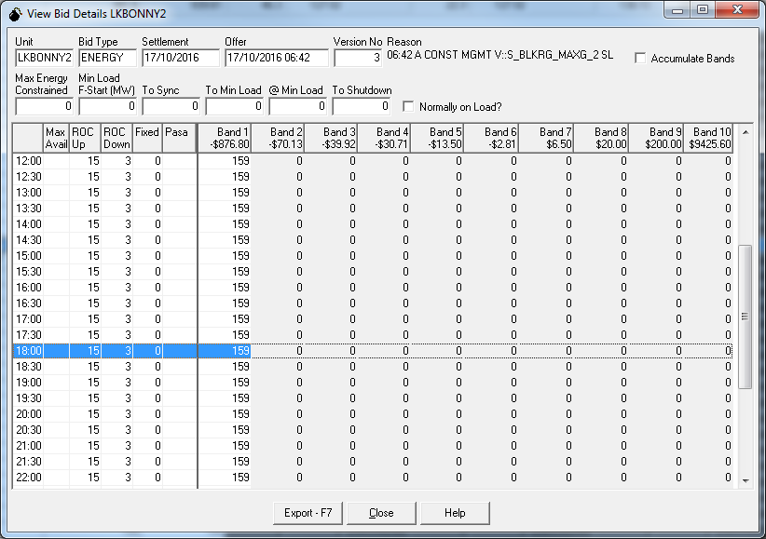
Example 5 - Wind
-$1,000/MWh
-$79.98/MWh

Slide 69
Market information

Slide 70
Session Objectives
Predispatch
PASA
Congestion Information Resource
Energy Adequacy Assessment Projection
Spot Market Information
NEM Rule Changes

Slide 71
Pre-dispatch schedule
Each day, AEMO publishes a pre-dispatch schedule
  Half hourly analysis
  Period covers next trading interval looking forward to the end of the last valid trading day
  In NEM, it looks ahead between 16 hours and 30 hours and ends at 4 am either tomorrow or the day after.
Public:
  Forecast demand
  Aggregate plant availability
  Projected surpluses and deficits
  Forecast prices and price sensitivities
Private
  Forecast of each participant’s dispatch targets

Slide 72
Projected Assessment of system Adequacy
“The PASA is a comprehensive program of information collection, analysis and disclosure of medium and short term security and reliability prospects so that participants are properly information to enable them to make decisions about supply, demand and outages of transmission networks up to 2 years in advance.”
Medium term PASA is a daily analysis, looking ahead 2 years, issued weekly.
Short term PASA is a half-hourly analysis, looking ahead 1 week, issued every two hours.
Both can be found under Electricity – Data - Market Management System MMS on the website.

Slide 73
Congestion information resource
Provides a range of operational, procedural and educational material on network congestion
  Operational information includes network diagrams, rating, Network Outage Scheduler (NOS), statistics and incident reports.
  Procedural information includes naming, formulation and implementation guidelines, management of infeasible solutions, confidence levels, offsets and margins policies.
  Educational material includes details of workshops and a plain English constraint converter.

Slide 74
Energy adequacy assessment projection
Analysis that quantifies the impact of energy constraints on energy availability.
Covers a 24 month period, published quarterly using a probabilistic assessment of energy adequacy.

Slide 75
Spot market information
Standing data
  Registration information
  Statement of opportunities
Spot market operations
Ancillary services contracting
Reporting
  Market suspensions, reviewable incidents, directions
Public information & confidentiality
Market auditor

Slide 76
Rule changes
NEM Rule Changes in train at present
  Inertia market
  Future power system security – rate of change of frequency, over and under frequency events, fault levels
  Five minute settlement
  Non-scheduled generation and load in central dispatch
  Ancillary services unbundling
Several others of less relevance to the markets review.

Slide 77
Questions/Discussions

Slide 78
Wholesale Market systems

Slide 79
Wholesale MARKET SYSTEMS – Introduction
AEMO’s proposed approach is to leverage existing expertise and market systems currently deployed to the NEM to deliver on requirements for WA
Leveraging AEMO’s market systems supports:
  Reduced implementation and operation cost
  Lower risk by using known solutions
  Reduce barriers to entry by harmonising interfaces to Australian energy markets
A key principle in our project decision framework is to deliver on WA requirements in the following prioritised approaches
  Consolidation of NEM and WA systems into a single solution
  Configuration of NEM system for WA
  Customisation of NEM system for WA
  This precedence of approaches ensures our decisions are consistent with the over-arching value proposition and managing delivery risk

Slide 80
Wholesale MARKET SYSTEMS OVERVIEW

Slide 81
Accessing the wholesale market system
Any access to AEMO’s market systems requires a data network connection to MarketNet
Participant
systems
Data network
connection
MarketNet
AEMO market systems
AEMO provides two types of connection options:
  A permanent continuous connection, available as either a dedicated link or via VPN
  A variable connection, intermittently connected for short durations. For security reasons, the connection is dropped if there is no activity for 30 minutes.
Further reading: Guide to Information Systems v2.03

Slide 82
Interactions with the wholesale MARKET SYSTEMS
The Wholesale Market Systems offer two primary methods of access for market participants:
  Batch interface
  Browser interface
Both access methods support the core Business-to-Market transactions associated with interacting with the wholesale electricity market.
A limited set of market information is available via the browser. More comprehensive data sets are available via the batch interface supporting participant activities such as detailed market analytics

Slide 83
Browser interface - ABOUT
The browser access is delivered via the “Energy Market Systems Portal” Wholesale Market Systems. This facility is largely equivalent to the MPI. The Web Portal can cut participant’s cost and client side footprint by:
Reducing the requirement for participants to maintain an IT infrastructure at their site.
Allowing participant business user access 24 hours a day, 7 days per week for 365 days per year—wherever a connection to MarketNet is available.
Being fully maintained and supported by AEMO.
Being available to all participants at no additional cost.
Providing a secure web interface with access rights managed by participants.
Allowing the use of multiple participant IDs.
Being easy to learn with user interface guides available for each web application—requiring less staff training.
Providing a consistent look and feel across each web application.

Slide 84
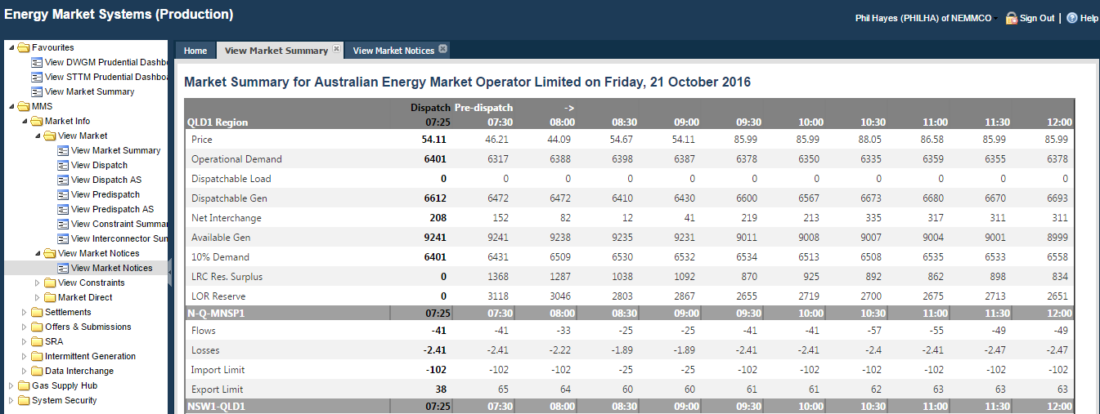
Browser interface – EXAMPLE 1

Slide 85
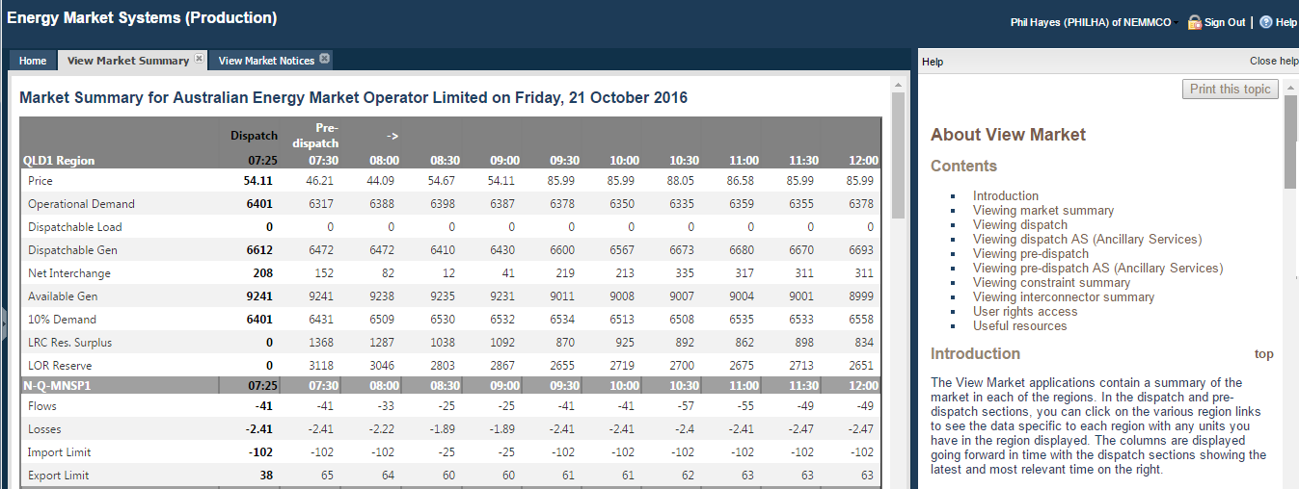
Browser interface – EXAMPLE 2

Slide 86
Browser interface - users
Is managed through “User Rights Management” (URM)
URM is a centralised identity repository with de-centralised user administration
For each Market Participant:
  AEMO creates a “Participant Administrator” (PA) user
  The PA can define “Rights” which are a collection of access permissions to the web applications contained within the Portal. These “Rights” definitions are private to the Participant.
  The PA can create additional users associated with their Participant ID, assigning them “Rights” which match a desired level of access
  The PA can perform administrative functions such as password resets
  The PA is responsible to ensure that user accounts within their associated Participant ID are appropriate.
Further reading: Guide to Information Systems v2.03

Slide 87
BATCH interface - ABOUT
Is provided by a file server
Each Participant has their own private directory
A standard folder structure is established within each participant’s private directory
Business to Market transactions (e.g. generator offer submission) are completed by placing an offer file compliant with the offer file specification into the appropriate directory. The AEMO systems process input files from participants and generate an acknowledgment file

Slide 88
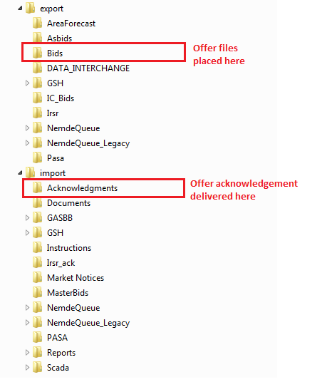
BATCH interface – generator offer
Prepare offer file using your local systems. This is a text based file and must conform to the specification MNSP/FCAS Bid file
Place the offer file into the Export\Bids folder of the participant file server. The available protocol to access the file server is FTP
Poll the import\acknowledgements directory for the return acknowledgement from the AEMO systems
An “ACK” return file means that the offer has been accepted
A “CPT” (Corrupt) return file means that the offer has been rejected. The reason(s) for rejection are contained within the acknowledgement file

Slide 89
data interchange - overview
DI manages, monitors, and replicates data between AEMO’s Electricity Market Management System (EMMS) and a participant’s database conforming to the Electricity and/or Gas Data Models
The core elements of DI are:
  AEMO applications generate compressed, structured .CSV files into the participant file server, according to the subscriptions managed by participants
  Participant runs software to download the compressed data from the participant file server across a MarketNet connection.
  Participant runs software to load this data into one or more local databases at the participant’s site, with optional monitoring.
  Participants manage their local databases.

Slide 90
data interchange - BENEFITS
A consistent logical data model across the industry
A broad range of vendor solutions now available which can be deployed out of the box without vendor lock in on data store.
Supports both high speed delivery (dispatch committed to participants database within 60 seconds), delivery of large data volumes (145MB largest single data set) with QOS
Fully managed delivery, including data reconciliation and recovery processes to detect and refetch missing data

Slide 91
Data interchange – facts and figures in the NEM
Delivering over 4 million files per week to market participants
Published data volumes at around 130GB/week
Managed data delivery to over 60 participant sites
Oracle (11g, 12c) and SQL Server (2008,2012) supported
Platform independent – installations running on Windows, Linux and Solaris
Delivered as CLI and full GUI based installer packages

Slide 92
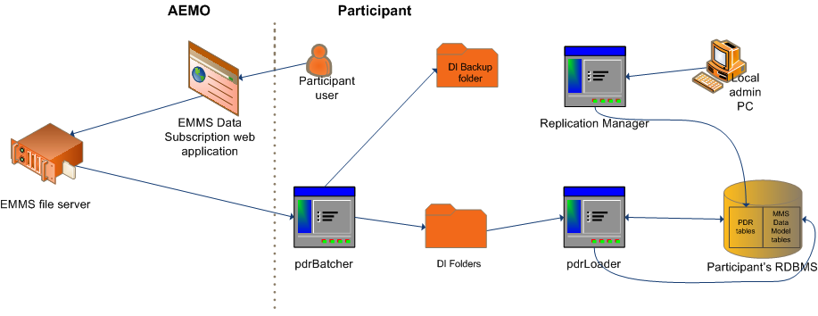
data interchange - overview

Slide 93
Data interchange – elec data model
Viewing the market data published in the data model will require the user to have skills in developing SQL queries to retrieve information. Full documentation of the data model tables and entity-relationship diagrams are provided to assist participants with querying the data model
Vendor packages are also available that integrate to the data model. These packages provide comprehensive data visualisation and analytics

Slide 94
Data interchange – installation
To install and maintain a Data Interchange system will require:
MarketNet connection and Participant ID
Access credentials to the AEMO participant file server and the Energy Market Systems Portal
A database to support the participant DI environment. Current supported database platforms are Oracle and Microsoft SQL Server.
The participant is responsible for hardware, OS and database licencing costs.
The participant should also have suitable IT support capabilities (platform and DBA) to establish and support the environment.
Implement updates to the Electricity Data Model every 6 months as new and updated data feeds become available
Maintain AEMO supplied software on supported versions

Slide 95

QUESTIONS

Slide 96
Next Meeting and Closing

Slide 97
Next steps
Next meeting: 22 November 2016
Suggested topics:
  Ancillary services dispatch
  Constraints
  Dispatch procedures
Any other suggestions or comments?

