Slide 1
Five-Minute Settlement Program:
Vendor Briefing Session
AEMO 5MS Program Team
Monday, 3rd December 2018
AEMO Offices:
Melbourne, Level 22, 530 Collins Street
Sydney, Level 2, 20 Bond Street
Webinar: Details included in agenda

Slide 2
Introduction, agenda & housekeeping
Agenda:
Please hold questions until the end
For webinar attendees, questions can be submitted through meeting, or via 5ms@aemo.com.au
Item | Time | Topic | Responsible
 | 10:00 am – 10:10 am | Welcome and introduction | Hamish McNeish (AEMO)
1 | 10:10 am – 10:20 am | 5MS and GS rule overview | Chris Muffett (AEMO)
2 | 10:20 am – 10:30 am | Program overview | Graeme Windley (AEMO)
3 | 10:30 am – 10:40 am | Procedures overview | Chris Muffett (AEMO)
4 | 10:40 am – 11:10 am | Systems approach | Hamish McNeish (AEMO)
5 | 11:10 am – 11:40 am | System and interface changes Metering Settlements Dispatch | Hamish McNeish (AEMO)
6 | 11:40 am – 12:00 pm | Questions and next steps | Hamish McNeish (AEMO)
 | 12:00pm | Meeting close | Hamish McNeish (AEMO)

Slide 3
Five-Minute Settlement and Global Settlement rule overview
Chris Muffett

Slide 4
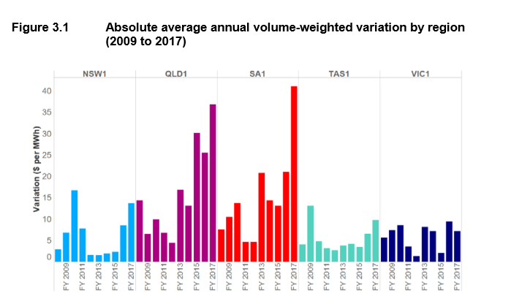
Current settlement arrangements
The NEM dispatch process determines an energy price every 5 minutes, however the energy market is only settled on the basis of 30-minute energy volumes
To accommodate the different timeframes, the “spot” price in the NEM is the average of 6 dispatch prices
This gives rise to the 5/30 minute problem
The AEMC considered that this is
resulting in negative consequences
for the wholesale market (which
ultimately impacts consumers)

Slide 5

Five-minute settlement
The AEMC has determined that from 1 July 2021, the NEM will be directly settled using 5-minute prices (i.e. the current 5-minute dispatch price will become the trading or “spot” price)
To support this, metering will progressively change to 5-minute:
  All type 1-3, type 7, and some type 4 connection points must be 5-minute prior to go-live
  New meters installed after 1 December 2018 must be 5-minute
  capable
Bids/offers are also changing:
  Scheduled participants must submit bids/offers with 5-minute
  granularity

Slide 6
Impact to participants
 | Prior to July 2021 | From July 20201
Generators / SGAs | Review/update procedures Review/update contracts Review/upgrade IT systems | Submit five minute granularity offers into the NEM
Large customers |  | Submit five minute granularity bids into the NEM
Retailers |  | Consider developing new products and services using 5 minute data to value dynamic generation / demand response for small and large consumers
Networks |  | Calculate charges for distribution services from either metering data or settlements ready data for type 4 meters Calculate type 7 unmetered loads on a 5 minute basis.
Metering coordinators | Upgrade types 1, 2 and 3 metering installations, and some type 4, to be capable of recording and providing five minute data. Ensure that new and replacement metering installations are capable of recording and providing 5 minute data Review/upgrade IT systems | By 1 December 2022 at the latest, ensure that all new and replacement metering installations record and provide 5 minute data
Metering data providers | Review/upgrade IT systems | By 1 July 2021, ensure that type 1, 2 and 3 and some type 4 metering installations record and provide five minute data. By 1 July 2021, ensure that type 7 unmetered loads are calculated on a five minute basis. By 1 December 2022 at the latest, ensure that all new and replacement metering installations record and provide 5 minute data
Information Exchange Committee | Consult and recommend to AEMO any changes to the B2B procedures

Slide 7
Global Settlement
AEMO lodged a rule change to the AEMC, proposing that global settlement be implemented to replace settlement-by-difference in the NEM: https://www.aemc.gov.au/rule-changes/global-settlement-and-market-reconciliation
If the rule is made, the change will be accommodated in the 5MS program. It primarily involves:
  The local retailer role no longer being required for settlement i.e. all retailers have the same settlement arrangements
  AEMO requiring meter data for all connection points
  AEMO calculating unaccounted for energy (UFE) which is recovered from retailers operating in each area
Draft determination and draft rule were published on 30 August
Final determination and final rule are expected to be published next Thursday, 6 December 2018

Slide 8
Global Settlement – overview of draft rule
NOTE: the following items relate to the draft Global Settlement rule and may be subject to change as a result of AEMC deliberations. Final rule is expected on Thursday, 6 December 2018.
UFE to be allocated at the local area (DNSP network) level
Virtual transmission nodes are retained. DNSPs using VTNs will need to provide more information to AEMO
Off-market unmetered loads (non-type 7) to be included in AEMO’s settlements processes
Alignment with 5MS:
  Commencement on 1 July 2021
  AEMO to update its relevant procedures by 1 December 2019
AEMO to be provided with NMI to TNI mapping
This will allow AEMO to calculate and publish UFE from 1 July 2020 (12 months prior to the GS rule commencing)
AEMO will engage through the PWG and SWG on the procedure and system impacts

Slide 9
Program overview
Graeme Windley

Slide 10
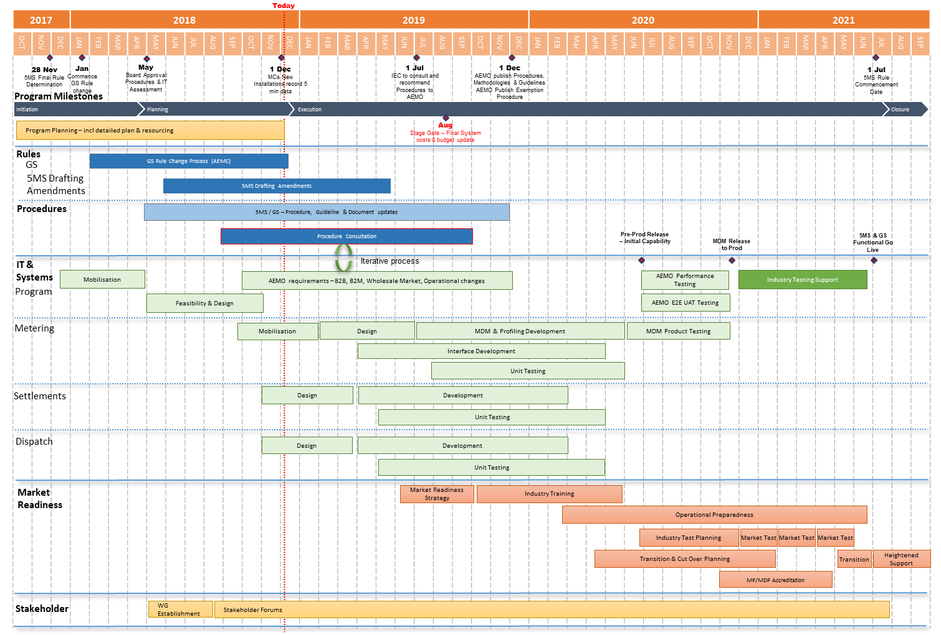
Program Conceptual Timeline

Slide 11
High-level status
Procedures work is progressing well, with most activities on track:
  Working groups and focus groups have been constructive
  Successful initial Settlements focus group and Dispatch focus group
Systems work mobilising and ramping up:
  Architecture, Requirements and Design work continuing
  Development work to commence December 2018
Rule changes:
  5MS Drafting amendments Rule due mid-2019
  Global settlement rule determination due in 6 December 2018
  DER rule has been made – potential impact to 5MS solution design; however go live of 1 December 2019 may have a resourcing impact for participants
Stakeholder engagement is proceeding:
  1 on 1’s available for any industry participant who requests these

Slide 12
Procedures overview
Chris Muffett

Slide 13
Procedures - packaging
Approximately 70 AEMO documents have been identified as directly affected by 5MS, across:
  Metering
  Settlements (including prudentials)
  Dispatch
  Operations
Around 20 of these are ‘rules consultation’ procedures, usually requiring 2 rounds of formal consultation
Work packages are being progressively considered by the Procedures Working Group:
  AEMO provides an impact assessment for each procedure and the proposed consultation approach for review and discussion
  Focus groups are being used to provide input into procedure development
  Procedure changes are then subject to consultation
Metering | Settlements | Dispatch | Operations
Metering data Metrology, MSATS procedures & service levels Miscellaneous | SRA Estimation Reallocations Prudentials TNSP Miscellaneous | Bids/Offers Spot market Pricing Specifications Miscellaneous | No packages – progressive release

Slide 14
Systems approach
Hamish McNeish

Slide 15
Systems Working Group (SWG)
Meets monthly
Open to software vendors, or system integrators
The SWG provides a forum to:
  Inform and consult during AEMO’s and Industry’s IT development on changes to AEMO’s participant facing systems
  Ensure sufficient information and systems are provided to support industry’s own system change
  Ensure a clear approach and timeline to AEMO system implementation and deployment
  Allow Industry to raise concerns or issues early in the system development process
  Seek feedback on proposed changes and the impacts to industry stakeholders, including vendors
Refer to the Terms of Reference available at: http://aemo.com.au/Electricity/National-Electricity-Market-NEM/Five-Minute-Settlement

Slide 16
Requirements and Design
Focus Groups
High-Level Impact Assessment (HLIA)
Consultation
Requirements
Design and Development
Initial Requirements
High-level design
Technical Specifications
Review of HLIA
Review of High-level design
Design
Technical Specification review

Slide 17
Focus Groups
Run in conjunction with AEMO’s Procedures Stream
A smaller group, e.g. 5 to 20 representatives
Meet face-2-face in one of AEMO’s offices to facilitate brainstorming/discussion
Focus on a particular technical issue or options as needed
Normally an Operational and an IT Systems representative attend
Recommendations are presented back to the SWG and PWG
Issue/options
Brainstorm
Recommendation

Slide 18
High-Level Impact Assessment (HLIA) Document
The HLIA was created to keep track of the expected 5MS systems changes based on the outcomes of Focus Groups and procedures consultation
The HLIA is intended to:
  Provide high-level information of the changes to AEMO’s Market Facing Systems changing in 5MS
  Continually be updated as system changes are confirmed, or there are any changes
  Provide AEMO view on participant impact related to these changes
The HLIA is not intended to replace the Technical Specification documents

Slide 19
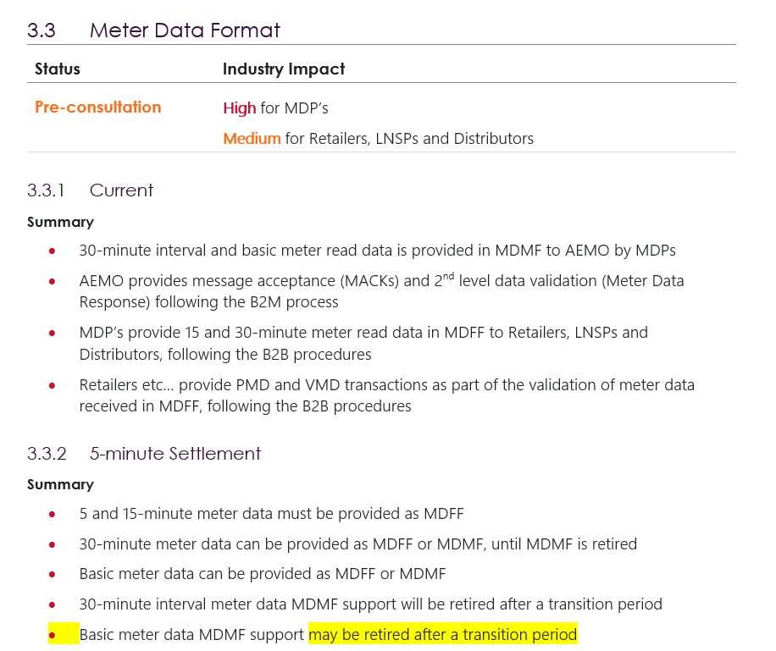
HLIA Excerpt

Slide 20
Technical Specifications
AEMO will provide technical specifications in line with the planned Systems Workstream schedule
Technical specifications are intended to provide sufficient technical detail for Industry to build/change their own systems
This includes:
  Interface connection information
  Interface data formats
  Changes to reports
  Changes to AEMO’s Data Model

Slide 21
Accessing Information
SWG - Slide packs and meeting notes are:
  emailed to SWG Members
  Published on AEMO’s web site http://aemo.com.au/Electricity/National-Electricity-Market-NEM/Five-Minute-Settlement
Focus Groups
  Slides and outcomes are emailed to SWG and PWG members
High-Level Impact Assessment (HLIA)
  An initial draft has been emailed to SWG members for comment
  Versions will be published on the 5MS section of the AEMO website
Technical Specifications
  These will be emailed to SWG members
  These will be published on the 5MS section of the AEMO website

Slide 22
External Testing
Hamish McNeish

Slide 23
External Test Environments
Sandbox Environment
  Provide early functional releases
  Functionality is expected to be periodically released
  Provides a dedicated 5MS environment separate to current pre-production
  Industry have requested this provide end-2-end functionality if possible
Preproduction Environment
  Used for Industry Testing and Market trials
  Used for performance and other non-functional testing

Slide 24
Proposed Timeline
Hamish McNeish

Slide 25
System Workstream - Metering
Estimated timeline

Slide 26
System Workstream - Dispatch
Estimated timeline

Slide 27
System Workstream – Settlement and Operations
Estimated timeline

Slide 28
System and interface changes
Hamish McNeish

Slide 29
NEM Retail System Change Heatmap
* Change likely based on PWG outcomes
B2M / B2B Interfaces
CATS / MDM Processes
MSATS Browser / Reports
MDMT
Profiling
Meter Data screens
B2M aseXML schema
CATS Standing Data
RM21/27
NMID
Meter Data Validation
C1,4
CATS
Estimation / Substitution
RM11,12,13,14,16
RM17,18,19,20,22
MSATS B2M APIs
Energy Allocation
RM28,30,31,32
RM33
B2B Transactions
CR Processing
SDR
B2B aseXML schema
RM7,8,9,10
RM15,29
VIC TUoS
C2,3,6,7,9,10
C11,12,13

Slide 30
NEM Wholesale System Change Heatmap
* Change likely based on PWG outcomes
DISPATCH
SETTLEMENT
POWER SYSTEM
Bids/Offers
Settlement 5MS Calc.
Negative Residue Management
Data Model
Settlement GS Calc.
ST PASA
Dispatch
Estimation and Prudentials
RERT
Predispatch (P5/P30s)
Reallocations
Data Model
Spot Price
Data Model
MT PASA / EAAP
Administered Pricing
SRA (IRSR Calc.)
Demand Forecasting
Suspension Pricing
Causer Pays Factors
Generator Recall
Constraints
Wind/Solar Availability
Registration
VAR/MW Dispatch

Slide 31
API Approach
HTTP-based API services through the AEMO e-Hub are one way in which AEMO is reducing friction and complexity in accessing our systems.
5MS continues to shift submission interfaces to web APIs
The proposed approach for 5MS is to:
  Provide an accompanying API where a significant change to a web application occurs in the EMMS Markets Portal.
  For other API’s will be considered on a case-by-case basis for functions that are considered high-value to the industry.
Identified 5MS API interfaces:
  Dispatch
    Bid submission and viewing
  Settlements
    Reallocation submission and viewing
  Retail
    B2B - Meter data (MDFF) (AEMO as a recipient)
    B2M - NMID, CATS, MTRD
    B2B – other transactions, e.g. NETB (to be confirmed)

Slide 32
FTP Interfaces
FTP submission interfaces remain supported
  The Data Model delivery mechanism remain unchanged
  Retail report delivery mechanism remains unchanged
  AEMO expects to see a shift to APIs offering faster synchronous service
  AEMO’s IT Strategy for the next 3 years is in development

Slide 33
Metering
Hamish McNeish

Slide 34
B2M Meter Data
Changes:
Significant meter data volume increase predicted
Transition to 5-minute interval reads
Impacts:
Unified meter data file format B2B and B2M format MDFF (NEM12/NEM13)
1 MB limit proposed to increase to 10 MB
Leverage B2B mechanism for MDFF to AEMO (MDFF B2B remains unchanged)
Review of 13 months online storage
Validation of meter data streams
Transition:
Early acceptance of MDFF format (1 November 2020) - 5/15/30-minute
AEMO will aggregate as required from 1 Nov 2020
Interval reads via MDMT will be retired after transition period from 1 July 2021
Basic reads via MDMT likely to remain supported for longer

Slide 35
CATS/MDM Processes
Changes:
Profiling basic and interval meter reads
Changes to how AEMO identifies settlement data streams
Impacts:
Profiling basic meter reads to 5-min meter reads
Profiling 30-min / 15-min interval meter reads to 5-min meter reads
Energy allocation process at 5-min resolution
Energy allocation process using settlement by difference and global settlements
Unaccounted For Energy (UFE) factor publication
MSATS screens and RM* reports – Display of interval meter reads to support variety of interval lengths

Slide 36
Settlement
Hamish McNeish

Slide 37
Settlement
Changes:
  SRA – changes the basis of inter-regional settlement residue calculation
  Settlement estimation – used to support prudentials
  Reallocations – in particular, reallocations that are based on spot price
  Prudentials – Credit Limit Procedures for determining prudential settings for participants
  Other supporting information and user guides
  Settlement/billing/prudential systems, and participant interfaces
Impacts:
  5-minute settlement data provided (AEMO proposed to use same data model tables)
  Reallocations new web UI and APIs
  Settlements Direct
  UFE publication as part of the weekly settlement cycle
Transition:
  AEMO systems release prior to 1 July 2021
  Split billing week containing 1 July 2021, settled at 30-min and 5-min
  30-min and 5-min reconciliation reports will be available
  Proposed request for AEMO to aggregate and continue 30-min report support

Slide 38
Dispatch and Power Systems
Hamish McNeish

Slide 39
Bids/Offers
Changes:
  Bids and offers shift from 48 periods to 288 periods
  Web bidding enhanced to be more functional for BCP and small participant use
  Likely Rebid explanation field changes
Interfaces:
  Current TXT file format is deprecated, new JSON format introduced
  Web API interfaces introduced
  FTP interface kept for transition and backup
  Web bidding and upload file functionality kept
  Data Model – Likely add new 5-minute bid table(s)
Transition:
  Proposed early 5-minute bid support from 1 April 2021
  TXT file no longer supported from Trading Day 1 July 2021

Slide 40
Dispatch / Predispatch / PASA
Changes:
  5-minute bids used in Dispatch and P5
  Last 5-minute bid in a 30-minute interval used in P30s
  Lowest 5-minute availability (proposed) in PD/ST PASA
  Possibility of increasing P5 length, adding FSIP and Daily Energy Constraints and doing price sensitivities
Interfaces:
  Dispatch no change in outputs
  P5 possibility of adding price sensitivities
  P30 Pre-dispatch / PD/ST PASA no planned change in outputs
  Data Model – likely changes due to P5 changes
Transition:
  1 April 2021 early release to support 5-minute bids
  30-minute bids translated to 5-minute by AEMO

Slide 41
Spot Price
Changes:
  Spot prices changes from 30-minute to 5-minute
  30-minute price still required to be published
Interfaces:
  Data Model – Likely minor changes to 5-minute price tables
  Data Model – Trading Price kept
Transition:
  Standard Data Model report transition

Slide 42
Questions and next steps
Hamish McNeish

