Slide 1
B2B Working Group Workshop
16 August 2016 10:00 – 15:30
Presented BY Chris Cormack

Slide 2
Agenda
In Attendance
Objectives of meeting
Cynefin Framework – framing complicated or complex problems
Process for development of Communication or Procedure Material
Worked Example – Remote Re-energisation
New Connections
Adds and Alts
Detail of B2BWG/IEC Meeting Schedule
Next Steps

Slide 3
In attendance
AEMO: Chris Cormack – Procedure Lead, Andrew Suwignjo – SME, Paul Le Favi - SME.
Retailer reps:, Mark Riley – AGL Energy, Mara Tenis – Lumo/Red Energy, Darren Bailey – Origin Energy, Karly Train – Energy Australia
Distributor reps: David Woods – SA Power Networks, Brett McLean – United Energy, David Sales –TasNetworks, Dino Ou– Endeavour Energy
Metering or Third Party reps: Dean Van Gerrevink/Paul Greenwood – Vector, Shaun Cupitt - Acumen, Charles Coulson – Metropolis Metering, Michael Cruse – Active Stream
Apologies – Aakash Sembey – Momentum, Anna Russo, Endeavour Energy.

Slide 4
Objective of WorkSHOP
Recap prioritised service list
B2B communications principles, factors and required end product
Define procedure drafting:
Communication Requirements
Parties for communication
Routing or system requirements
Back-up to communication
B2B communication process map
Timing requirements
Allow parties to meet other
regulatory requirements
B2B Procedures – simple communications to affect metering and market outcomes. Should be simple, efficient, reliable and easy to implement and promote innovation in advanced meter services.
They do not impose barriers to entry or discriminate between parties. They do protect confidential information and ensure a uniform approach in all states.

Slide 5
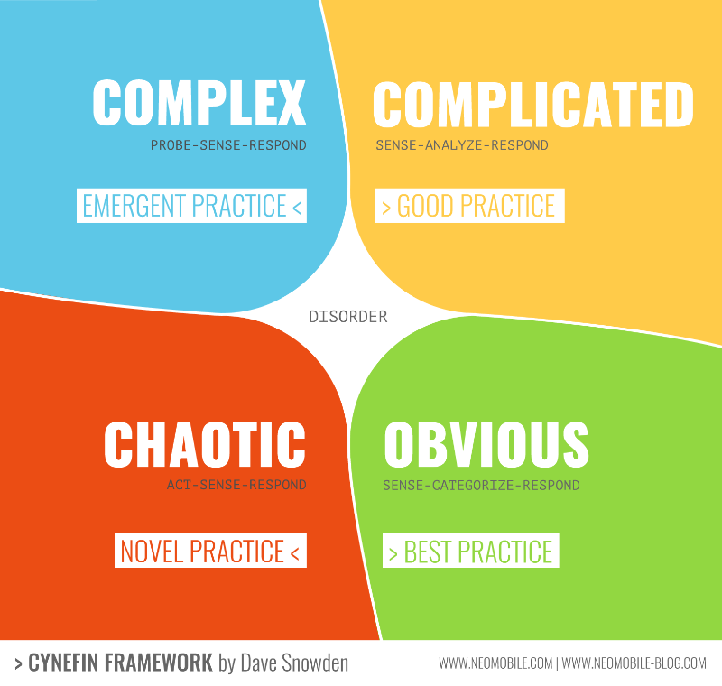
CYNEFIN FRAMEWORK
https://www.youtube.com/watch?v=N7oz366X0-8
https://www.youtube.com/watch?v=N7oz366X0-8

Slide 6
CYNEFIN FRAMEWORK – in context
Complex
New Service where counterparty is new or unclear and the service is not yet fully defined
Complicated
Existing services where a change in role may be required OR
New Service with existing counterparts
Chaotic
Not applicable to B2B Procedures at this time
Simple/Obvious
Current Services between two counterparties where procedures can remain

Slide 7
Process FOR GROUP DEVELOPMENT FOR EACH COMMINICATION/PROCEDURE
AEMO to detail service/existing procedure description and communication process/parties and routing from existing material and group discussion
Clarifying questions from the group
Each participant provides a reaction to the proposal, except AEMO – no discussion.
AEMO to clarify or amend based on feedback
Objections – “Do you see a reason why adopting this proposed communication procedure causes harm or moves us backward? Objection or No objection?
Is the proposed procedure unnecessary or incomplete? | If you objection is based on presently known data – is this likely to occur?
Will the proposal limit the effectiveness of one or more B2B parties/roles? | If your objection is based on prediction – is it safe to go with this drafting and revisit (adapt) Or no ?

Slide 8
WORKED EXAMPLE – REMOTE RE-EN
MSATS
Retailer
B2B e-hub
DNSP
Metering co-ordinator
MP
MDP
If YES Update MSATS
Send Re-en Service order – identify Actioner and Notified Parties
Follow on activities based on outcome
Request to MP, Notification to DNSP, MC, MDP
Response to Retailer, Notification to DNSP, MC,MDP
Routes Service Request and Notifications
Completes Request – Or Not
Send Service Order Response (Y,N)
Sender must identify actioner(s) and notified participants – in this case Retailer asks MP to action.
Message delivery time?
Back-up by email or MSATS?

Slide 9
WORKED EXAMPLE – REMOTE RE-EN
Message Content
NMI, Address, other identifying data ie customer reference number
Actioning Party – usually MC or MP
Notifying Parties – DNSP, MC, MP, MDP or Retailer (if 3rd party initiated)
Date/Time stamp
Freetext or Message Field
Response Only
Successful Re-energisation (Y/N)
Any other considerations?

Slide 10
New connections
Objective – Identify B2B communication requirements
Who needs to receive the b2b communication and why?
When is communication required by (to and from)?
What information is required in this communication? (to support the expected outcome)
Other considerations?

Slide 11
Additions and alterations
Objective - Identify B2B communication requirements
Who needs to receive the b2b communication and why?
When is communication required by (to and from)?
What information is required in this communication? (to support the expected outcome)
Other considerations?

Slide 12
Detailed B2BWG/IEC Meeting Schedule August/September

Slide 13
NEXT STEPs
Next meeting – Workshop 22 August

