Slide 1
PROGRAM CONSULTATIVE FORUM
Meeting pack
DATE: Thursday 24 August 2017
TIME: 10.00 AM – 1.00 PM (AEST)
VENUE: AEMO OFFICES; MEL, SYD, ADE, BRI
TELECONFERENCE: DIAL IN: 1800 055 132; PIN: 35565358
CONTACT: poc@aemo.com.au

Slide 2
Power of Choice PROGRAM UPDATE

Slide 3
Actions from previous meeting
# | Description | Date due | Status | Owner | Comments/Outcomes
A05 | LNSPs to circulate to all retailers draft’s T&C’s (per 11.86.7 of the new Rules) and any associated publications that they are developing (for example a ‘Retailer Handbook’) with industry. | 07 Jul 17 18 Aug 17 | Open | ActewAGL D | • Releasing 18 August
 |  | 07 Jul 17 18 Aug 17 | Open | Ausgrid | • Releasing late next week (WC 14 Aug) or early week after (WC 21 Aug)
 |  | 07 Jul 17 18 Aug 17 | Open | AusNet Services | • Releasing next week (WC 14 Aug)
 |  | 07 Jul 17 18 Aug 17 | Open | CitiPower PC | • Releasing next week (WC 14 Aug)
 |  | 07 Jul 17 18 Aug 17 | Open | Endeavour Energy | • Released draft for retailer review on 17 July. Two retailers provided feedback. Endeavour Energy is reviewing the feedback and will publish the final version by 1 September.
 |  | 07 Jul 17 18 Aug 17 | Open | Energex & Ergon | • Will be circulating mid to late August.
 |  | 07 Jul 17 18 Aug 17 | Open | Essential Energy | • Releasing next week (WC 14 Aug)
 |  | 07 Jul 17 18 Aug 17 | Open | SA Power Net | • Working on these internally, expect to publish in late August
 |  | 07 Jul 17 18 Aug 17 | Open | Jemena Networks | • Jemena’s commercial area is having discussions with retailers and the draft is being released through that process between mid to end of August
 |  | 07 Jul 17 18 Aug 17 | Open | TasNetworks | • Draft sent to retailers and will go to board next week (WV 14 Aug) for final sign off.
 |  | 07 Jul 17 18 Aug 17 | Open | United Energy | • Releasing 18 August
A06 | Industry Test Lead to report at next PCF on progress of testing. | 04 Jul 17 24 Aug 17 | Open | AEMO (ITWG Lead) | • Note: report on first days of market trial
A10 | LNSPs to circulate to all retailers ‘end of life meter replacement programs’ for existing fleets to facilitate adequate retailer and MC planning by Friday 7th July. | 07 Jul 17 18 Aug 17 | Open | ActewAGL D | • Information will be supplied by 18 Aug
 |  | 07 Jul 17 18 Aug 17 | Open | Ausgrid | • Information will be supplied by 25 Aug
 |  | 07 Jul 17 18 Aug 17 | Open | Endeavour Energy | • Networks area is 15k to 20k per annum
 |  | 07 Jul 17 18 Aug 17 | Open | Energex & Ergon | • Information will be supplied as soon as possible
 |  | 07 Jul 17 18 Aug 17 | Open | Essential Energy | • Information will be supplied by 18 Aug
 |  | 07 Jul 17 18 Aug 17 | Open | SA Power Net | • Have sent AEMO Information for 3 Years
 |  | 07 Jul 17 18 Aug 17 | Open | TasNetworks | • Information will be supplied by 18 Aug
A12 | LNSPs to provide example of corrective works program undertaken to rectify customer supply as a result of a natural disaster. Example program to focus on metering installations. | 07 Jul 17 | Open | LNSP | • Energex: 42,461 meters required replacing following the 2011 Brisbane Floods. Replacement rate was 3 – 6 months • Energex: 228 Disconnected Premises following Cyclone Debbie • Ergon: still investigating • AusNet: noted that 30 day meter stock was sufficient coverage for both, many meters followed new connection processes.
A13 | Retailers to provide an information request regarding end of life replacement meters to AEMO for circulation. | 04 Aug 17 | Closed | Retailers (Alinta lead)) | • Information provided to AEMO and circulated with PoC-PCF Pack for 11 August discussion. Note attachment : Item 2

Slide 4
AEMO Program Update
General:
Next Exec forum Monday 28 Aug
Communication plan – verbal update.
AEMO Procedures
Final determination will be published on 1 September 2017; effective date 1 December 2017
B2B Procedures
Current list of clarifications is available on AEMO website Power of Choice B2B consultation
Any suggested improvements or changes not identified as error corrections will be the subject to a consultation in 2018.
Systems
AEMO system released into pre-production environment 17 August

Slide 5
AEMO Program Update
Readiness:
Industry Testing Planning:
  Market Trial (Phase 3) – final test plan published – commenced 21 August
Accreditation and Registration Industry Plan
  First MC registration has been completed
Transition and Cutover
  Requirements have been finalised – draft plan available for industry review no later than 23 Aug
Contingency planning
  Commenced 18 August
  Focus group established to expedite scenario development
  Decisions escalated to the PoC-PCF
  Attached updated list of scenarios
ITCFG
  Met 18 August – reviewed processes under ‘transitional model’ for input to Exec Forum
  Initial Transition and Cut-Over planned reviewed on 23 August 2017

Slide 6
AEMO Program
CEO Letter Clarification:
AEMO notes the following statement from the CEO letters dated 15 August 2017 (dot-point in the list):
Retailers would have the option to send service orders to Metering Coordinators from 4 December.
Could have been written as:
Retailers would have the option to send service order requests to metering coordinators or local network service providers up until 30 November 17.
Following 4 December, retailers would send service orders to metering coordinators.

Slide 7
Power of Choice Transition and cutover period overview

Slide 8
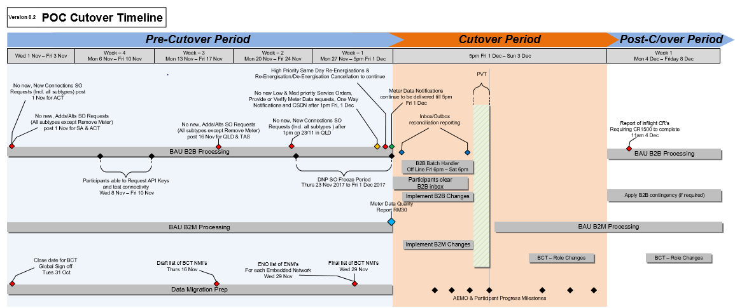
AEMO Program

Slide 9
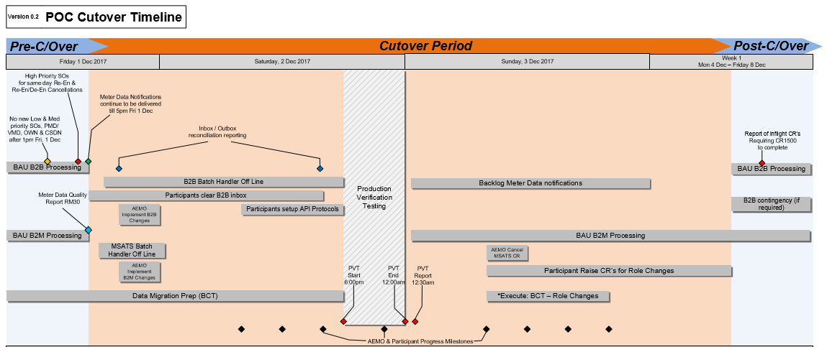
AEMO Program

Slide 10
Power of Choice
Contingency planning update

Slide 11
Contingency planning
RWG meeting held on 18 August – key outcomes:
  AEMO to establish a Contingency Planning Working Group (CPWG)
    CPWG will identify industry scenarios, triggers and actions and develop an industry contingency plan which forma part of the POC Market Readiness Strategy
    CPWG will be a sub-working group comprised of RWG reps
    Draft CPWG Terms of Reference have been circulated, including an upcoming meeting schedule
  AEMO has circulated an initial list of high-level scenarios
    RWG feedback requested by 24 August
  Next steps:
    CPWG will meet on 29 August to review the initial list of scenarios
    CPWG to finalise the industry contingency plan by end September

Slide 12
Power of Choice
August Readiness Report Summary

Slide 13
AUGUST 2017 READINESS REPORT
Summary:
Project status remains amber in August 2017:
  Status of “at risk” of achieving project deliverables on schedule.
  Progress increased to approximately 50%.
  Risk rating remains at “Medium”.
Participant categories:
  Retailer and Distributors are mainly reporting green (“within scheduled”) or amber (“at risk”) with a medium or high risk rating.
  Meter Providers, Meter Data Providers mainly reporting green or amber with a medium risk rating.
  Prospective Metering Coordinators mainly reporting green or amber, with one reporting red (“not within schedule”) due to IT vendor delays.
  Prospective Embedded Network Managers mainly reporting amber, with two reporting red due to running behind their planned schedules and uncertainty associated with different jurisdictional treatments of embedded networks.
  AEMO overall reporting green with a medium risk rating.

Slide 14
AUGUST 2017 READINESS REPORT
Highlighted risks:
Amber progress status relates primarily to constrained timelines for delivery:
  Compressed timeframes for system design, build and testing.
  Compressed timeframes for registration and accreditation – including e-hub accreditation.
Issue contributing to the Medium risk rating include:
  Number and complexity of commercial arrangements to be updated.
    A staged approach to transition is being examined investigated by the ITCFG.
  Lack of alignment across industry processes including faults and emergency processes.
    Participants are actively engaging with each other to discuss and align B2B processes.
    Faults and emergency processes now clarified across most jurisdictions.
    Market Trial commences on 21 August.
  Lack of clarity on jurisdictional safety regulations.
    Participants are actively engaging with jurisdictional safety regulators.
  Concerns regarding other participants’ readiness.
    Contingency planning by the Readiness Working Group to commence in August.
  Uncertainties in transition and cutover activities and the timing of cutover.
    The draft Industry Transition and Cutover Plan will be released for industry review and comment in late August.
  Lack of clarity of treatment of embedded networks in Victoria.
    Awaiting final approach from the Victorian government

Slide 15
AUGUST 2017 READINESS REPORT
Number of submissions:
47 reports received in total representing the following participant roles (increased from 44 in June):
  23 retailers (increased from 22)
  13 distribution businesses (includes initial MC, MP and MDP)
  10 metering companies (MPD, MP) (increased from 9)
  10 metering coordinators (MC) (increased from 9)
  7 embedded network manager (ENM) (increased from 5)
Approximately 13 retailers are not yet taking part in industry reporting
Note that organisations can nominate for multiple roles and participants can submit combined reports (i.e. one report for two distribution businesses)

Slide 16
Power of Choice
Issue and Risk Log

Slide 17
Industry Issues Register
System cut-over:
Industry raised an issue for discussion:
  Current assumptions are that the existing market arrangements and systems will cease to operate on Thursday 30 November, new arrangements (Rules, Procedures etc.) will commence morning of Friday 1st December.
  In effect, an overnight cut-over.
Discussion:
  Participants have advised a range of systems outage timings spanning from 12 to 48+ hours.
  Participants raised impacts to month end processes.
Actions taken:
AEMO / AER considering ‘letter of no action’ that may be required for weekend cutover approach.
AEMO expects that final mechanisms will be in place by end of September.

Slide 18
Watching briefs
Translation Tool
  Translation tool delivered to industry for testing
  It is reported to AEMO that the tool will be available to participants who may require it in time to support testing cycle 2 of Market Trials
Proposed Decision framework (as circulated by Jemena)
  Discussed at IEC – IEC supportive of actively engaging a B2B-WG member in early stages of process (during daily defect meetings for example) to expedite triage processes
  IEC typically comfortable with SLAs for resolution, however noted not willing to meet regularly – therefore will provide some delegation to the B2B-WG
  AEMO comfortable with providing SLAs around issue resolution for B2M and system related defects / issues
  AEMO releasing an update on Wednesday 16 August – intent is to include process in Test Plan

Slide 19
Power of Choice
Program Schedule

Slide 20
Power of Choice (PoC) Program Overview
High Level Program V6.4 – 24 Aug 2017
Today
2015 |  |  |  |  |  |  | 2016 |  |  |  |  |  |  |  |  |  |  |  | 2017 |  |  |  |  |  |  |  |  |  |  |  | 2018
JUN | JUL | AUG | SEP | OCT | NOV | DEC | JAN | FEB | MAR | APR | MAY | JUN | JUL | AUG | SEP | OCT | NOV | DEC | JAN | FEB | MAR | APR | MAY | JUN | JUL | AUG | SEP | OCT | NOV | DEC | JAN | FEB
Program Milestones
10 Sep
MRP Direction paper published
EN Draft Determination
26 Nov
MC
Final Determination
10 Mar
MRP
Final Determination
07 Apr
SMP Draft Determination
30 Jun
SMP Final Determination
1 Sep
EN & MC & MRP
Procedures Published
1 Dec
MC & EN Ring fencing and network exemption guidelines
1 Mar
MC
Registration & EN MSL and Accreditation Documentation Published
1 Jun
B2B – AEMO publish B2B Procedures & Accreditation Process
1 Sep
DNSPs to publish standard terms and conditions on which it will act as the initial Metering Coordinator
1 Dec
EN & MC & MRP & B2B
Effective Date (Go-Live)
DNSPs & Retailers to publish amended standard contracts
Oct
SMP Advice published
17 Dec
EN Final Determination
MRP Draft Determination
1 Aug
IEC Election Procedures Finalised
MC B2B Recommendation
1 Sep
IEC Election Complete - IEC Formed
1 May
B2B – IEC recommends B2B Procedures Finalised
Procedures
MC Draft Procedures
P
P
P
MC /
EN /
MRP
EN/MC/MRP Package 1 Development
EN/MC/MRP WP 1 Procedure Consultation
P
P
P
EN/MC/MRP Package 2 Development
EN/MC/MRP WP 2
Procedure Consultation
Package 3 ‘As Built’ Development
P
P
P
WP 3 & ‘As built’ Procedure Consultation
B2B
SMP Conceptual IT Designs
Market Readiness
SMP Procedure Development
P
P
P
SMP B2B Procedure Consultation
Market Readiness Strategy
Readiness Reporting Commences
Registration & Accreditation
Plan
Execute
Industry Training
Plan
Industry Test Planning
Phase 1
Phase 2
Market Trial – Phase 3
IT Systems
Transition & Cut Over Planning
Transition
Heightened Support
AEMO Requirements
AEMO Design
Pre-Prod Release
Prod Release
Supporting Activities
All - IT Development / Internal Testing
Industry Testing
Election Procedures
& Operating Manual
IEC Election
Fee methodology *(if required)
TRANS IEC
AER - Electricity ring-fencing guideline 2016
For Information: poc@aemo.com.au
EN = Embedded Network, MRP = Meter Replacement Processes
MC = Metering Competition, SMP = Shared Market Protocols
P
Publish
Milestone
Working group meeting
Proposed IEC Meetings (Trans & New)
For detailed meeting schedule and agendas, see the 2016 industry meeting schedule.

Slide 21
Power of Choice (PoC) Program Overview – Readiness Work Stream
High Level Program V6.4 – 24 Aug 2017
Today
2016 |  |  |  |  |  |  |  |  |  |  |  | 2017
JAN | FEB | MAR | APR | MAY | JUN | JUL | AUG | SEP | OCT | NOV | DEC | JAN | FEB
28 Feb
WP2 Procedures Published
10 Apr
EN/MC changes in pre-production
22 May
EN/MC patch release
5 Jun
Industry Test Plan B2B Published
16 Aug
Pre-Production system release
2 Oct
Industry Transition & Cutover Plan Published
17 Nov
Industry Test Report
1 Dec
Go-live date
06 Mar
B2B Procedures Published
28 Jul
Market Trial workbook complete
21 Aug
Commence Phase 3 Market Trials
Industry Testing
Industry Test Planning EN/MC
Test Set-up
EN/MC
Phase 1 Execution EN/MC
Industry Test Planning B2B/Market Trial
11 Aug
Submit entry Criteria checklist
Phase 2 Execution B2B
14 Aug
Commence daily meetings
Outage Window
Phase 3 Market Trial Execution
Cycle 1
Cycle 2
Cycle 3
Accreditation & Registration
1 Mar
Qualification, registration & accreditation checklists published
24 Mar
Second draft plan published
28 Apr
Registration & Accreditation plan published
9 May
Participant Information Session
16 Aug
E-Hub Certification screens released
31 Oct
Confirmation of registration and accreditation status
Planning
Accreditation and Registration Period
Transition & Cutover
1 Sep
Draft Transition and cutover plan
29 Sep
Final Transition and cutover plan review
System Cutover
Transition Planning
Cutover Planning
Transition
Heightened Support
Readiness Reporting
8 Feb
6 Mar
3 Apr
8 May
5 Jun
10 Jul
7 Aug
11 Sep
9 Oct
6 Nov
4 Dec
For Information: poc@aemo.com.au
EN = Embedded Network, MRP = Meter Replacement Processes
MC = Metering Competition, SMP = Shared Market Protocols
P
Publish
Readiness reporting
For detailed meeting schedule and agendas, see the 2016 industry meeting schedule.

Slide 22
Power of Choice Milestones
Deliverable / Milestone | Project / Stream | Description | Planned date | Expected date | Status
Phase 1 Test Execution Complete | Industry Testing |  | 30 Jun 17 |  | ✓
Phase 3 Market Trial Workbook Published | Industry Testing |  | 28 Jul 17 |  | ✓
Phase 2 Test Execution Complete | Industry Testing |  | 28 Jul 17 |  | ✓
Transition planning workshops conclude | Trans & Cut Over |  | 08 Aug 17 |  | ✓
Market Trial daily meetings commence | Industry Testing |  | 14 Aug 17 |  | ✓
AEMO releases updates systems into pre-production | Systems |  | 16 Aug 17 |  | ✓
E-Hub Certification screens released | Readiness |  | 21 Aug 17 |  | ✓
Phase 3 Market Trial cycle 1 commences | Industry Testing |  | 21 Aug 17 |  | ✓
Transition and cutover plan draft released | Trans & Cut Over |  | 01 Sep 17
DNSPs publish T&C’s on which it will act as the initial MC | DNSPs |  | 01 Sep 17
Phase 3 Market Trial cycle 1 concludes | Industry Testing |  | 08 Sep 17
Phase 3 Market Trial cycle 2 commences | Industry Testing |  | 18 Sep 17
Transition and cutover plan published | Trans & Cut Over |  | 02 Oct 17
Phase 3 Market Trial cycle 2 concludes | Industry Testing |  | 06 Oct 17
Phase 3 Market Trial cycle 3 commences | Industry Testing |  | 16 Oct 17
Registration & accreditation confirmation status | Readiness |  | 31 Oct 17
Phase 3 Market Trial cycle 3 concludes | Industry Testing |  | 03 Nov 17
Transition activities commence | Trans & Cut Over |  | 13 Nov 17
Phase 3 Market Trial Report released | Industry Testing |  | 17 Nov 17
PoC Effective date | All | Allowance for weekend system cutover | 01 Dec 17 | 04 Dec 17
Cutover Activities commence | Trans & Cut Over | COB Friday 1 Dec 17 | 01 Dec 17
Cutover Activities conclude | Trans & Cut Over | OOB Monday 4 Dec 17 | 04 Dec 17
Transition activities concludes | Trans & Cut Over |  | 08 Dec
Heightened Support Period | All |  | 02 Mar 18 | 07 Apr 18
Notes:
Intent to Publish

Slide 23
PoC - Program Overview
Version history
This table summarises the changes between the Program Overview as information changes or becomes available.
Version | Date | Amendments
4.1 | 23 Jun 16 | Increased AEMO’s “design phase” to carry on until the end of consultation (1 Mar 17) Altered WP 1 Procedure Change Process dates to accommodate additional four business days of consultation.
4.2 | 19 Aug 16 | Updated tracking; removed dates associated with B2B Procedures as a result of B2B Framework Rule being published
4.3 | 02 Sep 16 | Updated B2B Procedure consultation with AEMO’s proposed dates (pending IEC approval)
4.4 | 10 Oct 16 | Updated terminology – added ‘6 month outlook’ for Procedure development / consultation processes Updated key dates in relation to AEMO WP2 Procedures and B2B Procedure development / consultation Included key dates identified in Readiness strategy
4.5 | 17 Nov 16 | Amended dates for Fee Methodology consultation Updated B2B Procedure Consultation dates
4.6 | 16 Dec 16 | Updated Tracking
4.7 | 21 Dec 16 | Updated Industry Testing and Transition and cut-over activities to commence earlier. Removed achieved milestones (Sep 15 – Nov 16)
4.8 | 25 Jan 17 | Updated Fee Methodology timetable in accordance with AEMO consultation
4.9 | 16 Feb 17 | Removed version control updates prior to 3.5 Removed Industry meeting dates from Program overview (refer to the industry calendar publishes on www.aemo.com.au) Included a draft Readiness overview slide
5.0 | 21 Mar 17 | Removed Procedures Work stream outlook. Updated ‘As Built’ package timeframes
5.1 | 6 Apr 17 | Updated Readiness Work Stream overview following RWG and ITWG (Apr 2017)
5.2 | 19 Apr 17 | Removed Industry Test Box and extended Market Trial Box
6.0 | 19 May 17 | Updated Tracking
6.1 | 26 May 17 | Updated Tracking
6.2 | 18 Jul 17 | Updates Tracking Update WP 3 / As Built consultation dates amended Updated Readiness work stream program overview
6.3 | 14 Aug 17 | Updated Tracking
6.4 | 24 Aug 17 | Updated Tracking

Slide 24
Risk Register Review
See attached Risk Register

Slide 25
Forward Meeting Plan
Facilities:
Melbourne, Sydney, Brisbane, Adelaide offices
Video conference
Webinar (when required)
POC-PCF meeting dates | Dates
POC-PCF Meeting #12 | 24-Aug-17
POC-PCF Meeting #12A | 13-Sep-17
POC-PCF Meeting #13 | 28-Sep-17
POC-PCF Meeting #14 | 26-Oct-17
POC-PCF Meeting #15 | 23-Nov-17
POC-PCF Meeting #16 | 14-Dec-17

