Slide 1
Victorian System Strength Requirement RIT-T
Project Specification Consultation Report & Request for Information Webinar
9 August 2023
Notes:
Sam:

Slide 2
We acknowledge the Traditional Owners of country throughout Australia and recognise their continuing connection to land, waters and culture.
We pay respect to their Elders past and present.
Notes:
Sam:

Slide 3
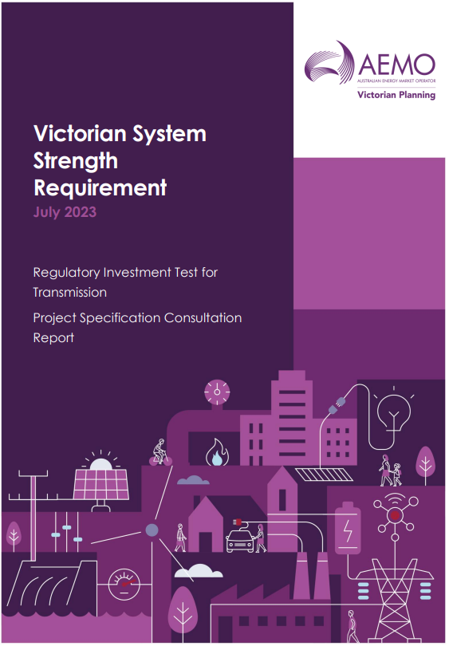
Objective
The purpose of this webinar is to summarise the Project Specification Consultation Report and Request for Information process, with time for questions and discussion.
The report and RFI is available here
Notes:
Sam

Slide 4
Agenda
Welcome
Introduction
Overview of the PSCR & RFI
Q&A
Notes:
Jason:
Sam has taken us though the welcome to country and the objective of today’s session.
I’ll take a few minutes to talk through system strength requirement and the indicative timelines we’re working to, YiSiang will talk us through the key points in the project specification consultation report, which first step in the regulatory investment test. That should only 10-15 mins, and then we should have around an hour to go answer the questions you have, including a number of pre-submitted questions.
Please submit your questions via slido, using the code “AEMO” as noted at the bottom of the slides

Slide 5
Victorian System Strength Requirement
AEMO Victorian Planning (AVP) as the System Strength Service Provider for Victoria is required to meet the system strength standard at each system strength node.
AVP is undertaking this Regulatory Investment Test for Transmission (RIT-T) & Request for Information (RFI) to consider options that enable AVP to meet regulatory obligations and standards.
The purpose of this session is to engage with industry regarding the Project Specification Consultation Report (PSCR) & RFI
Notes:
Jason:
The rule change that commenced 2 December 2022 introduces changes in approach of the system strength framework. AVP as the designated System Strength Service Provider for Victoria has system strength obligations that it will need to meet.
In line with NER requirements, AVP will through this RIT-T identify the optimal portfolio of system strength services to meet the system strength requirements
AEMO also intends to run a competitive procurement process in parallel for which the RFI is the first step.

Slide 6
Indicative Timeline
14 July 2023 Project Specification Consultation Report (PSCR) & Request of Information (RFI) published
6 October 2023 PSCR & RFI submissions closes
Early 2024 Project Assessment Draft Report (PADR) expected release
Mid 2024 Project Assessment Conclusions Report (PACR) expected release
Late 2024 System Strength Services contracts established
2 December 2025 System Strength obligation commences
Notes:
Jason:
The slide shows the indicative timeline for the regulatory investment test process that AVP is following in order to meet its system strength obligation. We also intend for the procurement process to be closely tied to the various RIT-T report milestones.
In preparing the Project Assessment Draft Report (PADR), AVP will assess the various credible options and this will be heavily guided by the submissions to both the PSCR and RFI. As part of the process, the net benefit of each credible option will be identified in which AEMO will rank the various credible solution that allow a proposed preferred option.
There will be a 6 week consultation period after the PADR is published and, considering any submissions to the PADR, a Project Assessment Conclusions Report will be prepared and published identifying the preferred option.
This will be followed up with the procurement process to establish system strength service contracts to meet the system strength obligations.
AVP understands that the timing from establishing contracts to meet the commencement of the system strength obligation is tight, but it is also acknowledged that it is plausible that the preferred option will consist of a portfolio of solutions and network support agreements, so not all proposed solutions are necessarily required to be in service by 2 December 2025.
It is also worth noting some regulatory uncertainty remains around the treatment of emissions in the National Electricity Objective and how that will flow into the RIT-T, and the Operational Security Mechanism and how that will feed into the services contract, so these factors do have potential to impact on these indicative timings.

Slide 7
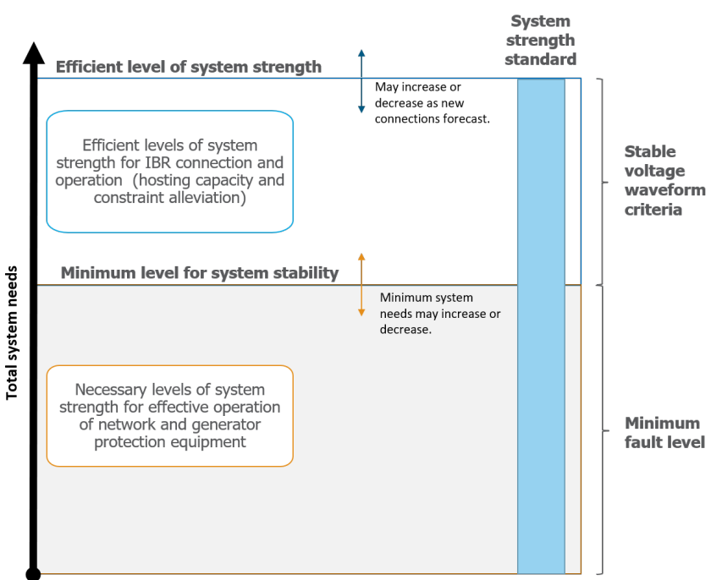
System Strength Standard
Efficient IBR requirement (MW):
Ensure stable voltage waveforms such that an efficient amount of Inverter Based Resources (IBR) can connect and remain stable during steady state conditions and following credible contingency events.
Minimum fault level requirement (MVA):
Ensure there sufficient fault level to enable network protection system, voltage control devices to operate correctly and power system to remain stable following any credible contingency event or protected event.
Source : AEMC Efficient Management Of System Strength On The Power System) Rule 2021 Final Determination
Notes:
Introducing the system strength standard that AVP needs to meet by 2 Dec 2025
System strength can broadly be described as the ability of the power system to maintain and control the voltage waveform at any given location in the power system, both during steady state operation and following a disturbance
Two components:
Minimum fault level
enable network protection system, voltage control devices to operate correctly
power system to remain stable following any credible contingency event or protected event
A stable voltage waveform is defined by four criteria:
• Voltage magnitude
• Change in voltage phase angle
• Voltage waveform distortion
• Voltage oscillations

Slide 8
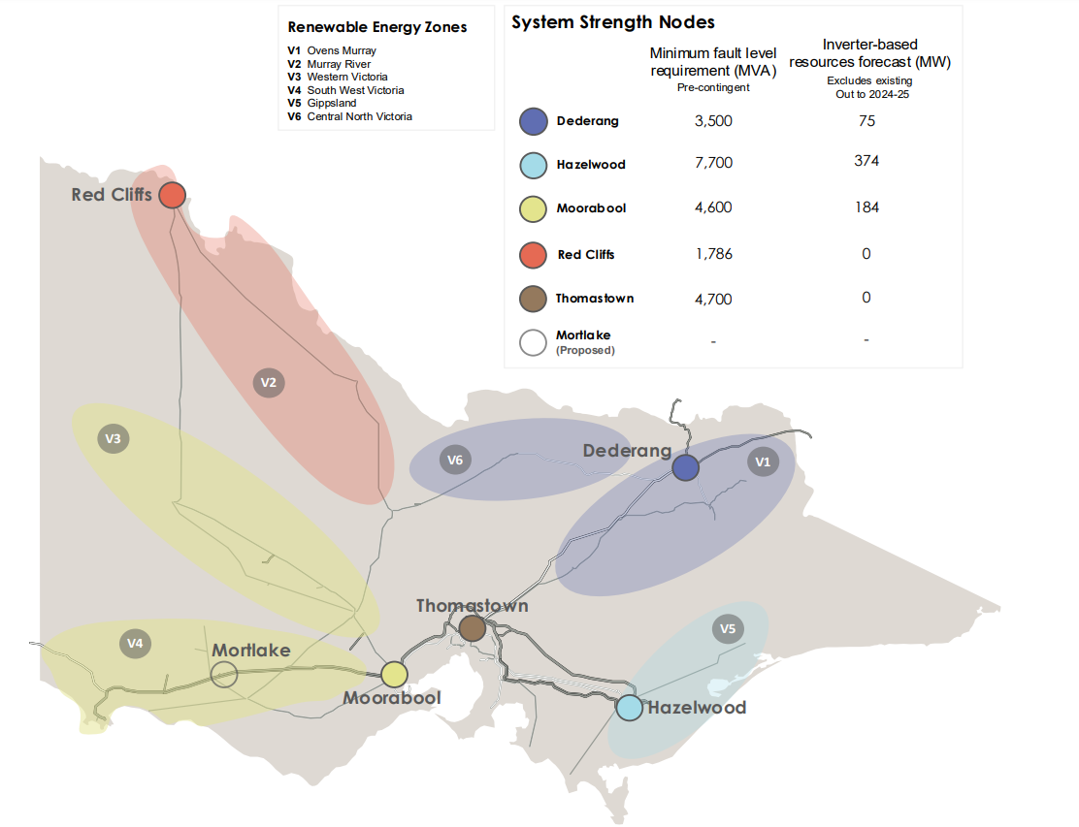
System Strength nodes
Node | Minimum fault level requirement
Node | Pre contingency | Post contingency
Dederang | 3,500 MVA | 3,300 MVA
Hazelwood | 7,700 MVA | 7,150 MVA
Moorabool | 4,600 MVA | 4,050 MVA
Red Cliffs | 1,786 MVA | 1,036 MVA
Thomastown | 4,700 MVA | 4,500 MVA
AEMO 2022 System Strength Report
Notes:
A total of five system strength nodes have been declared in Victoria with a proposed system strength node at Mortlake being considered in future System Strength Reports. As shown in the map, the System strength node are associated with the various REZ.
The minimum fault level requirement has two component, both a pre-contingency and post-contingency requirement which both need to be met by the system strength services identified as part of this RIT-T.

Slide 9
Forecasted IBR
AVP is required to ensure stable voltage waveform to allow for the connection and operation of forecasted efficient level IBR.
System strength node | Forecasted IBR (MW)
System strength node | 2025 | 2026 | 2027 | 2028 | 2029 | 2030 | 2031 | 2032 | 2033
Moorabool | 0 | 0 | 92 | 92 | 92 | 153 | 944 | 1,456 | 1,556
Hazelwood | 374 | 394 | 394 | 394 | 833 | 1,482 | 2,001 | 2,001 | 2,001
Dederang | 0 | 0 | 0 | 0 | 0 | 0 | 0 | 264 | 264
Red Cliffs | 0 | 0 | 0 | 0 | 0 | 0 | 0 | 354 | 1,437
Thomastown | 0 | 0 | 0 | 0 | 0 | 0 | 0 | 0 | 0
*Modified forecast IBR generation from AEMO 2022 System Strength Report at each system strength node with recent generation commitments subtracted from the relevant system strength node.
Notes:
Further to that, AVP will need to ensure that stable voltage waveform to allow for the connection and operation of forecasted efficient level IBR.
The forecasted IBR MW below is from the AEMO 2022 system strength report which is derived from the ISP central scenario. The forecasted IBR MW number is different from what has been published due to recent commitment of generation since the report has been published.
There may be changes in the system strength report to be published at the end of the year and we will be taken that into account.
The next slide shows the breakdown of the IBR by generation type.

Slide 10
Forecasted IBR breakdown
Notes:
Therefore, AVP needs to provide sufficient system strength service to enable the stable voltage waveform of the following IBR in the various nodes.
Acknowledge the uncertainty of where this projects may be in the REZ (or even which REZ).

Slide 11
Equivalent network solution to meet the system strength standard
System strength node | Equivalent network solution | Timing
Hazelwood | 5 x 250 megavolt amperes reactive (MVAr) synchronous condensers | From December 2025 ongoing
Moorabool | 1 x 250 MVAr synchronous condenser | From December 2025 ongoing
 | 2 x additional 250 MVAr synchronous condensers | From 2030 ongoing
Red Cliffs | 1 x 125 MVAr synchronous condenser | From December 2025 to the commissioning of Project Energy Connect (PEC) Stage 2
 | 1 x 250 MVAr synchronous condenser | From 2032 ongoing
Notes:
AVP’s analysis has identified that 6 synchronous condensers will be required in Victoria from 2 December 2025, with a short term requirement for a synchronous condenser in the Red Cliffs System Strength node should PEC Stage 2 be commissioned after December 2025. The majority of the synchronous condensers are to be located in the Hazelwood system strength node with 1 located in the Moorabool system strength node. This is in addition to the 2 system strength solutions that have been procured by the Victorian Government’s REZ Development Plan.
It is anticipated the 6 synchronous condensers plus Vic Gov services will enable AVP to meet both the minimum fault level and efficient level of IBR components of the system strength standard. 2 additional synchronous condensers were identified to be required from 2030 at the Moorabool system strength node whilst an additional synchronous condenser will be required from 2032. It should be noted that this are indicative network solutions and does not preclude other services capable of providing similar services as to these synchronous condensers.
We expect to be further refining the equivalent network solution with additional information provided by the PSCR and RFI submissions or as IBR generation project matures.

Slide 12
Potential options
AVP will consider the following options meeting the long-term system strength requirements beyond 2025.
Synchronous machines
Modification to existing synchronous generators
Grid forming solutions
Notes:
Synchronous machines – synchronous condensers and synchronous generators such as coal, gas and hydro are capable of providing system strength services when dispatched, as quantified in the current Victorian system strength minimum generator combinations for a secure state.
Modification to existing synchronous generators – synchronous generators may either be able to dynamically switch between operation as a synchronous condenser and operation as a generator, or to permanently convert from operation as a generator to operation as a synchronous condenser where hybrid operation is not feasible. The Australian Renewable Energy Agency (ARENA) has published a paper exploring the feasibility and technical challenges of converting synchronous generators into synchronous condensers. The paper was written in collaboration with AEMO, transmission network service providers (TNSPs), original equipment manufacturers (OEMs ) and generators.
Grid-forming batteries, generators, SVCs and STATCOMs – grid-forming inverters, when appropriately tuned and configured, may be capable of providing system strength services.
This is not an exhaustive list – we are open to submissions where the service is capable of assisting AVP meet the system strength standard.

Slide 13
Next Steps
Submissions to the PSCR and RFI are due on 6 October 2023
All submissions or any general question are to be submitted to SystemStrengthVIC@aemo.com.au

Slide 14
Question & Answers
Ask your questions at www.Sli.do #AEMO
Questions are not considered as submission to the PSCR

Slide 15
Pre submitted questions
Is it anticipated that conventional generators will enter Network Support Agreements with AVP to come on-line to provide system strength when otherwise not operating for market?
Is there an opportunity for the system strength provision from existing conventional generators to be financially recognised when they are operating in the energy market and deferring the need for synchronous condensers?
What is the assumed non-IBR generator commitment pattern, if any, behind the tables 1 and 6 (in the PSCR)?
Can AEMO provide information about the basis of the model on how these non-networks solutions would be remunerated if successful?
For GFM inverter to provide a material positive system strength contribution, is it correct to assume that SCR withstand will need to be lower than 1.2?

Slide 16
Pre submitted questions
Is it mandatory to demonstrate an available date no later than December 2025?
Is it mandatory to supply technical information that has been requested but not listed in the Technical Parameters table in the RFI Returnable Schedule, such as PSSE / PSCAD models and associated RUG?
Is there a minimum duration requirement for battery storage solutions?
Can you provide guidance on calculating estimated scope 1 and scope 2 greenhouse gas emissions associated with supplying system strength services for a battery project charging and discharging into the NEM? Should these calculations consider both the construction and operational phases?

Slide 17
Pre submitted questions
Please provide the timeline and next steps after the PSCR phase, including publication of the PADR and PACR.
How important will the timing of projects be against the proposed System Strength needs?
Would you be able to release more prescriptive technical specification baselines we can then check our technology against to ensure eligibility?

Slide 18
Pre submitted questions
What specific criteria is used to demonstrate that a battery technology (or other non-network) can support the minimum fault level requirements (criteria 1 for non-network option). AEMO's voluntary specification for grid forming inverters (GFI) presents qualitative capabilities (core + additional) for a GFI. Can you please outline which key capabilities are required for each location in relation to this criteria?
What specific criteria is used to demonstrate that a battery technology (or other non-network) can support stable voltage waveform (criteria 2 for non-network option). AEMO's voluntary specification for grid forming inverters (GFI) presents qualitative capabilities (core + additional) for a GFI. Can you please outline which key capabilities are required for each location in relation to this criteria?

