Slide 1
5MS & GS Program Consultative Forum 5MS Start Notice Update
Thursday, 26 August 2021
This meeting is recorded for the purpose of minute taking.
Please disconnect from your workplace VPN for the WebEx call​

Slide 2
AEMO Competition Law Meeting Protocol
AEMO is committed to complying with all applicable laws, including the Competition and Consumer Act 2010 (CCA). In any dealings with AEMO regarding proposed reforms or other initiatives, all participants agree to adhere to the CCA at all times and to comply with this Protocol. Participants must arrange for their representatives to be briefed on competition law risks and obligations.
Participants in AEMO discussions must:
Ensure that discussions are limited to the matters contemplated by the agenda for the discussion
Make independent and unilateral decisions about their commercial positions and approach in relation to the matters under discussion with AEMO
Immediately and clearly raise an objection with AEMO or the Chair of the meeting if a matter is discussed that the participant is concerned may give rise to competition law risks or a breach of this Protocol
Participants in AEMO meetings must not discuss or agree on the following topics:
Which customers they will supply or market to
The price or other terms at which Participants will supply
Bids or tenders, including the nature of a bid that a Participant intends to make or whether the Participant will participate in the bid
Which suppliers Participants will acquire from (or the price or other terms on which they acquire goods or services)
Refusing to supply a person or company access to any products, services or inputs they require
Under no circumstances must Participants share Competitively Sensitive Information. Competitively Sensitive Information means confidential information relating to a Participant which if disclosed to a competitor could affect its current or future commercial strategies, such as pricing information, customer terms and conditions, supply terms and conditions, sales, marketing or procurement strategies, product development, margins, costs, capacity or production planning.

Slide 3
Agenda
# | Time | Topic | Presenter
1​ | 15:00 – 15:05​ | Welcome​ | Peter Carruthers​
2 | 15:05 – 15:15 | 5MS Start Notice Status Update | Anne-Marie McCague & Greg Minney
3 | 15:15 – 15:35 | Risk Management | Greg Minney & Peter Carruthers
4 | 15:35 – 15:45 | Options Analysis | ​Peter Carruthers
5 | 15:45 – 15:50 | Conclusions and Next Steps | Peter Carruthers
6 | 15:50 – 16:00 | General Questions | Peter Carruthers
7 | 16:00 | Meeting Close | Peter Carruthers
8 |  | Appendix 1: 5MS Market Trial Status Report
9 |  | Appendix 2: Readiness Dashboard – Other Capability
10 |  | Appendix 3: Essential Meters Status
11 |  | Appendix 4: Support Arrangements for Participants

Slide 4
Welcome
Peter Carruthers

Slide 5
5MS Start Notice Status Update
Peter Carruthers

Slide 6
5MS start notice process
13-Aug
Readiness Questionnaire Round 9 Due
19-Aug PCF
Update on progress against essential criteria
24-Aug
Target for completing critical 5-min Market Trial scenarios
26-Aug PCF
Readiness Report Round 9 published
PCF Briefing (if required)
30-Aug
AEMO present go/no-go to Executive Forum
01-Sep
5MS start notice submitted by AEMO to AEMC
5MS start notice
Circulated to those on the 5MS general information distribution list
Published on 5MS webpage

Slide 7
Actions for “Green” 5MS start notice
 | On track | On track for commencement date
 | Risk 1 – Risk to major milestones or deliveries | Remediation or contingency activation required to ensure on track delivery for Rule Commencement
 | Risk 2 – Risk to rule commencement | Cannot be addressed with available contingencies to be on track for commencement date
Responsible Participant | Essential Criteria | Status | Conclusions and Actions for “Green” 5MS Start Notice
Generator | Generators and MNSPs are able to submit 5-min offers | On-track | No further actions. Status is acceptable.
MP, MC, MDP | All essential meters* are able to produce and store and deliver 5-min data | At-risk | All MSPs reporting compliance by 1 October. Completion of August scheduled installation and metering plans No reason to delay Market Go-Live on that basis Agreed Contingency Plan required from MPs and MDPs with any essential meters/metering data in September Sound progress on 5m metering upgrades and preparation of contingency plans Explicit confirmation sought, and received or in progress, from each MP/MDP of their readiness for 1 October and contingency plan established
AEMO | The 5-minute bidding and dispatch solution, including the web bidding interface is deployed | On-track | No further actions. Status is acceptable.
 | The Metering Data Management (MDM) solution is deployed | At-Risk | No fundamental capability issues identified to date Resolve metering data issues to enable clean 5m Settlements run in Market Trial to be completed AEMO advise on any residual UAT issues Criteria is no outstanding defects that have a material compliance or participant impact that cannot be remedied prior to 1 Oct Metering data issues improved, resulting in better quality 5m Settlements run Known defects are scheduled for resolution and will not impact 1 October go-live
 | The 5-minute settlements solution is deployed | On-track | No fundamental capability issues identified and independent certification completed Resolve metering data issues to enable clean 5m Settlements run in Market Trial to be completed AEMO advise on any residual UAT issues
Readiness Assessment status |  | At-Risk | Improving trend, although ‘green’ targets not fully achieved at the time of reporting No show-stoppers for 1 October, although risks exist that require mitigation

Slide 8
Current status for 5MS start notice
 | On track | On track for commencement date
 | Risk 1 – Risk to major milestones or deliveries | Remediation or contingency activation required to ensure on track delivery for Rule Commencement
 | Risk 2 – Risk to rule commencement | Cannot be addressed with available contingencies to be on track for commencement date
Responsible Participant | Essential Criteria | Status | Comments
Generator | Generators and MNSPs are able to submit 5-min offers | On-track | Criteria adequately met Evidence provided through Participant Readiness Reporting, observations through Market Trial and observations of Transition Bidding Contingency plan exists through web bidding interface
MP, MC, MDP | All essential meters* are able to produce and store and deliver 5-min data | At-risk | No show-stoppers exists and criteria is adequately met Risks exist. Contingency plans are necessary and have been, or are being, established. Monitoring will continue throughout September and activation of contingency plans will be discussed with MSPs where necessary. Evidence provided through Participant Readiness Reporting, Metering Transition Plan Reporting, observations of production operation and explicit readiness confirmation from MSPs.
AEMO | The 5-minute bidding and dispatch solution, including the web bidding interface is deployed | On-track | Criteria adequately met. Evidence provided through Production operation and Market Trial operation
 | The Metering Data Management (MDM) solution is deployed | At-Risk | No significant capability issues identified to date and no show-stoppers exist. No outstanding defects that have a material compliance or participant impact that cannot be remedied prior to 1 Oct. Criteria is adequately met. Risks exist, arising from Market Trial or completion of AEMO UAT edge cases. Risk management plan necessary. Market trial to continue and extension to be sought Evidence through Production operation and Market Trial critical business functions
 | The 5-minute settlements solution is deployed | On-track | Criteria adequately met. Evidence provided through Production operation, Market Trial operation and independent certification
Readiness Assessment status |  | At-Risk | Key Risks: Essential meter capability Industry end-to-end testing Market functions (AEMO) readiness

Slide 9
Risk Management

Slide 10
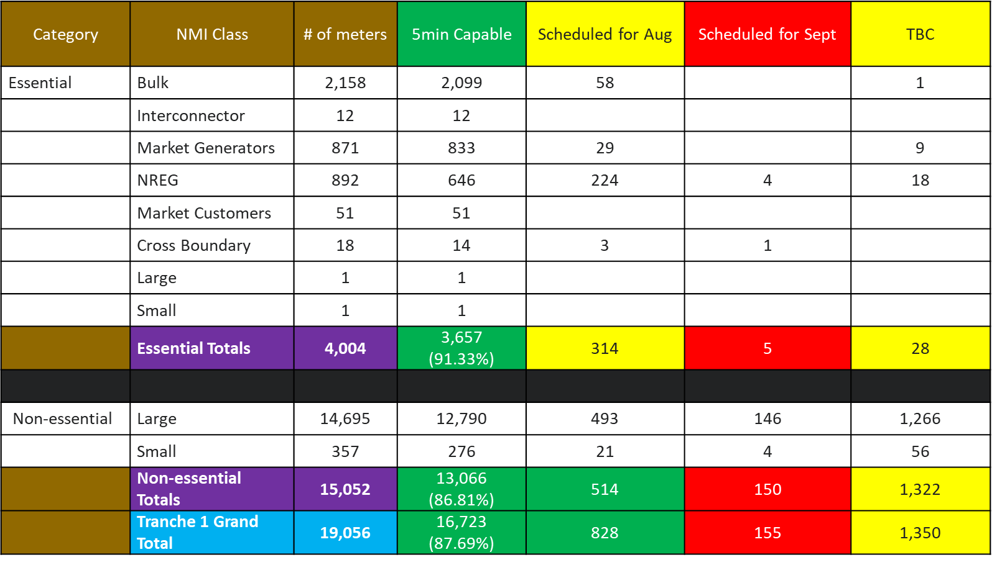
Risk 1: Essential Meter Capability
MP Status
Overall, good MP progress being made over the past week for essential meters and Tranche 1 meters, with:
574 (~13%) more essential meters being reported as being 5min capable
1,420 (~9%) more non-essential meters being reported as being 5min capable
TBC metering schedule needs to be finalised and monitored.
MDP Status
5/6 MDPs scheduled to deliver essential metering data by end August
3/6 MDPs have already delivered 5 minute data to AEMO
Key risk exists for MDPs delivering in September, successful delivery and suitable contingency plan is imperative
Assurance
Explicit confirmation on readiness and contingency plans received from (as at COB 25/08):
6 Metering Providers out of 8 (5 already complete)
3 Metering Data Providers out of 6

Slide 11
Risk 2: Industry end-to-end testing
Key issue identified at PCF of 19 August
Individually, 100% of participants have reported they are confident or very confident of being able to perform core functions from 1 October
However, some participants have indicated concern that testing through Market Trial is incomplete at the time of the Go/No-Go decision
Interpretation:
Participants are confident in their own readiness
Participants not necessarily confident of industry end-to-end readiness, as this has not been seen as proven through the Market Trial testing
In order to understand this risk and implications better, we examine:
Market Trial test case status
Market Trial Critical business functions (that relate to essential capability) test case status
Market Trial Critical business functions status
Defect status
Proposed mitigation

Slide 12
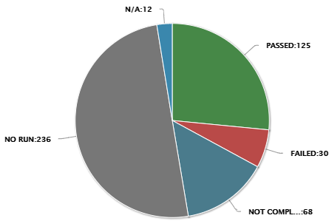
Risk 2: Industry end-to-end testing Key Market Trial Business Functions Test Case Summary
Current status sees some 46% of total scenarios are either completed or in progress.
Twofold Market Trial objective:
Demonstrate essential capability for bidding, metering and settlements in time for the go/no-go decision
Provide opportunity for participants to conduct (end-to-end, multi-participant) test scenarios that contributed to their own readiness, throughout the Market Trial period.
Focus for Go/No-Go decision is on objective 1 i.e. demonstrating the essential capability (i.e. the critical business functions).
Bidding Capability – for AEMO and Generators/MNSPs
Metering and Settlements – successful production of the Transition Week Preliminary and Final, and a 5m week Preliminary
Significant number of test scenarios/cases identified, scheduled across a range of market functions, for objective 2. Sign-up and execution is voluntary.
Test Scenario Summary

Slide 13
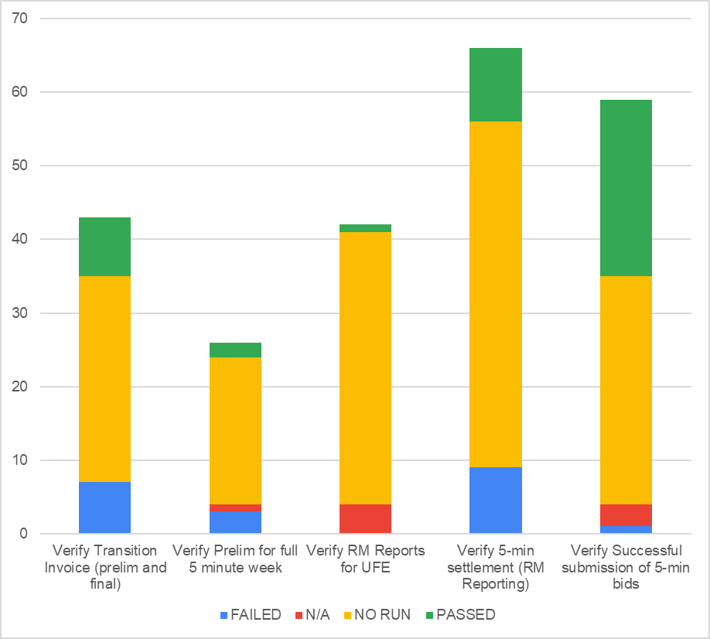
Risk 2: Industry end-to-end testing Key Market Trial Business Functions Test Case Summary
254 test cases identified related to the critical business functions:
40 Pass, 16 Fail, 8 N/A
190 No Run
High number of No Run, particularly given a number of functions have been available for several weeks. Contributing, and legitimate, factors include:
Participants choose whether/when their allocated test cases get executed
Participant execution completion can impact on downstream test case execution
Participants choose how a test case is marked as successful e.g. 5m metering data consumed? Reconciled? Processed through dependent internal systems?
Participants choose how and when the test statistics are updated in Practitest
In light of these factors, assessing progress of these key tests does not provide a meaningful metric for measuring essential capability
AEMO considers a better measure of readiness for critical business functions is:
Defect status
Demonstration of AEMO’s ability to fulfill critical business functions (as set out in the Market Trial status report)
Key business functions relate to Transition Week and 5m Week

Slide 14
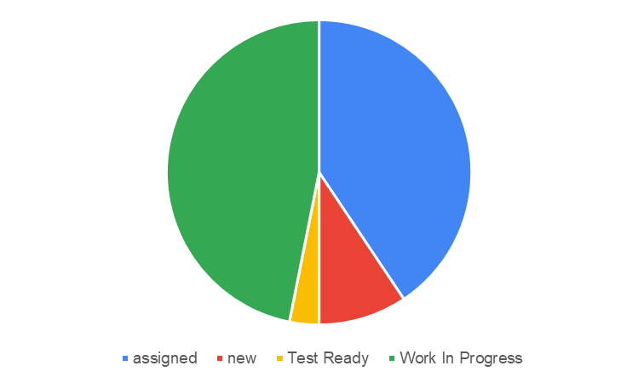
Risk 2: Industry end-to-end testing Defect Status
Severity (Participant rated) | 1 | 2 | 3
Defects | 1 | 5 | 27
Stream | Bidding | Settlements | Retail (inc CS)
Defects | 6 | 8 | 19
Open Issues Assigned to AEMO
All Participant rated Sev 1 & 2 defects are Assigned / WIP, overall market severity not yet established
Current Sev 1 defect relates to transaction acknowledgement on subset of Meter Data Notifications noted by one participant
All Participant Rated Sev 1 & 2 defects expected to be addressed prior to 1 Oct and capacity exists within AEMO to address

Slide 15
Risk 2: Industry end-to-end testing Key Market Trial Business Functions (24 Aug)
Stream | Action | Owner | TS #* | Status | Comment
Bidding | Verify successful submission of 5-min bids with varying underlying values | Generators | BD02,BD03 |  | Participants have been submitting 5-min varied bids. Open issues have resolution path.
Retail | Verify 5-min settlement (RM reporting) | Generators and Retailers | S02, S03 |  | 5-min RM reports have been issued and are available for participant verification. There are a few open investigations.
Retail | Verify RM reports for UFE | Generators and Retailers | S02, S03 |  | UFE reports produced. Two issues have been raised and are under investigation.
Settlements | Verify transition invoice – prelim and final | AEMO to send and Gens and Retailers to receive | S08, S02, S03 |  | The transition week preliminary invoice has been produced and available for participant verification. Final transition invoice scheduled to be produced 25 August.
Settlements | Verify prelim for full 5-min week | AEMO to send and Gens and Retailers to receive | S02 |  | Issued on 20 August. Once the wholesale reads were corrected the settlement run ran successfully.
Overall status |  |  |  |  | Overall status is amber and improving. Two key scenarios remaining for execution. No showstoppers issues identified to date. Delay in updating PractiTest is not providing an accurate view of participant success/failure.

Slide 16
Risk 2: Industry end-to-end testing Mitigation approach
Nonetheless, a strategy to address participants concerns in relation to end-to-end testing is required
Recognises that participant confidence is important, and industry testing makes a significant contribution in the smooth transition to a 5m market
AEMO is proposing to extend the Market Trial, acknowledging requests from participants
Aim is to enable the most important testing to proceed, but without causing 5m transition activities to be compromised
To the extent possible, facilitate increased “pairing” options for retailers given smaller numbers of DNSP / MDP to perform repeated cases
Arrangements to be discussed with the ITWG, focus on key scenarios requiring multiple participants

Slide 17
Risk 3: Market functions readiness
The phased implementation of AEMO systems has substantively de-risked 5MS go-live
All AEMO 5MS systems are in production operation and are proven.
AEMO cutover for go-live is a configuration and defect release.
Assurances on accuracy of commercial outcomes through a number of avenues
AEMO internal testing process
Independent certification of the settlements engine
Production operation and reliability of settlement outcomes for 30m
AEMO already accepting 5m granularity & register level metering data from MDPs, and processing this successfully to 30m outcomes
Market Trial process
Key risks, and commentary on mitigations
Complexities of transition week: Market Trial preliminary and final, AEMO UAT
MDP metering data input issues: transitional period underway, issues already encountered, AEMO data quality checks, co-ordination between MDPs and AEMO
Unexpected 5m specific issue arising for edge case scenario: 30m operation has identified the bulk of edge cases, AEMO 5m testing, support processes well practised
5m performance issues: current production operation, RM performance defect resolution, observations of pre-production performance
Contingency Plan for Settlements and Prudentials
Developed & tested during the Retail go-live
pre-emptive data checks
BAU processes for addressing data quality issues eg preliminary/final/revised settlements, prudential estimates where actuals not available
internal tools for additional prudentials assessments
shoulder season go-live
AEMO Support processes crucial
As set out in PCF of 19 August, and included in Appendix 4 FYI

Slide 18
Options Analysis

Slide 19
Overview
Go-Live for 1 October can be compared against Delay options
Assists to inform the decision making process
Baseline is 1 October go-live
No show-stoppers exist in any of the essential criteria categories
However, risks do exist and some participants have reservations about end-to-end industry readiness on the basis of Market Trial test status
Compare 1 October go-live against Delay options
Short delay: 1 December 2021
Extended delay: 1 Feb 2022 or 1 Apr 2022

Slide 20
Delay Impact Assessment
Short Delay (1 Dec 2021) | Extended Delay (1 Feb 2022 or 1 Apr 2022)
Additional time for Market Trial and MSP activity completion Increased participant confidence and time for participants and AEMO to resolve any defects Increased time for participants with at-risk program status to complete readiness activities Reduced risk of go-live operational impacts | Significant additional time for Market Trial and MSP activity completion Increased participant confidence and time for participants to resolve any defects Significant increased time for participants with at-risk program status to complete readiness activities Reduced risk of go-live operational impacts
Costs: Project extension/hold costs associated with delay, with consequent budgetary impacts & requests for extension Resources: Program fatigue, loss of IP for go-live esp for contractors seeking long-term roles Impacts to other internal projects: resource contention Delays to benefits of reform by 2 months Delays to other reform implementation: Customer switching, WDR, electricity B2B Adjustment of programs to manage bundling of CS, WDR, elec B2B 1 Dec date: close to holiday period with potential impacts for resources, concerns from some participants in relation to summer proximity Uncertainty whilst reform projects get re-planned for 1 Dec Impacts to open (4Q21) 5m financial contracts (esp 5m caps) and implications for managing within-quarter financial contracts and systems | Costs: Project extension/hold costs associated with delay, with consequent budgetary impacts & requests for extension Resources: Program fatigue, loss of IP for go-live esp for contractors seeking long-term roles Impacts to other internal projects: resource contention Delays to benefits of reform by 4 or 6 months Significant delays to other reform implementation: Customer switching, WDR, electricity B2B, Global settlement, entire 2022 reform implementation program Adjustment of programs to manage bundling of reform programs Uncertainty whilst AEMC makes decision on 1 Feb vs 1 April Uncertainty whilst impacted reform projects get re-planned, depending on AEMC decision Impacts to open (4Q21) 5m financial contracts (esp 5m caps) Potential implications for managing within-quarter financial contracts and systems and summer go-live (1 Feb) balanced against extended delay (1 Apr)
List of implications is general, and impact will vary between participants

Slide 21
Conclusions and Next Steps

Slide 22
Summary / Conclusions
AEMO 5MS Project Team ‘minded to’ position is to recommend Go decision
Based on no show-stoppers for any essential capability category
Delay options create substantial industry-wide issues and consequences
Recognises that risks exist and mitigations are necessary, including market trial extension and contingency plans for MSPs and AEMO
Participant views welcome
Next Steps:
AEMO 5MS Project Steering Committee on Friday 27/8 for recommendation, participant views to be included
Executive Forum for Monday 30/8
5MS Start Notice for Wednesday 01/9

Slide 23
Meeting Close
Peter Carruthers

Slide 24
Appendix 1: 5MS Market Trial Status Report

Slide 25
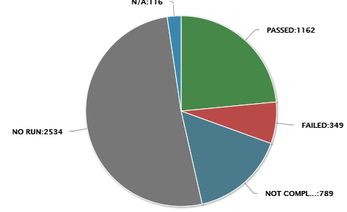
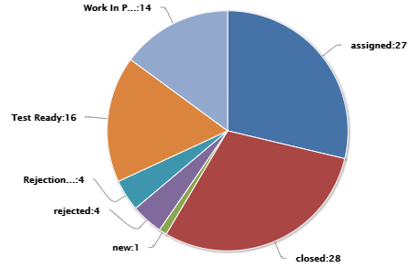
Overall Status as at 24 August 2021
Click here for PractiTest Dashboard
Overall RAG Status
Test Case Summary
Defects Summary
Schedule is on track however open issues and lack of visibility of participant progress
See slide 5 for details
46% of total scenarios are either completed or in progress.
5-min profiled bids continue to be submitted.
Preliminary invoice for 2021Wk33 released on 22 Aug.
Participant PractiTest profiles are inconsistently updated which may result in inaccurate status reporting.
Intervention Pricing testing commenced 19 Aug. Proceeding well.
3 of 5 key scenarios have been run with 2 scheduled for this week. No critical capability issues have been identified.
Key Risks – no change
Key Issues – see slide 4
Heightened risk of issues occurring early in the Market Trial as a result of:
Testing of production defects in pre-prod
Unexpected data/environment issues encountered following the refresh has required time to resolve
Conflicting resource demands based on production support, Market Trial preparations and completion of testing including edge case
5-minute pre-dispatch (5MPD) scenarios formulation error – due in pre-prod 25 Aug
Risk/Issue RAG Status
Amber risk status.
No critical capability issues for market start have been identified
Uses of estimated meter read data and participant input test data may impact data quality which will be reflected in Market Trial outcomes (Issue 5)

Slide 26
Key Market Trial Business Functions
* TS unique # reference to Market Trial Workbook
Stream | Action | Owner | TS #* | Status | Comment
Bidding | Verify successful submission of 5-min bids with varying underlying values | Generators | BD02,BD03 |  | Participants have been submitting 5-min varied bids. Open issues have resolution path.
Retail | Verify 5-min settlement (RM reporting) | Generators and Retailers | S02, S03 |  | 5-min RM reports have been issued and are available for participant verification. There are a few open investigations.
Retail | Verify RM reports for UFE | Generators and Retailers | S02, S03 |  | UFE reports produced. Two issues have been raised and are under investigation.
Settlements | Verify transition invoice – prelim and final | AEMO to send and Gens and Retailers to receive | S08, S02, S03 |  | The transition week preliminary invoice has been produced and available for participant verification. Final transition invoice scheduled to be produced 25 August.
Settlements | Verify prelim for full 5-min week | AEMO to send and Gens and Retailers to receive | S02 |  | Issued on 20 August. Once the wholesale reads were corrected the settlement run ran successfully.
Overall status |  |  |  |  | Overall status is amber and improving. Two key scenarios remaining for execution. No showstoppers issues identified to date. Delay in updating PractiTest is not providing an accurate view of participant success/failure.

Slide 27
Appendix 2: Readiness Dashboard – Other Capability

Slide 28
Part B – Other Industry Capabilities (as at 13 August)
 | On track | On track for commencement date
 | Risk 1 – Risk to major milestones or deliveries | Remediation or contingency activation required to ensure on track delivery for Rule Commencement
 | Risk 2 – Risk to rule commencement | Cannot be addressed with available contingencies to be on track for commencement date
Responsible Participant | Criteria | Status | Comments
Retailer | Receive and process 5-minute metering data. Receive and process 5-minute settlement data. | On-track | All 20 reporting Retailers confident or very confident of being able to operate core capabilities post 1 October 18 “on track”, 2 “at risk” to be able to receive and process 5-min metering data 16 “on track” and 4 “at risk” to be able to receive and reconcile 5-min settlement data Outstanding scenario execution in Market Trial reflected in level of at risk activities
DNSP | Receive and process 5-minute metering data. | At-risk | All DNSPs report "on track" for receive and process 5-min metering data Multiple DNSPs are reporting at risk or late for numerous GS related items, including:​ Cross boundary supplies, 4 reporting at-risk or late​ NCONUML, 2 reporting at-risk or late ​ NMI reclassification required for GS has commenced, 1 DNSP reporting "late" for this activity There will be an impact on the UFE values initially published for those profile areas, likely to be mainly confined to initial months of UFE reporting
 | Provide GS metering and standing data updates (incl. NCONUML).
TNSP | Receive and process 5-minute metering data | On-track | 5/7 TNSPs reporting their overall programs as on track​, 2 "At risk" in regards ability to receive and process 5-min metering data 2 out of 7 have the intention to receive 5-min metering data prior to the Rule commencement date​
 | Provide GS metering and standing data updates |  | 1 TNSP reporting "at risk" for establishment of new NMI classification codes
MDP | Provide 5-minute metering data T1-3 distribution connected meters, type 7 meters. | On-track | 98,000 Tier 1 basic meters do not have active datastreams (as at 8/8) indicating that basic reads may not be available for inclusion in UFE calculations, 93,000 relate to a single distribution area. Majority of impact will be confined to that area, all relevant MDPs reporting activity "on track" Delivery of 5-minute metering data for T1-3 distribution connected meters dependent on MP upgrades in addition to MDP delivery capability 2 MDPs reporting "late" for delivery of type 7 data, with rectification plan for October All MDPs report "on track" for delivery of interval metering data via MDFF
 | Provide type 4, 4A, Vic Ami metering data at 5-minute granularity by 1 December 2022
 | Provide basic metering data for tier 1 NMIs to AEMO.
MP, MC | All T1-3,4* meters are able to produce and store 5-minute data. | At-risk | 14% of T1 non-essential meters yet to be 5 minute capable (based on RTC update), with all scheduled to be compliant by 1 Oct, Potential impact to accuracy of 5 minute readings when profiled with FRMP exposure for non-compliant meters, if late
Summary – Other Industry Capabilities |  | On-track | Based on participant reports – no issues that would prevent rule commencement Noted Risk re tranche 1 metering completion that has potential impact to FRMP Impacts of late and at-risk activity relate to GS Soft start
28

Slide 29
Appendix 3: Essential Meters Status

Slide 30
Tranche 1 Meters Overview (As at 23 August 2021)
Total Tranche 1 meters – 19,056
Essential Meters (Transmission connected)
Total number of meters – 4,004
# of meters 5min capable, after MP updates applied - 3,657 (91.33%)
574 (~13%) more essential meters confirmed as being 5min capable compared to last week
# of meters not 5min capable, after MP updates applied – 347 (8.67%)
Non-essential Meters (Distribution Connected)
Total number of meters - 15,052
# of meters 5min capable, after MP updates applied - 13,066 (86.81%)
1,420 (~9%) more non-essential meter confirmed as being 5min capable compared to last week

Slide 31
Tranche 1 Overview (Based on MSATS RTCs Only )
As at 23rd August
Category | NMI Class | # of meters | With 5min RTC | % with 5min RTC | RTC still to be updated
Essential | Bulk | 2,158 | 1,776 |  | 382
 | Interconnector | 12 | 10 |  | 2
 | Market Generators | 871 | 716 |  | 155
 | NREG | 892 | 638 |  | 254
 | Market Customers | 51 | 43 |  | 8
 | Cross Boundary | 18 | 14 |  | 4
 | Large | 1 | 1 |  | 0
 | Small | 1 | 1 |  | 0
 | Essential Totals | 4,004 | 3,199 | 79.9% | 805
Non-essential | Large | 14,695 | 12,779 |  | 1,916
 | Small | 357 | 275 |  | 82
 | Non-essential Totals | 15,052 | 13,054 | 86.73% | 1,998
 | Tranche 1 Grand Total | 19,056 | 16,253 | 85.29% | 2,803
Note: Updates to NMI Classification Codes and meter statuses in MSATS will change reported volumes week to week

Slide 32
Tranche 1 Overview (Post MP Update)
As at 23rd August
Category | NMI Class | # of meters | 5min Capable | Scheduled for Aug | Scheduled for Sept | TBC
Essential | Bulk | 2,158 | 2,099 | 58 |  | 1
 | Interconnector | 12 | 12
 | Market Generators | 871 | 833 | 29 |  | 9
 | NREG | 892 | 646 | 224 | 4 | 18
 | Market Customers | 51 | 51
 | Cross Boundary | 18 | 14 | 3 | 1
 | Large | 1 | 1
 | Small | 1 | 1
 | Essential Totals | 4,004 | 3,657 (91.33%) | 314 | 5 | 28
Non-essential | Large | 14,695 | 12,790 | 493 | 146 | 1,266
 | Small | 357 | 276 | 21 | 4 | 56
 | Non-essential Totals | 15,052 | 13,066 (86.81%) | 514 | 150 | 1,322
 | Tranche 1 Grand Total | 19,056 | 16,723 (87.69%) | 828 | 155 | 1,350

Slide 33
MP Updates
As at 23rd August
The following MPs provided a Tranche 1 metering update this week:
AusNet Transmission
Intellihub
Metropolis
Mondo
PlusES
Powermetric
TasNetworks - TNSP
Transgrid
Yurika

Slide 34
Appendix 4: Support Arrangements for Participants

Slide 35
Summary of Feedback Received
AEMO requested feedback through the RWG PIR and the Retail Q&A sessions.
Responses were received from Red Energy, PlusES, AGL, Origin and Intellihub.
AEMO has reviewed feedback and identified three ways in which feedback can be taken into account: immediately though the Retail Support Process, putting in place processes for Rule Commencement and post commencement support, sharing the feedback with other AEMO programs through the Lesson Learned Log
Retail Support Process
Twice weekly Retail Q&A sessions and daily issues log are helpful
Not including incident numbers against Issues makes it difficult for participants to track their own issues
AEMO has advised that incident numbers can be included with consent from participants
Greater transparency for defect fixes / participant role in testing defect fixes
Further information on defect fix dates is included in the Retail Issues Log
Overview of defect fix is provided through the twice weekly Retail Q&A sessions
Lack of visibility into the prioritisation of feedback and whether an issue impacts multiple participants
Prioritisation and impact have now been included in Log
Defect release predictability
AEMO has committed to regular defect releases
5MS Industry Go-Live Plan
Frequent comms worked well and were clear and well structured
Comms scheduled will be included in the Go-Live Plan
Preparation briefing sessions worked well – AEMO will schedule same in advance of 1 Oct
Delay in scheduled comms can cause confusion
AEMO will avoid delays by issuing a status at scheduled time
Greater transparency on go/no-go decision making
AEMO has provided PCF the approach to the go/no-go assessment including the criteria
Two-way comms and transparency over industry facing incidents
AEMO will establish a Support Room for 1 Oct and will continue Q&A sessions during October
Online Issues Log could provide greater flexibility and reduces risk of working from old version
AEMO Lessons Learned Log
AEMO should consider maintaining an environment for the purposes of participant testing of defect fixes
System changes communicated through slide packs have resulted in discrepancy from consulted procedures.
Failure to deliver projects to a schedule, impacting our resourcing and costs.
Not enough time between first clean run of settlements left limited time for participant testing prior to Retail Go-Live
Lack of performance testing prior to Go-Live
AEMO’s approach to performance testing targeted the solution areas identified most at risk for performance challenges, that is metering data ingestion and profiling allocation/preparation.

Slide 36
Overview of Support Arrangements for 5MS Commencement
Pre- 1 October
Go-Live Plan walkthrough with RWG 7 September
Q&A sessions – dates TBD – approx. 17- Sep, 24-Sep, 29-Sep
1 October
Q&A session on 1 October at 10:00
Increased Support staff and SME availability
5MS Cutover Support
It is expected that the Retail cutover will take approximately 3 hours and will commence at 17:00 on Thursday 30 September – final times TBD
AEMO will send a commencement email, a mid-point update email (time to be included in go-live plan) and a completion email
A ‘support-room” will be available from outage finish until 03:00 on 1 October.
This will be in place to cover post cutover issues and queries/issues with 5-min bidding from 00:01
Can be used to check if an issue has already been identified
All issues should still be logged with Support Hub
Once the issue has been logged, the ‘support-room’ can be used to receive updates on progress
Note: Issues will be prioritised during this time.
Updates on key issues (high impact) will be displayed on a slide in the ‘support-room’
Participants may use the chat function or speak
5MS Commencement Weekend
Increased Support Hub staffing over weekend
SMEs will be available over the weekend
Support post 1 October
Daily Q&A Sessions
Daily publication of Issues Log (medium under investigation)
Extended Q&A session for preliminary and final settlements invoice days
AEMO will assume that the consent provided to include incident numbers is still in place – please contact 5MS mailbox if you no longer wish to have your organisation’s incident numbers included
If you have not already provided consent to include incident numbers, please contact the 5MS mailbox

