Slide 1
5MS & GS Readiness Working Group #22 (incl. Systems Working Group)
Tuesday 6 April 2021
WebEx only: **Please disconnect from your workplace VPN for the WebEx call**
PLEASE NOTE THIS MEETING WILL BE RECORDED FOR THE PURPOSE OF PREPARING MINUTES

Slide 2


AEMO Competition Law
Meeting Protocol
AEMO is committed to complying with all applicable laws, including the Competition and Consumer Act 2010 (CCA). In any dealings with AEMO regarding proposed reforms or other initiatives, all participants agree to adhere to the CCA at all times and to comply with this Protocol.
Participants must arrange for their representatives to be briefed on competition law risks and obligations.
Participants in AEMO discussions must:
Ensure that discussions are limited to the matters contemplated by the agenda for the discussion
Make independent and unilateral decisions about their commercial positions and approach in relation to the matters under discussion with AEMO
Immediately and clearly raise an objection with AEMO or the Chair of the meeting if a matter is discussed that the participant is concerned may give rise to competition law risks or a breach of this Protocol.
Participants in AEMO meetings must not discuss or agree on the following topics:
Which customers they will supply or market to
The price or other terms at which Participants will supply
Bids or tenders, including the nature of a bid that a Participant intends to make or whether the Participant will participate in the bid
Which suppliers Participants will acquire from (or the price or other terms on which they acquire goods or services)
Refusing to supply a person or company access to any products, services or inputs they require.
Under no circumstances must Participants share Competitively Sensitive Information. Competitively Sensitive Information means confidential information relating to a Participant which if disclosed to a competitor could affect its current or future commercial strategies, such as pricing information, customer terms and conditions, supply terms and conditions, sales, marketing or procurement strategies, product development, margins, costs, capacity or production planning.

Slide 3
Agenda
Greg Minney

Slide 4
Agenda
**Please disconnect from your workplace VPN for the WebEx call**
# | Time | AGENDA ITEM | Responsible
1 | 10:00 – 10:05 | Welcome and Agenda | Greg Minney
2 | 10:05-10:10 | Minutes/Actions | Anne-Marie McCague
General Update
3 | 10:10 – 10:20 | 5MS Program Update | Greg Minney
4 | 10:20 – 10:40 | Industry Readiness | Greg Minney
5 | 10:40 – 10:50 | Industry Testing Update | Tui Grant
6 | 10:50 – 11:05 | TFG/ MTP Update | Greg Minney
7 | 11:05 – 11:15 | Risks and Issues | Greg Minney
8 | 11:15 – 11:25 | Origin’s proposed changes to GS Market Trial | Fergus Stuart, Origin
Retail/ Metering Readiness
9 | 11:25 – 11:40 | Retail / Metering Update | Jim Agelopoulos
Dispatch / Bidding Readiness
10 | 11:40 – 11:50 | Dispatch / Bidding Update | Ian Devaney
Settlements Readiness
11 | 11:50 – 12:00 | Settlements Update | Mark Hillaby
Meeting Closing Items
12 | 12:00 – 12:10 | Forward Plan and Other Business | Greg Minney
13 | 12:10 | Procedure update - No changes since last RWG | Simon Tu
14 | 12:10 | Meeting Close | Greg Minney

Slide 5
Minutes & Actions
Anne-Marie McCague

Slide 6
RWG Actions
No. | Status | Action | Comment
21.4.1 | Ongoing | AEMO to provide RWG with an impact assessment of any participants not completing associated activities by GS soft start on 1 October | AEMO will continue to monitor Readiness Reporting and where a participant noted they will not have completed the associated activities by 01-Oct, AEMO will provide an impact assessment to RWG for discussion.
21.4.2 | Open | Local Retailers to provide assessment of materiality of NCONUML for greater industry visibility of impact on UFE | LNSPs have provided AEMO with rollout plans indicting the number of expected NMIs to be created in MSATS to support the introduction of Non-contestable unmetered loads, approximately 115k NMIs. To gauge the potential materiality on UFE values from 1 Oct 2021, should a delay in these creations occur, AEMO is seeking information from LRs on the indictive energy volumes associated to these loads. AEMO is requesting this information from LRs as they currently bill customers for these supplies.
21.5.1 | Closed | AEMO to provide RWG and ITWG a list of published settlement runs in the staging environment | Settlement runs in pre-production: 23 March - PRELIMINARY – Week 39/2020 (Settlement dates – 20/09/2020 to 26/09/2020) 26 March – FINAL – Week 27 /2020 (Settlement dates 06/09/2020 to 12/09/2020) 30 March – REVISION - Week 21/2020 (Settlement dates 17/05/2020 to 23/05/2020) The settlement runs in Staging were completed in March 2020. If there is something specific that a participant needs for testing, please contact 5MS@aemo.com.au

Slide 7
5MS Program Update
Greg Minney

Slide 8
Program Update and Timeline
Current as at 05-03-2021
Retail: System Integration Testing (SIT) and User Acceptance Testing (UAT) in progress. ​
Settlements: UAT and Performance Testing in progress. ​
Bidding: SIT and UAT Complete. Performance Testing is in progress.
Industry Go-Live Plan Bidding & Dispatch Final issued on 19/03/21
Industry Go-Live Plan Settlements issued on due 01-Apr-21
Settlements Industry Test commenced 22-Mar-21
5-min Bidding Phased Go-Live on track for 01-Apr-21

Slide 9



Approach to Retail Status Updates
19-Apr
Retail Industry Testing Commences
31-May
5MS Retail/ Metering
Solution Go-Live
12-May [TBC]
Retail Go/No-Go Communicated to PCF via email
Key milestones
08-Apr
Pre-Prod and Industry Test Go/No-Go email
18-Feb PCF
Forward Planning for Retail
Update on Interim Checkpoint Criteria Status
23-Apr PCF
April Checkpoint Criteria - assessment and outcomes
Go/No-Go – confirm date
19-May PCF
Confirming Go/No-Go
Issue management
Replanning (if necessary)
18-Mar PCF
March Checkpoint Criteria – assessment and outcomes
Pre-prod – status and go/no-go date
Production go-live – checkpoint date and criteria, go/no-go date
Communication timeline

Slide 10
April Retail Checkpoint Criteria
Criteria represent activities scheduled for completion by first week of April.
Aim is to fully meet all criteria. If criteria not met, remedies to be developed and implications assessed before any change to 31 May target go-live date.
Pre-prod go/no-go date is 8 April – industry to be notified via email.
Criteria​ | Description
Testing | All UAT test cases executed with no critical defects that cannot be remedied for 31 May go-live.
Solution Stability | End-to-end solution operating stably in Test with no process blockers or unexplainable pauses/interruptions to processing.
Remediation | Known remediation work (internal reports performance, business activity monitoring) completed and remediation for any new defects scheduled.
Performance | “Day in the Life Testing” completed with no performance issues identified that cannot be remedied for 31 May go-live.
Pre-Production | Data migration on track and no blockers to meeting criteria/schedule for pre-production deployment.
Industry Test | On track to commence Retail Industry Test on 19 April.

Slide 11
Industry Readiness
Greg Minney

Slide 12
5MS Rule Commencement – Round 6
 | On track | On track for commencement date
 | Risk 1 – Risk to major milestones or deliveries | Remediation or contingency activation required to ensure on track delivery for Rule Commencement
 | Risk 2 – Risk to rule commencement | Cannot be addressed with available contingencies to be on track for commencement date
On track
Risk 1
Risk 2
Activity | Status | Comments
AEMO Business Readiness for 5MS and GS (Part A) |  | Bidding platform operating successfully in Industry test, on schedule for 1 April Go-live, and commencement of bidding transition period Retail Platform go-live rescheduled to 31 May, Settlements platform rescheduled to 17 May. Rescheduling of platform deliveries is not expected to impact 5MS Rule commencement or 5MS market trials.
Essential Industry Capabilities for 5MS commencement (Part A) |  | On track for 1 Oct 21 commencement Metering Data Providers and MPs reporting on track with minor exceptions. Generators reporting on-track delivery.
Summary: 5MS Rule Commencement |  | Overall Industry and AEMO components of essential capability currently on track for 5MS Rule commencement.
Other industry capabilities for 5MS and GS (Part B) |  | Other Participant readiness activities proceeding in line with 5MS rule commencement. Individual participant readiness risks noted in regards Global Settlement population activities. No systemic issues noted
Risk 1
On track
On track
On track
*** As at 8/3

Slide 13
Part A 5MS Essential Capability
 | On track | On track for commencement date
 | Risk 1 – Risk to major milestones or deliveries | Remediation or contingency activation required to ensure on track delivery for Rule Commencement
 | Risk 2 – Risk to rule commencement | Cannot be addressed with available contingencies to be on track for commencement date
On track
Risk 1
Risk 2
Responsible Participant | Essential Criteria | Status | Comments
Generator | Generators and MNSPs are able to submit 5-min offers |  | 16/17 Generators representing 95% of NEM volume reporting on-track. 15/17 intend to participate in Market Trials. Average program completion in range 50-74%. 12/17 intend to commence 5 minute bidding within transition period.
MP, MC | All essential meters* are able to produce and store 5-min data |  | 9/10 MPs reporting on track, 1 MP reporting “late” with identified remediation Rollout plans received for 99% of Tranche 1 meters, with all plans indicating completion prior to 1 October, 30% of meters currently 5 minute capable
MDP | All essential meters* are able to deliver 5-min metering data |  | 3/3 MDPs for Essential meters are reporting programs on track. 1 participant noting at risk against MTP criteria, but on track for 1 October Rollout plans (due 1 May) to be used to validate responses
AEMO | The 5-minute bidding and dispatch solution, including the web bidding interface is deployed |  | AEMO platform deployed for Industry test, on track for 1 April production deployment.
 | The Metering Data Management (MDM) solution is deployed |  | Mitigation Action: Retail Platform Deployment rescheduled to 31 May, criteria rated Amber to reflect the increase in delivery risk
 | The 5-minute settlements solution is deployed |  | AEMO Settlement Platform deployment rescheduled to 17th May. Industry test period extended to reflect changed order of platform deployment Certification testing of platform successfully completed
Summary - Essential Criteria | - | - | All components on track for delivery at 5MS rule commencement, AEMO Metering and Settlement rating reflects shift in planned go-lives and subsequent compression of transitional activity
On track
On track
On track
On track
Risk 1
On track
On track
*** Round 6 – as at 8/3

Slide 14
Part B – Other Industry Capabilities
Responsible Participant | Criteria | Status | Comments
Retailer | Receive and process 5-minute metering data. Receive and process 5-minute settlement data. |  | All responding retailers (18, representing 95% of retail load) reporting ‘On track’. 17/18 retailers plan to participate in Market trials. 6/18 intend to perform in Bi-Lateral Testing. 18/18 ‘On-track’ for 5 min settlement data, with 2 late for UFE Allocation
DNSP | Receive and process 5-minute metering data. |  | 10/10 DNSPs reporting ‘On track’ to receive 5-minute data and planning on participating in market trials.
 | Provide GS metering and standing data updates (incl. NCONUML). |  | 10/10 DNSPs reporting ‘On track’ with average program completion of 50-74% GS Standing Data updates reported as ‘On track’ (including NCONUML). Type 7 Metering Data “On Track” 1 Participant reporting ‘At-risk’ for the delivery of NCONUML,
TNSP | Receive and process 5-minute metering data |  | 6/6 TNSPs reporting ‘On track' to receive 5-minute data 2/6 have the intention to receive 5-minute data prior to the Rule commencement date
 | Provide GS metering and standing data updates |  | 6/6 reporting ‘On track’.
MDP | Provide 5-minute metering data T1-3 distribution connected meters, type 7 meters. |  | 16/17 MDPs reporting ‘On track’, representing 100% coverage of Tranche 1 NMIS 1 participant ‘At risk’, recovery plan is in place 17/17 MDPs report ‘On track’ for the delivery of interval metering data by 1 October, including 1 MDP flagging “A risk” for delivery of T1-3 customer meters
 | Provide type 4, 4A, Vic Ami metering data at 5-minute granularity by 1 December 2022 |  | Majority of Roll-out scheduled to commence 3rd quarter of 2021. Rollout plans requested from impacted participants by 1 March 2021 100% of MDPs reporting ‘On track’ for interval meter delivery by Rule commencement.
 | Provide basic metering data for tier 1 NMIs to AEMO. |  | 3 MDPs reporting ‘Completed’, 6 MDPs reporting “On Track” 1 MDP reporting ‘Late’, with plan to commence delivery prior to 1 Oct
MP, MC | All T1-3,4* meters are able to produce and store 5-minute data. |  | 18 /19 MPs representing tranche 1 meters reporting ‘On track’, 1 reporting ‘Late’ with a stated remediation plan 16 Rollout plans covering 93% of tranche 1 meters received, 25% of tranche 1 meters currently 5 minute capable.
Summary | - | - | Overall summary “on track” , no systemic issues identified, individual exceptions noted
On track
On track
On track
On track
On track
On track
*** Round 6 as at 8/3

Slide 15

Readiness report summary
Reporting against MTP Dates
Participants are to report status and progress against transition end dates, not Rule dates
  If a MTP transition end date cannot/will not be met, a remediation plan must be provided
Approach to reporting MTP activities as ‘Late’ or ‘At Risk’
  Activities to be reported as ‘Late’ only where:
  The MTP transition end date has passed, and the activity has not been completed
    The MTP activity will not be completed by the MTP transition end date even with remediation
      The remediation plan is to be provided with the readiness survey, including expected completion date
      NB A ‘Late’ status is to be based on the MTP transition end dates, not on a Participant’s internal program dates
  Activities to be reported ‘At Risk’ only where:
  A Participant’s progress towards a MTP transition end date indicates that the completion date may not be met
      The remediation plan is to be provided with the readiness survey, including expected completion date
  Impact Assessments
  For activities that are ‘Late’, industry impact assessments may be required
      Note, this is not being requested for compliance purposes but instead to enable other participants to assess potential impacts on their own programs and preparations

Slide 16
Readiness Reporting Actions and Follow ups – Summary / progress update
A total of 18 actions were captured, with AEMO to follow up with 14 organisations
The full list of actions is captured in the readiness report, and is included in the appendices of this meeting pack.
At a high level, AEMO will be following up to understand:
The activity status and adequacy of remediation plans for any items that were not on track, including Metering Transition Plan activities
    MP/ MC remediation plans confirmed, expected to be addressed in next reporting round
    MDP "late" status actions in train to address plan slippage
    DNSP actions yet to be confirmed
Why some generators are not planning to utilise the 5-minute bidding service and/or pre-production environment before 1 October 2021
  In Progress

Slide 17
Readiness reporting – 2021 schedule
The next readiness survey will be released on Thursday 1st April, with the final report released on Thursday 29 April.
Readiness reporting | Survey released | Survey responses due | Distribute results | Discuss at RWG meeting | Discuss at PCF | Discuss at EF
Round #6 | 02-Feb-21 | 11-Feb-21 | 25-Feb-21 | 02-Mar-21 | 18-Feb-21 | 25-Mar-21
Round #7 | 01-Apr-21 | 15-Apr-21 | 29-Apr-21 | 04-May-21 | 20-May-21 | 24-Jun-21
Round #8 | 02-Jun-21 | 11-Jun-21 | 25-Jun-21 | 06-Jul-21 | 17-Jun-21 | 24-Jun-21
Round #9 | 04-Aug-21 | 13-Aug-21 | 27-Aug-21 | 07-Sep-21 | 19-Aug-21 | 02-Sep-21

Slide 18
Industry Testing Update
Tui Grant

Slide 19
ITWG Update
The ITWG #14 took place on 23-March and the discussions that took place include:
Settlements industry test:
  The dates of the 3 settlement runs were provided:
  23 March - PRELIMINARY – Week 39/2020 (Settlement dates – 20/09/2020 to 26/09/2020)
  26 March – FINAL – Week 37 /2020 (Settlement dates 06/09/2020 to 12/09/2020)
  30 March – REVISION - Week 21/2020 (Settlement dates 17/05/2020 to 23/05/2020)
  Weekly defect report will be provide to RWG, SWG & ITWG (included in existing weekly staging defect report)
  All runs have been completed on schedule and reports produced
Noted that Retail industry testing is on track to commence 19-Apr (further detail in Retail section)
  Daily meetings will be conducted – all participants are welcome to attend
  Daily testing progress report and defect report will be issued to RWG, SWG & ITWG
  Participant pairings communicated to Invitation test group
Market Trial Focus Group
  Met on 29-Mar to discuss potential scenarios
  AEMO is reviewing requests and will discuss all feasible test scenarios in more detail with MTFG and ITWG
MSATS Training
  Session 1 - 22-Mar – well attended, over 130 participants
  Session 2 – 6 Apr
Practitest Training
  Currently organised for those participants taking part in Retail Invitation testing
  Further sessions will be arranged for all other participants in advance of Market Trial.

Slide 20
5MS Staging Environment – 26 March 2021
Issue ID​ | Description​ | Status​ | Stream | Action​
New | Issue with generation of new settlement run in wholesale due to NEM reports being out of sync with SIT | Closed | Retail | Settlement run completed for Week 20 2020
3832 | Set participant functionality is broken and throwing error | Closed | Retail | System returns and error message but does allow you to use the functionality. Scheduled to be deployed into staging 23rd March
3834 | Metering Data Search screen is throwing error when searching for Interval Reads | Closed | Retail | No searching of interval meter reads possible at this stage.
4046 | STG - Getting blank C1 response for CATS_NMI_DATA & CATS_NMI_PARTICIPANT_RELATION table for NCONUML nmi class code changes | Closed | Retail | Some tables are not extracting.
4048 | DB Archiving in TN has not been configured. | Closed | Retail | One of the observed impacts of this is that some participants are unable to be brought out of a PARKED state. A flow-on effect is that an acks cannot be processed.
4090 | RM43 report is throwing error(1809 -> Security validation) when requested from MSATS. | In Progress | Retail | RM43 report is throwing an error. Scheduled to be deployed into staging 1st April
4210 | Reports Outputs are not getting Delivered | Closed | Retail | Reports are not being generated but not delivered when 4107requested by participants.
4107 | Standing data is out of sync with MDM | In Progress | Retail | New standing data is not being updated correctly in the MDM causing meter reads not to be able to be loaded
4159 | Incorrect event is being sent to participant for an invalid aseXML message submitted by participant. | In Progress | Retail | Incorrect error message is being sent when we receive an invalid schema message.

Slide 21
5MS Pre Production – 26 March 2021
Issue ID​ | Description​ | Status​ | Stream | Action​
4043 | Prudential External Alert - BUSALERT_PRUD_EXT_GRT_EXPIRE11 not generating alerts | In Progress | Settlements | This alert is not generated when guarantee expire
4127 | Settlements - FCASREGIONRECOVERY Report is not being generated for participants | In Progress | Settlements
4148 | Settlements Direct screen has additional categories being displayed | In Progress | Settlements | Screen is still able to be used.
4160 | Meter Data Report Publishing is not able to be displayed in the settlement direct screen | In Progress | Settlements
4183 | Issues with Publishing Direct/Settlement Direct API - getAvailabileFiles is timing out without specifying the PublishingCategoryID | In Progress | Settlements | If participants use the PublishingCategoryID the API responses correctly.
4201 | CDEII Report Issue | In Progress | Settlements | This report is not generated in all instances.
4264 | Reports are being generated but not displayed in settlements direct - Final/Provisional Direction RECON & DAILY public report & CO2EII/CDEII | In Progress | Settlements
4273 | Settlement Direct screen - billing week From/To fields needs to be in descending order as per Production | In Progress | Settlements

Slide 22
TFG/MTP Update
Greg Minney

Slide 23

TFG/MTP Update
The last TFG meeting was held on Thursday 11 March 2021. The agenda included:
Readiness report summary
Roll-out plans overview
RTC transition approach
Upcoming MTP Activities
MSDR Data Transition WG Update
GLOPOOL planning
The next meeting is on Thursday 15th April 2021. The draft agenda for this meeting is:
CATS Transaction Volume updates
  Roll-out plans analysis
Upcoming MTP activities
MSDR Data Transition WG engagement
Draft Global Settlements Participant ID Update Plan
RWG requests?

Slide 24
Roll-out plans overview
Objective
Rollout plans are to be provided to AEMO to assist in confirming:
  Tranche 1 meters becoming 5min capable (MTP by 31 July 2021 and Rule by 1 Oct 2021)
  Tranche 2 meters delivering 5min metering data (MTP by 30 Nov 2022 and Rule by 1 Dec 2022)
  Tranche 1 and 2 datastreams being converted from Net to register level
  NCONUML and ‘unknown’ cross boundary NMIs being created
AEMO’s validations
AEMO will mainly scrutinise Tranche 1 meter rollout plans, using MSATS Prod values as a gauge
AEMO is considering the development of reports to validate RTC code population and 5min metering data delivery for Tranche 1 meters (emphasis will initially be on essential meters)
General observations
Good coverage across all plan types
Several Participants have not consented to sharing their rollout plans with Industry
AEMO proposing to request Tranche 1 Metering Data Delivery plans from 1 May
Next steps
AEMO to circulate rollout plans where explicit consent has been provided (circulated on the 10 March)
AEMO to circulate updated rollout plan templates to ensure reporting is at the meter level, excluding NCONUML and ‘unknown cross boundary NMI creation plans (to be circulated by 15 April).
AEMO to update its CATS transaction volume analysis and share the updated results with the TFG (included in the next TFG agenda)

Slide 25
Provided Plans’ Summary
Organisation | MC/MP Tranche 1 | MDP - Tranche 2 | MDP Net to Register | LNSP NCONUML and CB | Explicit Consent Provided
AusGrid​ | Yes | Yes | Yes | Yes | Yes
Ausnet Services​ |  | Yes | Yes | Yes | Yes
CitiPower Powercor​ | Yes | Yes | Yes | Yes | Yes
ElectraNet | Yes |  |  | Yes | Yes
Endeavour |  |  | Yes | Yes | Yes
Energex DB |  | Yes | Yes | Yes | Yes
Ergon DB |  | Yes | Yes | Yes | Yes
Essential Energy​ | Yes | Yes | Yes | Yes | No
EvoEnergy | Yes |  | Yes | Yes | No
Intellihub​ | Yes | Yes | Yes |  | No
Jemena | Yes | Yes | Yes | Yes | Yes
Metropolis | Yes | Yes | Yes |  | No
Mondo​ | Yes | Yes | Yes |  | No
Organisation | MC/MP Tranche 1 | MDP - Tranche 2 | MDP Net to Register | LNSP NCONUML and CB | Explicit Consent Provided
Origin | Yes |  |  |  | No
PLUS ES | Yes | Yes | Yes |  | Yes
Powerlink | Yes |  |  |  | TBC
Powermetric​ | Yes |  |  |  | No
SAPN |  |  | Yes | Yes | Yes
Spotless/ Secure Meters​ | Yes | Yes | Yes |  | No
TasNetworks (LNSP) |  |  | Yes | Yes | Yes
TasNetworks (TNSP) | Yes |  |  |  | Yes
Transgrid | Yes |  |  |  | Yes
United Energy​ | Yes | Yes | Yes | Yes | Yes
Vector​ |  | Yes | Yes |  | No
Yurika​ | Yes | Yes | Yes |  | No

Slide 26
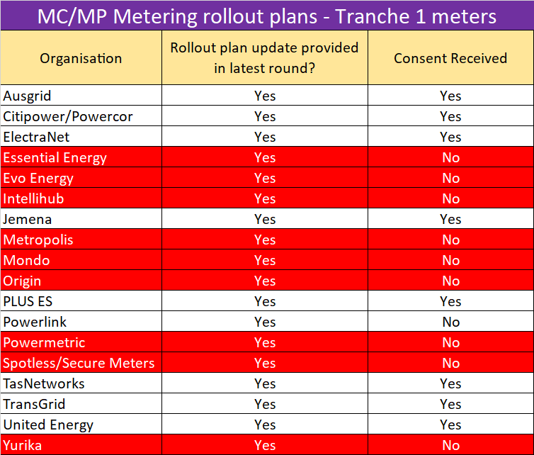
MC/MP Metering rollout plans
Tranche 1 meters
18 Rollout plans received
  8 Participants consented to sharing their plans
Over 99% tranche 1 meter coverage
Over 25% Tranche 1 meters reported as been 5min capable

Slide 27
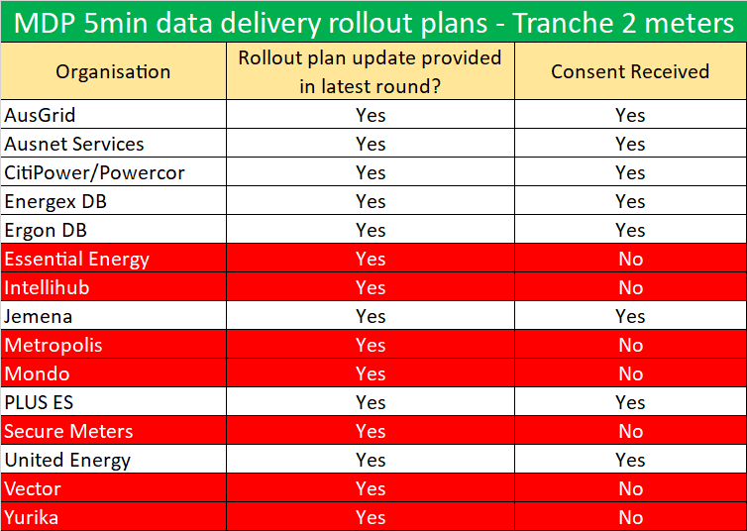
MDP 5min Metering Data Delivery rollout plans
Tranche 2 meters
15 Rollout plans received
  8 Participants consented to sharing their plans
Over 2.6 million meters in total
Conversions mainly commencing from Q1 2022

Slide 28
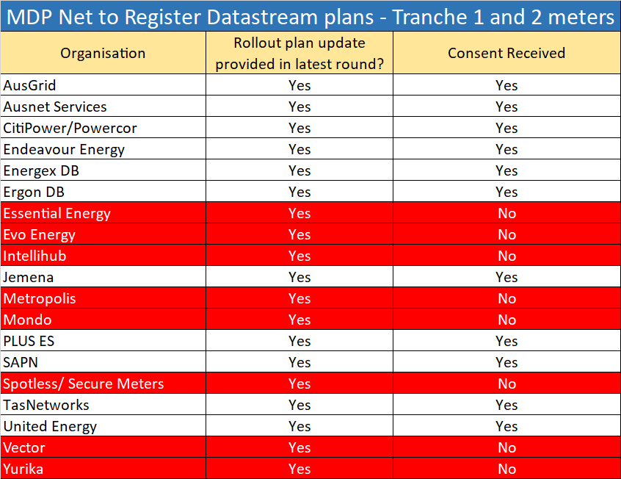
MDP Net to Register Datastream Conversion plans
Tranche 1 and 2 meters
19 conversion plans received
  11 Participants consented to sharing their plans
Over 1.7 million meters in total
Conversions to commence from Q3 this year

Slide 29
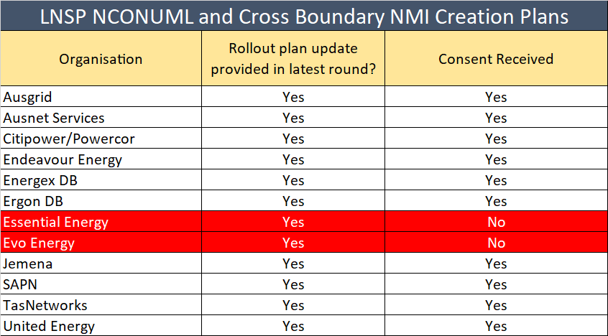
LNSP NCONUML and Cross Boundary
NMI Creation Plans
12 plans received
  10 Participants consented to sharing their plans
~115k NCONUML NMIs expecting to be created

Slide 30
Upcoming v1.7 MTP Activities
Description | Date | Activity ID
MCs to provide visibility of the approach / timeframe for required meter replacement or reconfiguration of ‘unknown’ cross boundary meters | By 31 March 2021 | A23
MCs to ensure that details of the Inventory Table, calculation methodologies and Agreed Loads are agreed prior to implementation by relevant Registered Participants | By 31 March 2021 | A87
AEMO to have the capability to provide 5-min metering data based on SCADA data | By 1 April 2021 | A30
MPs to update the Meter Read Type code with RWDA or RWDD, as applicable, as per the transitional arrangements | From 1 May 2021 | A4a, A9a, A14a, A20a, A25a, A26a, A27a, A28a
AEMO Metering Business to approve MDP NCONUML profiles/algorithms | By 1 May 2021 | A89
MDPs to provide AEMO with NMI lists associated with each NCONUML profile/algorithm | By 1 May 2021 | A89a
MCs to provide progress and amendments to forward plans for Type 1-3, subset of 4 and ‘known’ cross boundary meters to AEMO | By 1 May 2021 | A3a, A8a, A13a, A19a
MDPs to provide progress and amendments to forward plans for Type 1-3, subset 4, 4, 4A, VICAMI and Sample meters to AEMO | By 1 May 2021 | A52a, A58a, A64a, A70a
MDPs to provide datastream conversion plans to convert Net datastreams to register level | By 1 May 2021 | A32a, A37a, A42a, A52b, A58b, A64b, A70b, A82a
LNSPs to provide NMI Create plans for Cross Boundary and NCONUMLs to AEMO | By 1 May 2021 | A95a, A99a

Slide 31
Upcoming v1.7 MTP Activities
Description | Date | Activity ID
Participants to establish agreements to allow the delivery of 5min metering data pre 1 Oct 2021 between NSP, Retailer, MDP and AEMO, as applicable | By 31 May 2021 | A32, A37, A42, A47, A53, A59, A65, A71, A84, A88
MDPs to create/convert export and import Active (kWh) and Reactive (kVarh) energy datastreams, where applicable, in the CNDS table | From 31 May 2021 | A36, A40, A45, A51, A57, A63, A69, A75
Participants to create cross-boundary NMIs, datastreams and registers | From 31 May 2021 | A95, A96, A97
Participants to create NCONUML NMIs, datastreams and registers | From 31 May 2021 | A99, A100, A101
MDPs able to send 15 and 30min metering data via MDFF to AEMO | From 31 May 2021 | A94
LNSPs to apply new NMI classification codes | From 31 May 2021 | A103, A105, A107, A109, A111, A113, A115
MDPs to provide 5min metering data to AEMO (MDFF) (Export and import (active (kWh) and reactive (kVarh)) energy metering data as applicable) | From 21 June 2021 | A35, A41, A46, A50, A56, A62, A68, A74, A86, A92
SAPN to make existing 'Bulk' NMI extinct in MSATS and create/activate individual controlled load datastreams and registers | By 30 June 2021 | A101a, A101b, A102c
MDPs to deliver tier 1 basic meter metering data (Actuals, Subs and Forward Estimates) to AEMO | By 30 June 2021 | A93
MPs Install or reconfigure 5min meters as required | By 31 July 2021 | A4, A9, A14, A20, A24
MPs to apply for data storage exemptions as required | By 31 July 2021 | A5, A10, A15, A21,

Slide 32
MSDR Data Transition WG Update
An initial MSDR WG meeting was held Tues 30 March 2021. The approach to the workshop and outputs were:
Objective
To establish transitional arrangements, where appropriate, to enable an orderly data transition
  Participants proposed and explained preferred holiday/transitional arrangements
Approach
A pack was sent out prior to the meeting, which outlined AEMO’s draft plan for the data transition
Participants were asked to provide indicative CR volumes (including notifications) to help inform the discussions on the day
Suggested prioritisation based on volumes of data (CR and Notifications) being rated highest to lowest
Broke workshop attendees into smaller groups (virtually using the Teams "Breakout groups" function) to discuss lower-level field details
Second workshop planned to occur Thursday 29 April to finalise the transitional arrangements

Slide 33
Risks and Issues
Greg Minney

Slide 34
Purpose of the session
To review critical and significant risks and risks that have changed
Medium risks have been included where they are relevant
There are currently no Readiness related issues logged.
Delay to Retail is an issue that is currently managed by the PCF.

Slide 35
Retail Risks (1/3)
​ | Improving​ ​ No Change /Stable​ ​ Worsened ​
Risk ID | Description | Inherent Rating | Residual Rating | Comments
R33 | Further delays to AEMO Retail Systems impact 5MS rule commencement critical path There is a risk that further delays beyond those identified put the critical path through market trial to 5MS rule commencement (01-Oct-21) at risk | Critical | Significant | Inherent Likelihood: Possible Inherent Consequence: Extreme This risk remains a “significant” risk and is being monitored through checkpoints with the PCF. Trend remains at stable. No issue has been identified that would impact critical path. Residual Likelihood: Unlikely Residual Consequence: Extreme
R34 | Delay to AEMO 5MS Retail impacts participants readiness There is a risk that the delayed availability of the 5MS Retail solution impacts participants readiness programs resulting in delays in some participants programs. | Critical | Significant | Inherent Likelihood: Possible Inherent Consequence: Major Readiness Reporting Round 6 showed majority of participant were on track. None of the respondents noted that the Retail replan had caused a change in their readiness status. While dependencies had been identified e.g. NCONUML, none of the respondents noted their critical capability at risk as a result of the replan. The key impact reported was a decrease in the time available for testing AEMO prosing that Residual Likelihood be set as “Unlikely”, Residual Consequence to remain as “Major” and that this should be reviewed after Round 7. This provides an overall Residual Rating of “Significant”.

Slide 36
Retail Risks (2/3)
​ | Improving​ ​ No Change /Stable​ ​ Worsened ​
Risk ID | Description | Residual Rating (Current) | Comments
R21 | Risk of degraded operational performance at go-live Risk of degraded operational performance at go-live | Medium | Trend remains stable AEMO performance testing has been performed for initial Retail release, with further performance test cycles planned, has been conducted for Bidding and is planned for bidding and planned for settlements Retail Day in the Life testing to be carried out prior to Go-Live Participant metering rollout plans have been consolidated to provide likely rollout timeframes and volumes indicate majority of participant driven volume impact Actions: Proposing that risk remains stable and medium Review risk in May

Slide 37
Retail Risks (3/3)
​ | Improving​ ​ No Change /Stable​ ​ Worsened ​
Risk ID | Description | Residual Rating (Current) | Comments
R17 | Industry 'big bang' approach Potential for Participant systems to fail at go-live due to insufficient transitional provisions e.g. market trial participation and staged system implementation resulting in market disruption (meter data flows and standing data flows) | Significant | Approx. 90% of participants that responded to Round 6 have stated they intend to participate in market trials​ 11 participants indicated intention or willingness to transact in 5-min data prior to commencement date​, a reduction of 3 over the previous survey 21/40 participants indicate intention to undertake retail bi-lateral testing 12/17 generators intend to utilise Bidding transition period prior 1 Oct Action: Continue to monitor through readiness reporting. ​ Trend remains stable
R04 | AEMO Big bang approach AEMO systems for bids/offers and meter data all going live at once on 1 October 2021, results in a failure of go live. | Significant | AEMO proposal to reduce Residual Likelihood to “unlikely” subject to 5MS Bidding Service going live on 01-April. Two deployments will remain and Settlements is on track for 17-May This would result in a residual rating of “Medium” Action: Review risk post Settlements go-live

Slide 38
Industry & AEMO Readiness
​ | Improving​ ​ No Change /Stable​ ​ Worsened ​
Risk ID | Description | Residual Rating (Current) | Comments
R19 | Risk of a critical mass of participants not being ready at identified critical path milestones Critical capability of participants fail to meet expected industry Readiness critical path milestones, resulting in failure to be ready for go-live and impacting the proper functioning of the market. | Medium | Results of Readiness Reporting Round 6 shows that critical capability of respondents is green, on track and stable. Actions: Trend remains as stable and rating remains as Medium Continue to monitor through Readiness Reporting
R02 | Risk that there is one or more participants that aren’t ‘ready’ at go-live Participants may not be ready at rule commencement dates resulting in inadequate systems to operate within new market conditions and an inability to fully or effectively participate in the market. Impact is to the participant rather than compromising a critical capability required for market go-live. | Significant | Coverage in readiness reporting stable at between 86-100% of industry coverage Currently 2 participants reporting programs as late Proactive communication through to smaller participants to highlight 5 MS transition support Actions: Proposing no change to status Review at next quarter
R11 | The AEMO business and operations are not ready for 5MS Rule Commencement on 1 Oct 21 AEMO may not be ready to deliver the full extent of the 5MS deliverables by Go Live, results in failure of Go Live for 5MS and GS Program | Significant | As reported through AEMO’s Readiness Report, the Retail workstream within the 5MS Program is amber which is impacting AEMO’s overall Readiness. Progress on the Retail Go-Live is being monitored through monthly checkpoints with the OCF. Currently, AEMO remains on track for Retail Go-Live on 31-May. Actions: Proposing that the rating remains as significant. Continue to monitor through Readiness Reporting

Slide 39

Any other risks or issues to be raised?

Slide 40
Origin’s proposed changes to GS Market Trial
Fergus Stuart, Origin

Slide 41
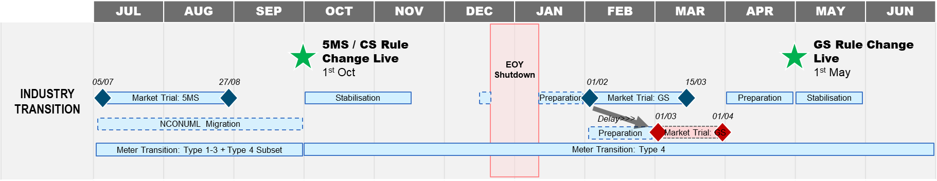
Origin proposal - GS Market Trials
Origin proposes AEMO delays and reduce the window of GS Market Trials highlighted in pink/red below
RATIONALE
1) OFF MARKET BASED UPDATES:
The bulk volumes of updates will be processed via off market processes, therefore significantly reducing the necessity for market testing / verification for Retailers (minimum regression testing is required).
2) SCHEDULE & RESOURCE OPTIMISATION
The delay and reduction of market trial window will allow schedule and resource optimisation permitting 5MS / Industry resources to be repointed to other initiatives (for example as MSDR).

Slide 42
Industry Discussion points
Initial views on timing and extent of Global Settlement Market Trial
Program approaches to implementation of GS:
  Retailer
  DNSP
  MDP
Other Program alignment benefits or disadvantages
Please provide feedback to 5MS@aemo.com.au by Tuesday 20-Apr-21

Slide 43
Retail/ Metering Readiness
Jim Agelopoulos

Slide 44
Retail Metering
Staging, Pre-production & Production timelines
Updated to reflect replanned pre-prod and prod dates
Date to be confirmed.
Staging
31 Oct 2020
01 Oct 2021
GS from 1st quarter 2021 - TBC
Pre-production
19 Apr 2021
5 Jul 2021
1 Feb 2022
Production
31 May 2021
1 Oct 2021
1 May 2022
Legend
Legacy | 30MS with new platform | 5MS Rule | GS Rule
30-minute meter reads | 30-min settlement 5-min reads supported Standing data updates for GS | UFE calculation and 5-min settlement | LR updated to GLOPOOL

Slide 45
Systems Workstream – Metering
Current as at 12-02-2021
Updated to reflect replanned pre-prod and prod dates
R3 Go-live : 31/05/21
5 MINUTE SETTLEMENT SYSTEMS TRACKING | TIMING
 | Internal HLIA | Focus/Group | SWG Engagement | External HLIA | Draft Tech Spec | Final Tech Spec | User Guides | 5MS Staging | Preprod | Production
METERING
PACKAGE 1 - Metering Data & Metrology
MDFF • MDFF Specification NEM12 NEM13 v20 | Aug-18 | Oct-18 | Oct-18 | Nov-18 | Jan-19 | Apr-19 | - | 1-Dec-19 | 19-Apr-21 | 31-May-21
PACKAGE 2 - MSATS & SLPs
Transition • MSATS Technical Specification | Aug-18 | Sep-18 | Aug-18 | Nov-18 | 31-May-19 | 30-Sep-19 | - | - | - | -
Meter Data - MDFF and MDMF • MDM File Format and Load Process (User Guide) • MSATS Technical Specification | Aug-18 | Oct-18 | Sep-18 | Nov-18 | 31-May-19 | 30-Sep-19 | - | 1-Dec-19 | 19-Apr-21 | 31-May-21
PACKAGE 3 - Miscellaneous
B2M via API • MSATS Technical Specification | Oct-18 | - | Apr-19 | 9-May-19 | 31-May-19 | 30-Sep-19 | 01-Jun-20 (Draft) | 15-Jun-20 | 19-Apr-21 | 31-May-21
 |  |  |  |  |  |  | 14-Sep-20 (Final)
MSATS Browser (LVI) changes • MSATS Technical Specification | Aug-18 | - | May-19 | 9-May-19 | 28-Jun-19 | 30-Sep-19 | 10-Oct-20 | 15-Jun-20 | 19-Apr-21 | 31-May-21
MSATS Report changes • MSATS Procedures MDM Procedure • MDM File Format and Load Process (User Guide) • MSATS Technical Specification General Process & Document Clean-up | Oct-18 | - | Apr-19 | Apr-19 | 28-Jun-19 | 30-Sep-19 | - | 31-Aug-20 | 19-Apr-21 | 31-May-21

Slide 46
Pre-prod cutover
On 8 April, AEMO will provide a Go/No-Go decision for its deployment of the Retail solution into the pre-production environment. The Retail Industry Test period will commence on 19 April.
To facilitate the cutover, there will be an outage in the MSATS pre-production environment from 10 to 16 April. This does not impact AEMO’s production environment, or the Wholesale pre-production environment.
AEMO will communicate the availability of pre-production at the completion of the cutover activity, and the availability of the environment for participant usage, which may be prior to 19 April.
For the pre-prod cutover:
  B2M processing is expected to be unavailable for 34 hours
  B2B processing is expected to be unavailable for 12 hours
The production cutover schedule will be refined based on learnings from the pre-prod cutover.

Slide 47
Production cutover update
DR2b has been completed, providing a firm basis for cutover to pre-prod
The 5MS retail platform industry go-live plan will be updated after the pre-prod cutover, including refined timings of B2M and B2B outage periods.
Key Aspects / Consideration:
  Length of time B2B and B2M processing will be unavailable during cutover
  MDP/ DNSP / Retailer Timing for processing of held B2M / B2B transaction and "catch up" processing:
    Metering Data
    CATS Transactions
    Service Orders
  Online access to MSTATS during period of cutover
  VPXP replaced by NEMMCO
  PVM timing and participation
  Communications
    Progress
    Issues
  Participants to consider how to restart processing after B2M and B2B outages

Slide 48
Dispatch / Bidding Update
Ian Devaney

Slide 49
Bidding / Dispatch
Staging, Pre-production & Production timelines
No change
For business continuity reasons, 30-mins offers and bids will be accepted until 01 Oct 21
STAGING
01 Oct 2021
PRE-PRODUCTION
29 Nov 2020
05 Jul 2021
PRODUCTION
01 Apr 2021
01 Oct 2021
LEGEND
LEGACY | BIDDING TRANSITION | 5MS RULE
30-minute bidding only via: FTP (txt) Web Bidding (Legacy) | 30-minute bidding via: FTP (txt) Web Bidding (Legacy) 5-minute bidding* via: FTP (JSON) Web Bidding (5MS) API *Each 5-minute bid within each half hour must be identical, giving the same effect as the submission of a 30-minute bid. | 5-minute bidding* only via: FTP (JSON) Web Bidding API *30-minute bid emulation restriction lifted

Slide 50
Systems Workstream – Dispatch & Operations
Changes Highlighted
5 MINUTE SETTLEMENT SYSTEMS TRACKING | TIMING
 | Internal HLIA | Focus/Group | SWG Engagement | External HLIA | Draft Tech Spec | Final Tech Spec | User Guides | 5MS Staging | Preprod | Production
DISPATCH and OPERATIONS
PACKAGE 1 - Bidding FTP and API
Transition | Aug-18 | Oct-18 | Aug-18 | Nov-18 | Dec-18 | 2-Apr-19 | 31-Oct-19 | 29-Nov-19 | 30-Nov-20 | 01-Apr-21
Bidding Data Model | Aug-18 | - | Sep-18 | Mar-19 | Dec-18 | 2-Apr-19 | 31-Oct-19 | 29-Nov-19 | 30-Nov-20 | 01-Apr-21
Bidding Format | Aug-18 | - | Sep-18 | Nov-18 | Dec-18 | 2-Apr-19 | 31-Oct-19 | 29-Nov-19 | 30-Nov-20 | 01-Apr-21
PACKAGE 2 - Bidding Web UI
Bidding Web UI and APIs | Aug-18 | Nov-18 | Dec-18 | Jan-19 | Mar-19 | 31-Jul-19 | 16-Dec-19 | 29-Nov-19 | 30-Nov-20 | 01-Apr-21
PACKAGE 3 - Dispatch, Pre-dispatch and PASA
Dispatch | Aug-18 | - | Oct-18 | Nov-18 | Oct-18 | 2-Apr-19 | - | 29-Nov-19 | 30-Nov-20 | 01-Apr-21
Predispatch P30/7DAY | Aug-18 | - | Oct-18 | Nov-18 | Oct-18 | 2-Apr-19 | - | 29-Nov-19 | 30-Nov-20 | 01-Apr-21
Pre-dispatch P5 - Fast Start Inflexibility Profile | Nov-18 | Jan-20 | Nov-18 | Jan-20 | May-20 | 10-Nov-20 | - | - | 01-Apr-21 | 03-May-2021
5MPD - Price Sensitivities | - | Jan-20 | Nov-18 | Jan-20 | May-20 | 10-Nov-20 | - | - | TBC | TBC
ST and PD PASA | Aug-18 | - | Oct-18 | Nov-18 | Oct-18 | 2-Apr-19 | 31-Oct-19 | 29-Nov-19 | 30-Nov-20 | 01-Apr-21
PACKAGE 4 - Pricing and Miscellaneous
Trading Price / Price Revision | Aug-18 | - | Feb-19 | Nov-18 | Mar-19 | 31-Jul-19 | - | 15-May-20 | 05-Jul-21 | 01-Oct-21
Administered Pricing and CPT | Aug-18 | - | Feb-19 | Dec-18 | Mar-19 | 31-Jul-19 | - | 15-May-20 | 05-Jul-21 | 01-Oct-21
Suspension Pricing | Sep-18 | - | Feb-19 | Dec-18 | Mar-19 | 31-Jul-19 | - | 15-May-20 | 05-Jul-21 | 01-Oct-21
Negative Residue Management | Sep-18 | - | Feb-19 | Dec-18 | Jun-19 | 31-Jul-19 | - | 15-May-20 | - | -
RERT | Oct-18 | - | - | - | - | - | - | - | - | -
PACKAGE 5 - Full Data Model
Full Data Model | Sep-18 | Ongoing | Ongoing | Apr-19 | Ongoing | 31-Jan-20 | 16-Mar-20 | 29-Nov-19 | 30-Nov-20 | 01-Apr-21

Slide 51
5MS Bidding Service Go-Live –
01 April 2021
MSUG discussing 5MS and non-5MS changes to Data Model v5.0
  FAQs will be published on the website
5MS Bidding Portal Walk through – 21 April 2021
Verbal update to be provided on 5MS Bidding Service Go-Live

Slide 52
Settlements Update
Mark Hillaby

Slide 53
Settlements
Staging, Pre-production & Production timelines
Supports 30MS, 5MS and GS modes
APIs for Settlements Direct and Prudential dashboard added
Staging
1 Oct 2021
Incl. UFE Reporting from 05/07/21
Pre-production
22 Mar 2021
5 Jul 2021
1 Feb 2022
Production
17 May 2021
1 Oct 2021
1 May 2022
Legend
Legacy | 30MS with New Settlement Platform | 5MS Rule | GS Rule
30-minute Settlements | The 5MS capable solution is available in the relevant environment, however 30-minute settlement will remain until the environment reflects the 5MS Rule solution | Five-minute settlement and Global Settlement soft-start - UFE Reporting | All Retailers become liable for UFE

Slide 54
Systems Workstream – Settlements
Current as at 22-03-2021
5 MINUTE SETTLEMENT SYSTEMS TRACKING | TIMING
 | Internal HLIA | Focus/Group | SWG Engagement | External HLIA | Draft Tech Spec | Final Tech Spec | User Guides | 5MS Staging | Preprod | Production
SETTLEMENTS
PACKAGE 1 - Reallocations
Reallocations | Dec-18 | Nov-18 | Dec-18 | Mar-19 | 31-Jul-19 | 15-Oct-19 | 1-Nov-19 | 1-Nov-19 | 1-Mar-20 | 1-Apr-20
PACKAGE 2 - Settlements and Billing
Settlements | Oct-18 | Nov-18 | Dec-18 | Mar-19 | 30-Aug-19 | 15-Dec-19 | - | 16-Mar-20 | 22-Mar-21 | 17-May-21
Billing | Oct-18 | Nov-18 | Dec-18 | Mar-19 | 30-Aug-19 | 15-Dec-19 | - | 16-Mar-20 | 22-Mar-21 | 17-May-21
PACKAGE 3 - Prudentials and Estimation
Prudentials | Sep-18 | Nov-18 | Dec-18 | Mar-19 | 31-Oct-19 | 31-Jan-20 | 15-May-20 | 15-May-20 | 22-Mar-21 | 17-May-21
Estimation | Oct-18 | Nov-18 | Dec-18 | Mar-19 | 31-Oct-19 | 31-Jan-20 | - | 15–May-20 | 22-Mar-21 | 17-May-21
Full Data Model | Refer DISPATCH
Pre-prod and Production dates updated as a consequence of Retail re-plan.

Slide 55
Settlements Implementation Plan
Full description of implementation principles is set out in the Industry transition and go-live strategy at: https://aemo.com.au/Electricity/National-Electricity-Market-NEM/Five-Minute-Settlement/Readiness-Workstream/Key-Readiness-Documents.
  Rules start dates must be met
  Operation of the NEM must be uninterrupted
  Flexibility in implementation must be maximised for Participants.
  Participants and AEMO are each responsible for their own transition and go-live planning.
In addition, the following principles are specific to this plan:
  AEMO must keep Participants informed with status updates during implementation.
  Participants must comply with directions from AEMO during implementation.
Update 30/3/2021: No objections were raised by Participants:
Changed 'shutdown' time to 2 pm on Friday 14 May. This might still be adjusted to 3 pm if required.
Minor corrections for clarity.
Timings in Pre-prod were generous, release was completed on time.

Slide 56
Debrief on Pre-prod Release
Successful deployment of Settlements solution into pre-prod
Settlements Industry Test commenced on 22-Mar as scheduled
Currently in 30-min mode
Three settlement runs due to be released by 30-Mar with Q&A session scheduled (RWG, SWG, ITWG) for 31-Mar as support
Additional settlement runs will be released once the 5MS Retail system has been deployed into pre-prod
Will change to 5-min mode in July for Market Trial

Slide 57
Forward Plan and Other Business
Greg Minney

Slide 58

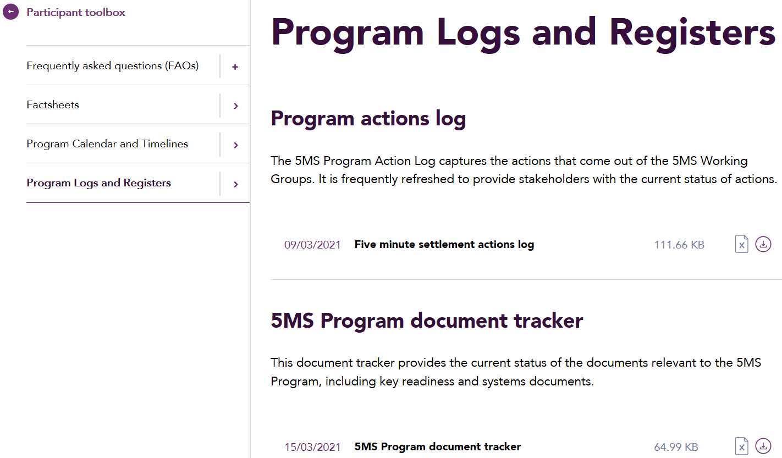
Document tracker updates
For March
Document/ Item | Version | Status | Type
MSATS 46.99 Technical Specification | 1.02 | Draft | Technical specification
MSATS 46.99 Technical Specification - marked up | 1.02 | Draft | Technical specification
Metering transition plan (Spreadsheet) | 1.7 | Final | Key readiness document
Industry go-live plan: Bidding | 1.0 | Final | Key readiness document
Draft EMMS Technical Specification - 5MS - Data Model v5.00 | 3.02 | Draft | Technical specification
Draft EMMS Technical Specification - 5MS - Data Model v5.00 - Marked up | 3.02 | Draft | Technical specification
This page will appear in all RWG packs moving forward to represent the updates that were made to 5MS and GS documents for the preceding month.
This information is also captured within the document tracker, with recently updated documents highlighted in yellow.
Where is the document tracker located?
The document tracker is located in the Participant toolbox under the Program Logs & Register menu option.

Slide 59
RWG 2021 Proposed Topics
*Dates depend on Checkpoint outcomes
Month | Topics | Month | Topics
January | Preparing for Retail Invitation Industry Test Platform Go Lives criteria Market Commencement criteria Risk Review | 02-June | Preparing for Market Trial Metering rollout progress Risk review – any Market Trial risks? Approach to Global Settlements engagement
09-February | Update on Retail systems go-live changes Metering Transition Preparation | 06-July | Market Trial progress, Readiness Reporting #8 Market Commencement Criteria
02-March | Retail Go-Live Update Preparing for 5MS Bidding Cutover Settlements Industry Test Readiness Reporting #6 5MS Market Trial – planning approach | 03-August | Market Trial progress Go-Live risks
06-April | Retail Go-Live Update – checkpoint outcomes Debrief on Bidding go-live Debrief on Settlements Industry Test commencement 5MS Market Trial – planning update Metering provider implementation planning Risk review | 07-September | Results of Market Trial, Preparing for 1 Oct – Ind Go-Live Plan review Readiness Reporting #9
04-May | Retail Go-Live Update and preparing for cutover Readiness Reporting #7 Preparing for Settlements Cutover Approach to Global Settlements engagement 5MS Market Trial approach Industry Go-Live plan approach | TBC-October | Debrief and reconfirmation of approach for Global Settlements

Slide 60
ITWG 2021 Proposed Topics
Month | Topics | Month | Topics
January | Retail invitation test plan Status of Dispatch and Bidding in Pre Prod | June | Final review of tests for market trials Review of production across all 5MS systems
February | Retail invitation test plan and participant involvement Settlements Industry Test Market Trail approach to preparation | July | Results of Market Trials
23-March | Settlement Platform industry testing Nomination for MTFG to define test approach for Market Trials | August | Results of Market Trials
27-April | Test scenario review in preparation for market trials Status of Dispatch and Bidding in Production | September | General update on upcoming market start
May | Review pairing and finalise market trials Status of Settlements in Production

Slide 61
Upcoming meetings
https://aemo.com.au/initiatives/major-programs/nem-five-minute-settlement-program-and-global-settlement
Current as at 24/03/2021

Slide 62
Questions

Slide 63
Procedure update
Simon Tu

Slide 64
5MS/GS-related procedure change log
Procedure issue | Status | Final Determination Date
Consolidation of Retail Electricity Procedures | Consultation to commence May-2021 The consolidation of Procedures will not be a full consultation as the Procedures (BAU and 5MS/GS) have already gone through their respective formal consultations. | 30-Jun-2021
Update to published settlement formulas* | 5MS/GS & Customer Switching B2M Consultation commenced 12-Jan-2021, first submissions closed 18-Feb-2021 | 17-May-2021
Cross Boundary (CB) connections, inclusion of cross boundary energy formulas and a Change Request type for CB updates update * | 5MS/GS & Customer Switching B2M Consultation commenced 12-Jan-2021, first submissions closed 18-Feb-2021 | 17-May-2021
MDFF Specification NEM12 & NEM13 update to clarify MDP obligation where a NULL exists in their systems | 5MS/GS & Customer Switching B2M Consultation commenced 12-Jan-2021, first submissions closed 18-Feb-2021 Related to Endeavour Energy’s feedback of the Aug-2020 Metering ICF Package update of the MDFF Specification to remove the ‘N’ quality flag. | 17-May-2021
Clarification on existing requirements for the 5-minute load profile and RM reports | Consultation commenced 12-Oct-2020. Part of the Retail Procedures (Wholesale Demand Response) consultation. | Mar-2021
*raised by the 5MS Program
# aseXML schema impact

Slide 65
5MS/GS-related procedure change log – no change
Procedure issue | AEMO Retail Systems Impact | Available in Staging | Readiness Considerations
Consolidation of Retail Electricity Procedures | No impact to 5MS Retail systems. | N/A | N/A
Update to published settlement formulas* | No impact to 5MS Retail systems. | N/A | N/A
Cross Boundary (CB) connections, inclusion of cross boundary energy formulas* | No impact to 5MS Retail systems. | N/A | N/A
MDFF Specification NEM12 & NEM13 update to clarify MDP obligation where a NULL exists in their systems | No impact to 5MS Retail systems. | N/A | N/A
Clarification on existing requirements for the 5 minute load profile and RM reports | 5MLP included in RM20 and RM25 reports | R27 - 31-Oct-20 - Existing Settlements Reports @5-min: RM16, RM17, RM20, RM21, RM22, RM26 | N/A
Proposed procedural change to MDFF quality flag (N flag)* | Rejection of B2M MTRD MDFF meter reads where quality flag is ‘N’. Results in B2M MTRD Transactions with the status of ‘Partial’ or ‘Rejected’. | R1 - 1-Dec-19 - Support for new B2M MTRD validations. | Participant Mkt Systems must not send ‘N’ for B2B or B2M MTRDs.
Removal of end user details from inventory table | No impact to 5MS Retail systems. | N/A | N/A
Removal of register ID = suffix requirement | No impact to 5MS Retail systems. | N/A | Material participant readiness activity impact as the existing requirement is to be retained.
*raised by the 5MS Program
# aseXML schema impact
Notes:
Removed:
10MB file size

Slide 66
5MS/GS-related procedure change log – no change
Procedure issue | AEMO Retail Systems Impact | Available in Staging | Readiness Considerations
Proposal for RWD | No impact to 5MS Retail systems. | N/A | ReadTypeCode amended from ‘Optional’ to ‘Required’. Fourth character added to identify whether a meter is capable of reading at five-minute granularity. 4th char field is already avail for data updates in PROD
TNI 2 for cross-boundary meters *# | CATS CR support for TNI2 field. MSATS Browser to support display TNI2 for NMI Discovery Transactions. aseXML schema support extension to support TNI2 inclusion (r39). | R18 and R19 - 31-Aug-20 - Support for TNI2 for CATS CRs. | TNI Code assigned, by AEMO, however Participants to undertake the generation of associated CR2xxx transactions, to register a cross boundary meter using TNI 2. Migration to r39 aseXML necessitated.
New NCONUML NMI Class codes available in list for SORD #​ | Likely B2B schema change. AEMO confirms that the Electricity B2B changes for v3.5 will be made available in pre-production in September or early October 2021. The changes will be in pre-production for a minimum of 4 weeks. 5MS will have to merge the changes from Electricity B2B for the GS May 2022 release. | TBD | 10-Nov-2021 effective date decided as part of the regulator implementation roadmap.
*raised by the 5MS Program
# aseXML schema impact
Notes:
Removed:
10MB file size

Slide 67
Appendix

Slide 68
Readiness Reporting Actions and Follow ups – Round 6
No. | Status | Action | Comment
6.1 | Open | AEMO to confirm progress and status of non-responding TNSP's readiness activities | Participant confirmed that a response will be provided in future rounds of reporting
6.2 | Open | AEMO to seek clarification from generator reporting 'late' and if remediation action is successful | Participant noted that they are ‘’late’ based on their own project schedule and not for 1 Oct 21
6.3 | Open | AEMO to monitor status of MDP reporting that their overall program is 'at risk' in round 7 of readiness reporting | Participant noted that they expect to be late for the MTP transition end date for Type 1-3 5-minute meter data delivery, but will be on track before 1 Oct 21
6.4 | Open | AEMO to follow up with TNSP reporting 'at risk' to understand timing of remediation | Participant noted that they are ‘’late’ based on their own project schedule and not for 1 Oct 21
6.5 | Open | RWG to consider if risks raised by respondents in readiness reporting should be captured as industry risks | Discussion held at RWG 21.
6.6 | Open | AEMO to follow up with MP/MC with essential meters reporting a 'late' status to confirm timing of remediation | Participant outlined their remediation plan and contingency approaches, confirming that MTP activities are expected to be completed by the transition end dates
6.7 | Open | AEMO to clarify 5-minute bidding go-live approach with generators that are not planning to utilise the bidding transition period, and establish level of industry risk | Readiness survey amended to allow generators to provide further details if there are not planning to submit 5-minute bids before during the bidding transition period before 1 Oct 21

Slide 69
Readiness Reporting Actions and Follow ups – Round 6
No. | Status | Action | Comment
6.8 | Open | AEMO to follow up with MP responding that 'S09 - New and replacement SAMPLE meters' is 'at risk' to confirm status and if remediation is required. | AEMO to follow up with participant and provide update in the next readiness report
6.9 | Open | AEMO to follow up with MP responding that 'S01 - BULK/ Wholesale Meters', 'S02 - Type 1 - 3 Meters', and 'S03 - Subset of type 4 meters - TNI, Market Generator or SGA' is late to confirm timing on remediation and if escalation is required | Participant outlined their remediation plan and contingency approaches, confirming that MTP are expected to be completed by the transition end dates
6.10 | Open | AEMO to follow up with MP responding that 'S15 - Cross Boundary meters (KNOWN)' and 'S20 - New and replacement SAMPLE Meters' is 'at risk' to confirm status and if remediation is required. | AEMO to follow up with participant and provide update in the next readiness report
6.11 | Open | AEMO to follow up with MP responding that 'S41 - MP accreditation update (for 1 Oct 2021)' is 'late' to confirm remediation and consider if escalation is required | Participant outlined their remediation plan and contingency approaches, confirming that MTP are expected to be completed by the transition end dates
6.12 | Open | AEMO to follow up with MDP responding that 'S24 - Tier 1 basic metering data' is 'late' to confirm delivery timing | Participant is unable to complete MTP activities before the MTP transition end dates, and will not be able to send a full cycle of Tier 1 basic metering data before 1 Oct 21
6.13 | Open | AEMO to follow up with MDP responding that 'S14 - Type 1-3, subset of Type 4' is 'at risk' to confirm status and if remediation is required. | Participant noted that they are ‘’late’ based on their own project schedule and not for 1 Oct 21

Slide 70
Readiness Reporting Actions and Follow ups – Round 6
No. | Status | Action | Comment
6.14 | Open | AEMO to follow up with MDP responding that 'S37 - Interval meter datastreams' is 'at risk' to confirm status and if remediation is required | Participant noted that this MTP subcategory is not applicable to them as they are not a MDP for sample meters
6.15 | Open | AEMO to follow up with MDP responding that 'S36 - Tier 1 basic meter datastreams' is 'late' to confirm status and if remediation is required | Participant is unable to complete MTP activities before the MTP transition end dates, and will not be able to send a full cycle of Tier 1 basic metering data before 1 Oct 21
6.16 | Open | AEMO to follow up with MDP responding that 'S27 - Non-contestable metered loads' is 'late' to confirm status and if remediation is required | Participant is unable to complete MTP activities before the MTP transition end dates, however expect to be in a position to delivery NCONUML data to AEMO by 1 Oct 21
6.17 | Open | AEMO to follow up with MC responding that 'S01 - BULK/Wholesale Meters', 'S02 - Type 1-3 Meters', 'S03 - Subset of type 4 meters, TNI, Market Generator or SGA' is 'late' to confirm remediation plans and if escalation is required | Participant outlined their remediation plan and contingency approaches, confirming that MTP are expected to be completed by the transition end dates
6.18 | Open | AEMO to follow up with MC responding that 'S02 - Type 1-3 Meters' is 'at risk' to confirm remediation plans and if escalation is required | Participant noted that they are ‘’late’ based on their own project schedule and not for 1 Oct 21

