Slide 1
5MS & GS Readiness Working Group #23 (incl. Systems Working Group)
Tuesday 4 May 2021
WebEx only: **Please disconnect from your workplace VPN for the WebEx call**
PLEASE NOTE THIS MEETING WILL BE RECORDED FOR THE PURPOSE OF PREPARING MINUTES

Slide 2

AEMO Competition Law
Meeting Protocol
AEMO is committed to complying with all applicable laws, including the Competition and Consumer Act 2010 (CCA). In any dealings with AEMO regarding proposed reforms or other initiatives, all participants agree to adhere to the CCA at all times and to comply with this Protocol.
Participants must arrange for their representatives to be briefed on competition law risks and obligations.
Participants in AEMO discussions must:
Ensure that discussions are limited to the matters contemplated by the agenda for the discussion
Make independent and unilateral decisions about their commercial positions and approach in relation to the matters under discussion with AEMO
Immediately and clearly raise an objection with AEMO or the Chair of the meeting if a matter is discussed that the participant is concerned may give rise to competition law risks or a breach of this Protocol.
Participants in AEMO meetings must not discuss or agree on the following topics:
Which customers they will supply or market to
The price or other terms at which Participants will supply
Bids or tenders, including the nature of a bid that a Participant intends to make or whether the Participant will participate in the bid
Which suppliers Participants will acquire from (or the price or other terms on which they acquire goods or services)
Refusing to supply a person or company access to any products, services or inputs they require.
Under no circumstances must Participants share Competitively Sensitive Information. Competitively Sensitive Information means confidential information relating to a Participant which if disclosed to a competitor could affect its current or future commercial strategies, such as pricing information, customer terms and conditions, supply terms and conditions, sales, marketing or procurement strategies, product development, margins, costs, capacity or production planning.

Slide 3
Agenda
Greg Minney

Slide 4
Agenda
**Please disconnect from your workplace VPN for the WebEx call**
# | Time | AGENDA ITEM | Responsible
1 | 10:00 – 10:05 | Welcome and Agenda | Greg Minney
2 | 10:05-10:10 | Minutes/Actions | Anne-Marie McCague
General Update
3 | 10:10 – 10:20 | 5MS Program Update | Greg Minney/ Graeme Windley
4 | 10:20 – 10:40 | Industry Readiness Report #7 | Blaine Miner
5 | 10:40 – 11:10 | Contingency Planning | Anne-Marie McCague / Greg Minney
6 | 11:10 – 11:20 | Industry Testing Update | Tui Grant
7 | 11:20 – 11:40 | TFG/ MTP Update | Blaine Miner
8 | 11:40 – 11:45 | Procedure update | Simon Tu
9 | 11:45 – 11:50 | 5MS Staging Environment availability | Greg Minney
 | Settlements Readiness
9 | 11:50 – 12:05 | Settlements Update | Mark Hillaby
Retail/ Metering Readiness
10 | 12:05 – 12:30 | Retail / Metering Update | Jim Agelopoulos / Graeme Windley
Dispatch / Bidding Readiness
11 | 12:30 – 12:35 | Dispatch / Bidding Update | Ian Devaney
Meeting Closing Items
12 | 12:35 – 12:45 | Feedback on Origin’s proposed changes to GS Market Trial | Greg Minney
13 | 12:45 – 12:50 | Forward Plan and Other Business | Greg Minney
14 | 12:50 | Meeting Close | Greg Minney

Slide 5
Minutes & Actions
Anne-Marie McCague

Slide 6
RWG Actions
No. | Status | Action | Comment
21.4.2 | Closed | Local Retailers to provide assessment of materiality of NCONUML for greater industry visibility of impact on UFE | One response received noting that there is a small impact
22.4.1 | Closed | AEMO to provide clarity on how 5MS working groups will be updated on MSDR activities. | Correspondence, outcomes and requests from the MSDR WG are being shared with the TFG and RWG. Any subsequent implications are discussed and considered in the following TFG.
22.6.1 | Closed | AEMO to confirm whether they intend to provide an extension to the deadline for cross-boundary meters as a result in the delay in publishing the guideline. | AEMO does not intend to provide an extension on the deadline for cross-boundary meters.
22.6.2 | Closed | AEMO to confirm that all NCONUML NMIs are to be provided to AEMO including the profile. | Requirement is to provide for each algorithm the number of NMIs and the energy volume as part of the template. The individual NMI IDs are not required.

Slide 7
No. | Status | Action | Comment
22.7.1 | Closed | RWG to consider whether action R02 can be considered superseded by R19 and therefore can be closed. | See next slide.
22.7.2 | Open | AEMO to consider incorporating the impact of increased CATS transaction volumes from initiatives such as MSDR into 5MS readiness risks | In discussion with MSDR team to establish overall AEMO ownership of this risk.
N/A | N/A | AEMO to include WDR and Customer Switching release dates in the 5MS Functionality Deployment Matrix | AEMO will release a draft by the end of May.

Slide 8
Proposal to Close R02
Risk ID | Description | Residual Rating (Current) | Comments
R19 | Risk of a critical mass of participants not being ready at identified critical path milestones Critical capability of participants fail to meet expected industry Readiness critical path milestones, resulting in failure to be ready for go-live and impacting the proper functioning of the market. | Medium | Results of Readiness Reporting Round 6 shows that critical capability of respondents is green, on track and stable.
R02 | Risk that there is one or more participants that aren’t ‘ready’ at go-live Participants may not be ready at rule commencement dates resulting in inadequate systems to operate within new market conditions and an inability to fully or effectively participate in the market. Impact is to the participant rather than compromising a critical capability required for market go-live. | Significant | Coverage in readiness reporting stable at between 86-100% of industry coverage Currently 2 participants reporting programs as late Proactive communication through to smaller participants to highlight 5 MS transition support

Slide 9
5MS Program Update
Greg Minney

Slide 10
5MS Program Timeline
Readiness and Go-Live
User Acceptance Testing is in progress for both Retail and Settlements
Performance Testing is complete for Settlements and in-progress with Day in the Life testing for Retail
Settlements Industry Test Period ongoing
Retail solution available for participant testing from 16-Apr-21
5-min Bidding Phased Go-Live achieved on 01-Apr-21

Slide 11



Approach to Retail Status Updates
19-Apr
Retail Industry Testing Commences
14-May
Retail Go/No-Go Communicated to PCF via email
31-May
5MS Retail/ Metering
Solution Go-Live
Key milestones
08-Apr
Pre-Prod Go/No-Go email
18-Feb PCF
Forward Planning for Retail
Update on Interim Checkpoint Criteria Status
23-Apr PCF
April Checkpoint Criteria - assessment and outcomes
Go/No-Go – confirm date
19-May PCF
Confirming Go/No-Go
Issue management
Replanning (if necessary)
18-Mar PCF
March Checkpoint Criteria – assessment and outcomes
Pre-prod – status and go/no-go date
Production go-live – checkpoint date and criteria, go/no-go date
07-May
PCF Update Session
Communication timeline

Slide 12
April Retail Checkpoint Criteria as at 16-Apr – Verbal update to be provided on 4-May
Criteria​ | Description | Status | Commentary
Testing | All UAT test cases executed with no critical defects that cannot be remedied for 31 May go-live. | In Progress | Data-related defects have caused the UAT target completion date to push out to 30-Apr. There will be defect resolutions that will need to go into May. The program needs to see UAT complete before it can commit that all critical defects can be remedied in time for 31 May go-live.
Solution Stability | End-to-end solution operating stably in Test with no process blockers or unexplainable pauses/interruptions to processing. | ✓ | Stability has improved, and enabled testing execution to progress. Improvements (i.e. defensive programming) introduced have been successful.
Remediation | Known remediation work (internal reports performance, business activity monitoring) completed and remediation for any new defects scheduled. | In Progress | Internal work on Operational Reporting and Business Activity Monitoring has progressed well. However there remains work to do to ensure key Operational Reports are ready for go live as per AEMO business team expectations.
Performance | “Day in the Life Testing” completed with no performance issues identified that cannot be remedied for 31 May go-live. | In Progress | Some delays starting, now in progress and initial results from 2 / 5 runs are positive.
Pre-Production | Data migration on track and no blockers to meeting criteria/schedule for pre-production deployment. | ✓ | Pre-production deployment complete. Reviewing timeline for go-live cutover from lessons learnt.
Industry Test | On track to commence Retail Industry Test on 19 April. | ✓ | Industry testing available from 15-Apr Retail industry invitation testing to commence on 19-Apr as scheduled.
Overall |  |  | Overall, the Retail workstream remains amber for 31 May go-live. There are currently no blockers to achieving 31 May go-live, and the project remains committed to meeting this date. However, as per the above, there are still a number of outstanding items that is putting pressure on meeting the timeframe.

Slide 13
Contingency Planning

Slide 14
Purpose of this section
Provide an overview of 5MS Contingency Planning
Discuss the addition of the Retail delay risk to the 5MS Contingency Plan and the approach to developing the contingency
Review the risk and proposed contingency options
Review the Regulatory tools that may be used to achieve the contingency response
Discuss initial thoughts from RWG

Slide 15
Overview of Industry Contingency Planning to date
Industry Contingency plan developed by RWG in April 2020
26 contingency scenarios identified, with associated monitoring , responses and trigger points
Scenarios coverage includes:
  AEMO “Not Ready” to operate for 5MS Rule commencement
  Minimum / Essential criteria not met for 5MS Rule Commencement
  Essential Meters not fully compliant at 5MS rule Commencement
  Essential Meter(s) metering data delivery issues
  Delays to platform deployments
  Platform Deployment failures
  Post go-live inaccuracies and issues
Where applicable contingency responses utilise existing NEM operating processes
Monitoring Mechanism a number of scenarios include monitoring of participant and AEMO progress via readiness reporting and completion of planned milestones
As component of RWG readiness reporting assessment will be made against identified contingency scenarios for contingency implementation

Slide 16
Contingency Plan Extract
5MS GS INDUSTRY READINESS CONTINGENCY PLAN |  |  |  |  |  |  | 5-Jun-20
Contingency Scenario Ref | Industry Risk Ref | Contingency Scenario | Scenario Description | Scenario Category | Priority (H/M/L) | Likelihood (H/M/L) | Impacted Stakeholders | Triggers | Monitoring Mechanism | Response
C1 | R14, R15, R16, R17 | Minimum criteria not met for 5MS/GS commencements | Minimum criteria (defined in Industry readiness contingency plan word document) not met for 5MS/GS commencements resulting in critical impact to NEM operations and/or material risk of market or power system failure | Readiness | H | L | AEMO, Impacted Participants | The following triggers may indicate that minimum criteria for 5MS/GS commencements may not be met: - Readiness reporting results, 7-8 months in advance of the commencement dates - Insufficient participants in industry testing/market trials - Unfavourable industry testing/market trial results | Industry Readiness Reporting, Industry testing and Market trials | - Perform impact assessment, confirming risk of fundamental market failure and recommend preferred contingency response based on the physical and commercial market requirements - Where necessary, escalate issue and recommend actions to the PCF or EF - Submit rule change to AEMC (6 month process) where no other alternative approach exists
C25 | R11 | AEMO 'not ready' to operate | AEMO 'not ready' to operate within market conditions at rule commencement resulting in fundamental impact to ongoing NEM operations | Readiness | H | L | AEMO, Impacted Participants | Critical AEMO Milestones missed and not considered recoverable prior to rule commencement when assessed major checkpoint | Program Milestones and Industry Readiness Reporting | Establishment of extent of delay and industry consultation on appropriate response. Confirmation that impact of delay will result in fundamental market failure Development of Rule Change Proposal for AEMC consideration (AEMO).

Slide 17
Risk Assessment
Risk
Impact
Contingency options
AEMO’s new MDM solution is deployed and operating successfully in 30-min mode, but not ready to properly process 5-min metering data by 1 October due to further workstream slippages
AEMO would be able to receive 5-min meter reads, it would not be possible to process the data for the purposes of Settlements and calculation of UFE
  Move the commencement date for all aspects of 5MS rule
  Move the start date for a subset of the 5MS rule (i.e. for AEMO settlement only)
  Resettle the market at 5-min
AEMO is proposing to add this risk to the contingency planning, linked to C25. While other risks exists, it is considered that this is the most likely risk scenario related to the Retail workstream. It is the focus of discussion today but lessons learnt may be applied to other risks should they materialise.
These options assume that all other actions have been considered to avoid impacting 01-Oct-21 e.g. compressed market trial
The following slides explore the contingency options in more detail
The contingency options would be executed through a regulatory tool. Possible regulatory tools include:
  Letter of no action from AER
  Rule change by AEMC
Which regulatory tool should be selected depends on which contingency option is selected, the timeline for decision making, the impact of the contingency options on industry, NER and other regulatory initiatives.
Whether GS commencement date would be proportionately deferred may depend on the severity of the delay

Slide 18
Notes
Slide added post meeting as notes
AEMO considers delivering against 01-Oct-21 paramount and will make every effort to maintain this date.
In the event of a further delay to the Retail go-live or an issue arising, AEMO will evaluate options to mitigate the impact and maintain 01-Oct-21. This may involve compressing the Market Trial and transition period.
The contingency scenarios set out in this pack would only be implemented in the event that the market cannot operate properly in 5m mode on 01-Oct-21 and a delay is unavoidable even having taken the mitigation actions.

Slide 19
Timeline Scenarios
Slide added post meeting as notes
The following scenarios are provided to aid participants in assessing the contingency options. Should a contingency event arise, the exact dates and circumstances are not known. Therefore, the points below provide sample dates solely for the purpose of illustrating the two main scenarios to provide participants with extra information for meaningful consultation responses.
Scenario 1: Short Slippage – 4 weeks max
  Under this scenario, the planned Retail go-live of 31-May-21 and the backup date of 21-June-21 would not be met. The Retail Go-Live (for 30m) would take place in July 2021. This would mean that Market Trial would commence in August and run until late September or early October 2021.
  Those MTP activities dependent on the Retail Platform capability would commence in July. This includes NCONUML population, NMI Standing Data updates and delivery of 5 minute metering data to AEMO. Other MTP activities can continue during the period.
  5m market commencement would not be viable for 01-Oct-21 but would occur prior to 01-Nov-21.
Scenario 2: Slippage longer than 4 weeks
  The nature of the issue causing this delay would need to be assessed for timeline impact. The timeline presented here provides the earliest dates as an assumption.
  Under this scenario, it would not be possible to go-live with the Retail solution until August-21. Consequently, Market Trial would be run from September until end of October. This would mean a new market commencement date of post 01-Nov-21.
  Those MTP activities dependent on the Retail Platform capability would not commence until the Retail Platform go-live in August. This includes NCONUML population, NMI Standing Data updates and Delivery of 5 minute metering data to AEMO. Other MTP activities can continue during the period

Slide 20
Option 1 & 2: Move the commencement date
 | For all aspects of 5MS Rule | Only for AEMO’s 5MS Settlement
Description | Postpone all elements of 5MS Rule for AEMO and participants. | Allow the rules relating to bidding, dispatch and meter data provision to commence. Defer the obligation on AEMO to settle at 5-mins.
Impact to GS | Not moving GS proportionately reduces the time between UFE soft-start and when participants become financially responsible for UFE. Feedback is requested from industry on the maximum period of delay to GS soft start that would be acceptable without a deferral to GS commencement.
Pros | Simple approach and well understood process | Less impact to participant readiness timelines – feedback requested Contract market may use 5-min spot price
Cons | Impacts other initiatives – WDR must commence in a 5-min market CS not expected to be impacted but it will depend on the circumstances and nature of issue Increases participant readiness program timelines which may increase costs ASX 5-min caps will remain on foot, and use 5-min dispatch price given that a 5-min settlement price will not be available, creating a mismatch between the spot market and the contract market. | WDR impacted - must commence in a 5-min market CS not expected to be impacted but it will depend on the circumstances and nature of issue There will be winners and losers compared to a market that would have been settled at 5-mins ASX 5-min caps will remain on foot and use 5-min dispatch price given that a 5-min settlement price will not be available, creating a mismatch between the spot market and the contract market.

Slide 21
Option 3: Resettle the Market at 5-min
Billing week 40: 26-Sep-21 to 02-Oct-21
Payment Due 29-Oct-21 (4wks)
20-wk Revised Statement
15-Feb-22
Preliminary Statement
08-Oct-21 (1 wk)
Final Statement 27-Oct (3.5 wks)
30-wk Revised Statement
28-Apr-22
Delay <3.5 wks would mean that the final statement would be in 5-mins
Delay >3.5 wks would mean that the final statement would be in 30-mins and a revision would take place in 5-mins through either the 20 or 30 wk statement
Under this approach, AEMO would continue settling the market at 30-mins from 1 October until the 5m solution goes live. Once the 5-min Retail solution went live, AEMO would resettle at 5-mins.
If 5-min settlement goes live prior to Final Statement then only the first 3 preliminary statements will be in 30-mins. All subsequent statements (preliminary and final) will be in 5-mins
If the delay is longer than 27-Oct-21 then the final statement will be in 30m, and resettlement in 5m will take place using the 20-wk or 30-wk revised statement
Pros:
  Since participants would be resettled, it could allow the benefits of 5MS to be realised from 01-Oct-21
  It may be beneficial for a short delay (<3.5 weeks) as it would have minimal impact on industry
  ASX 5-min caps settled using the dispatch price will align to the spot market after the spot market resettlement has occurred
Cons:
  Cashflow implications for participants if delay is beyond Final Statement
  May have implications to prudentials
  More complicated approach

Slide 22
Obligation Dates
Slide added post meeting as notes
Obligation | Option 1 All aspects of 5MS rule deferred | Option 2 Defer only AEMO 5MS settlements | Option 3 Re-settle the market at 5m
5 minute bidding only | Deferred. Commences on revised rule commencement date | Not deferred. Commences on 1 October | Not deferred. Commences on 1 October
Metering Installations (tranche 1) capable of storing and recording 5 minute data | Deferred. Commences on revised rule commencement date | Not deferred. Commences on 1 October | Not deferred. Commences on 1 October
Metering Data delivery (B2M) of 5 minute metering data for tranche 1 meters | Deferred. Commences on revised rule commencement date | Not deferred. Commences on 1 October | Not deferred. Commences on 1 October
B2B delivery 5 minute metering data (tranche 1) | Deferred. Commences on revised rule commencement date | Not deferred. Commences on 1 October | Not deferred. Commences on 1 October
Establishment and data delivery for GS Calculations (UFE) (e.g. Nconuml, X-boundary meters, tier 1 metering data) | Deferred. Commences on revised rule commencement date | Not deferred. Commences on 1 October | Not deferred. Commences on 1 October
UFE Reports produced | Deferred. Commences on revised rule commencement date | Deferred. Commences on revised 5MS settlement commencement date | UFE reports will be produced as soon as the 5m solution is available, and will apply to all periods from 1 October.
5 Minute settlements statements produced | Deferred. Commences on revised rule commencement date | Deferred. Commences on revised 5MS settlement commencement date. | 30m settlements will continue to operate until the 5m solution is available. 5m settlements will be calculated/produced as soon as the 5m solution is available. The 5m solution will be applied to all periods from 1 October, either through the Final Statement or the Revised Statement.

Slide 23
Impacts to other Regulatory Implementation Programs
Slide added post meeting as notes
The information provided here should be taken as an indicative/initial impact analysis, and is subject to further analysis and any required regulatory consultation and approval processes
Wholesale Demand Response (WDR): Requires 5-min settlement. Will be impacted by options 1 and 2. Under Option 3 the WDR go-live is expected to be maintained
Customer Switching: It is expected that Customer Switching go-live will be maintained at 1 Oct 21. This is not influenced by the contingency option selected. Note that this may depend on the exact nature of the issue encountered.
MSDR and MCPI: Both programs are linked to the Global Settlements commencement date. If GS date needs to be changed, MSDR and NCPI dates would ideally be moved in alignment with the new GS commencement date.
B2B changes: likely to be impacted by all 3 contingency options.

Slide 24
Leadtime to Implement
Planned timeline
14-May Go/
No-Go Decision
Go
31-May –
Retail Go-Live
21-Jun back-up date
05-Jul Market Trial Commences
01-Oct-21 5MS Rule Commences
Mid-June assessment
Contingency trigger assessment
4 weeks notice TBD
8 weeks
Dates are indicative only and assume an expedited rule change process is followed
Rule change
01-Sep AEMC Final Determination
Mid-June
AEMO submission to AEMC
07-Jul AEMC Consultation commence for
4 weeks
04-Aug AEMC Consultation close
New date 5MS Rule Commences
Note: ongoing readiness assessment will be performed aligned with RWG and PCF meetings

Slide 25
Considerations to assess options – feedback requested by 11-May
What level of impact would each of the contingency options have on your organisation's implementation program?
What commercial impacts would each of the contingency options have on your organisation?
What is the maximum deferral of the GS soft-start that is acceptable without deferring the GS rule commencement?
The delay of 5MS commencement would impact WDR and Customer Switching as both are dependent on a 5-min market
  What impact would each of the contingency options have on your organisation’s other regulatory delivery programs?
The earlier in the timeline that AEMO needs to determine a new commencement date, the more likely it is that assumptions will be taken to determine that new date, increasing the risk of a longer delay than necessary. AEMO is seeking feedback on the required notice period for a new commencement dates, should this scenario arise.
  What is the minimum notice period required for a change to the 5MS commencement date?
  Which should AEMO consider more important when assessing the contingency options: certainty of go-live date or ability to reduce overall delay period?
Do you consider that any of the contingency options would cause your organisation to be in breach of your obligations under NER?
Does your organisation have a preferred contingency option?

Slide 26
Next Steps
AEMO requests written feedback by 11-May to 5MS@aemo.com.au
Feedback will be shared with AEMC and AER
Any feedback shared with other parties will be anonymised e.g. summary provided to working groups

Slide 27
Industry Readiness Report #7
Blaine Miner

Slide 28
Readiness Report Key Observations
General:
  Two-thirds of participants reported at least 50-74% completion of their overall programs
  All Generator respondents report "on track", 16/17 of which plan on utilising the bidding transition period
  AEMO's new Bidding Platform was successfully deployed into Production on 1 April 2021, as scheduled, commencing the bidding transition period
  Retailers reporting ‘Receive and reconcile UFE allocation data (from 1 May 2022)’ as only 1-24% complete
At-risk/Late Items:
  One MSP is reporting on track against compliance obligations but amber against AEMO MTP readiness criteria due to minimal schedule contingency
  Multiple Victorian DNSPs/MPs have reported that some cross boundary supplies may not be installed until April 2022
    Noting that larger cross boundary supplies would be prioritised to reduce the impact on UFE calculations
  Two Participants (retailer and TNSP) reported their ability to process and reconcile 5min metering data as being 'at-risk’.
  AEMO's new Retail Platform continues to be reported as 'at-risk' and in leadup to planned go-live on 31 May
  Multiple Victorian DNSPs reported the delivery of NCONUML 5min metering data as being 'at-risk' or 'late’
    Noting that metering data delivery should occur by October
  Two MPs reported a 'late' status for MTP activities relating to S41 - MP accreditation update (for 1 Oct 2021).
  One key Generator / MNSP participant is currently not providing a readiness report, impact on criteria to be established
Raised Risks:
  Two participants raised the risk that MSATS may not be able to process significant change request volumes in a timely and effective manner.

Slide 29
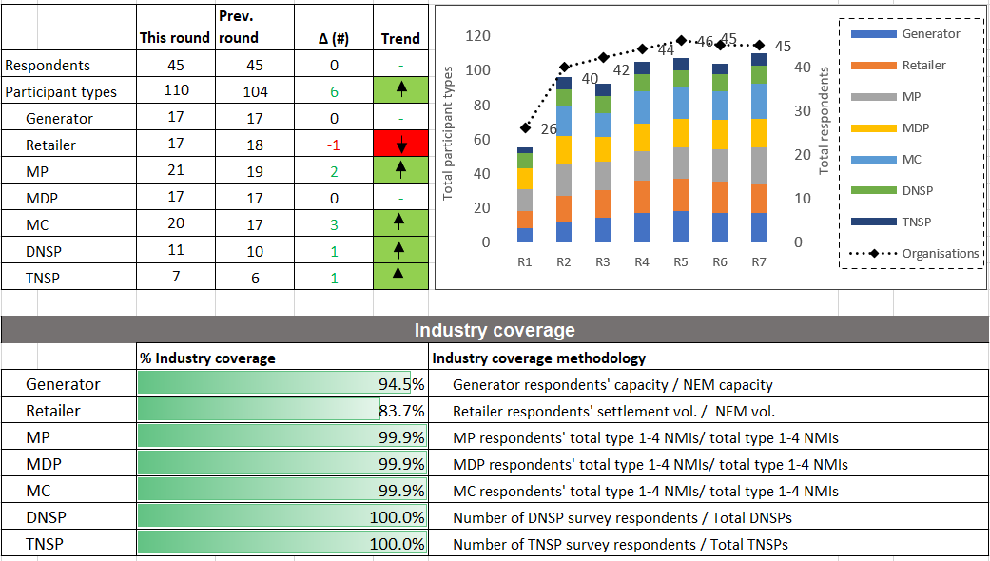
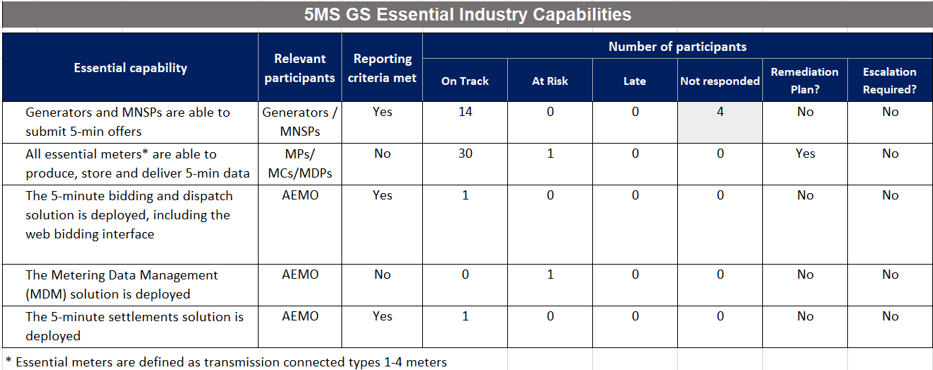
Readiness Report Key Observations
Coverage:
45 organisations have responded to the seventh round of readiness reporting, as at 20 April
  Same number of responses as Round 6, however total 'Participant types’ has risen by six
Retailer coverage lower than expected (83.7%) due to one key Retailer not submitting a survey response
  AEMO has and will continue to follow up this Retailer
Essential Capability
“All essential meters* are able to produce, store and deliver 5-min metering data’’:
  Reporting Criteria not met due to one MSP reporting on track against compliance obligations but amber against AEMO MTP readiness criteria due to minimal schedule contingency
    AEMO working with this MSP to confirm contingency plans
‘The MDM solution is deployed’:
  ReportingCriteria not met as it continues to be reported as 'at-risk’, being closely monitored via the PCF.

Slide 30
Readiness Report Open Actions – Round 6
Action | Action | Comment
6.12 | AEMO to follow up with MDP responding that 'S24 - Tier 1 basic metering data' is 'late' to confirm delivery timing | Participant still reporting as 'late' in Round 7 survey. Action 7.6 raised in this report to continue engagement with effected Participant..
6.15 | AEMO to follow up with MDP responding that 'S36 - Tier 1 basic meter datastreams' is 'late' to confirm status and if remediation is required | Participant still reporting as 'late' in Round 7 survey. Action 7.6 raised in this report to continue engagement with effected Participant.

Slide 31
Readiness Report Open Actions – Round 7
Action | Action | Comment
7.1 | AEMO to discuss with a specific MSP issues associated to their overall program delivery. | One MSP reported that their overall program delivery is 'at-risk'. This MSP currently provides services to essential meters.
7.2 | Applicable DNSPs/MPs/MCs to provide additional information to help assess the potential consequences of cross boundary supplies not being installed by 1 Oct 2021. | Multiple Victorian DNSPs/MPs/MCs reported that some cross boundary supplies may not be installed until April 2022. Larger cross boundary supplies would be prioritised for completion.
7.3 | Applicable DNSPs to provide additional information to help assess the potential consequences of NCONUML 5min metering data not being delivered by 1 Oct 2021. | Multiple Victorian DNSPs reported the delivery of NCONUML 5min metering data as being 'at-risk' or 'late'
7.4 | AEMO to follow up with the applicable Participants to confirm their remediation approach regarding their potential inability to process and reconcile 5min metering data by 1 Oct 2021. | One Retailer, one Generator and one TNSP have reported 'at-risk' for the processing and reconciliation of 5min metering data. These are not Participants who have called out issues previously in this area.
7.5 | AEMO to follow up with MPs responding that 'S41 - MP accreditation update (for 1 Oct 2021)' is 'late' to confirm remediation and consider if escalation is required | Two MPs reported a 'late' status for MTP activities relating to S41 - MP accreditation update (for 1 Oct 2021).
7.6 | AEMO to follow up with MDP responding that S24 - Tier 1 basic metering data, S22 - Type 7 metering installations and S23 - Non-contestable unmetered loads. is 'late' to confirm delivery timing | One MDP reported a 'late' status for MTP activities relating to S24 - Tier 1 basic metering data, S22 - Type 7 metering installations and S23 - Non-contestable unmetered loads.
7.7 | RWG to consider the risk associated to Meter Read Type Codes being updated prior to 1 Oct 2021. | One participant raised a risk relating to Meter Read Type Codes being updated to four characters prior to the 1 Oct 2021 procedure effective date. The participant noted that not all receiving participants of CATS 3xxx transactions will be able to process new four character values prior to their internal project code deployments.
7.8 | RWG to consider the risk associated to the significant volume of expected CATS CR transactions resulting from MTP, MSDR, BAU and other activities. | Two participants raised the risk that MSATS may not be able to process significant change request volumes in a timely and effective manner. One of the participants suggested that a more holistic view of upcoming change requests should be established by AEMO in order to manage and mitigate this issue.
7.9 | AEMO to follow up with participant to confirm progress and readiness status | One key participant in the generator/ MNSP capability has yet to provide a readiness response

Slide 32
5MS Rule Commencement – Round 7 as at 23/4
 | On track | On track for commencement date
 | Risk 1 – Risk to major milestones or deliveries | Remediation or contingency activation required to ensure on track delivery for Rule Commencement
 | Risk 2 – Risk to rule commencement | Cannot be addressed with available contingencies to be on track for commencement date
On track
Risk 1
Risk 2
Activity | Status | Comments
AEMO Business Readiness for 5MS and GS (Part A) |  | Bidding Platform deployed to Production 1 April Retail Platform go-live scheduled for 31 May AEMO Program rated Amber for Retail Go-Live Settlements platform scheduled 17 May – On-Track Rescheduling of platform deliveries is not expected to impact 5MS Rule commencement or 5MS market trials.
Essential Industry Capabilities for 5MS commencement (Part A) |  | On track for 1 Oct 21 commencement Metering Service Providers (MCs, MPs, MDPs) generally reporting on track, metering installation and configuration well progressed One MSP highlighting their program as Amber against MTP criteria, on track against compliace obligations Generators reporting on-track
Summary: 5MS Rule Commencement |  | Overall, Industry and AEMO components of essential capability currently on track for 5MS Rule commencement, noting individual participant exceptions across readiness criteria
Other industry capabilities for 5MS and GS (Part B) |  | Other Participant readiness activities proceeding in line with 5MS and GS rule commencements Individual participant readiness risks noted in regards Global Settlement activities, with no systemic risks
Risk 1
On track
On track
On track

Slide 33
Part A 5MS Essential Capability – round #7 as at 23/4
 | On track | On track for commencement date
 | Risk 1 – Risk to major milestones or deliveries | Remediation or contingency activation required to ensure on track delivery for Rule Commencement
 | Risk 2 – Risk to rule commencement | Cannot be addressed with available contingencies to be on track for commencement date
On track
Risk 1
Risk 2
Responsible Participant | Essential Criteria | Status | Comments
Generator | Generators and MNSPs are able to submit 5-min offers |  | 17 Generators representing 95% of NEM volume reporting on-track 15/17 intend to participate in Market Trials Average program completion in range 50-74% One key participant is currently not providing a readiness report, impact on criteria to be established 16/17 intend to commence 5 minute bidding within transition period, initial deployments planned commencing end April Progress reported for UFE allocation trails other retailer specific capability progress
MP, MC, MDP | All essential meters* are able to produce and store and deliver 5-min data |  | One MSP is reporting on track against compliance obligations but amber against AEMO MTP readiness criteria due to minimal schedule contingency. AEMO discussing contingency approach with the MSP Previous “late” status recovered by MP ​Rollout plans received for 99% of Tranche 1 meters, with all plans indicating completion prior to 1 October, 30% of meters currently 5 minute capable, plan updates due 1 May and will include tranche 1 metering delivery
AEMO | The 5-minute bidding and dispatch solution, including the web bidding interface is deployed |  | AEMO Platform deployed 1 April, to commence bidding transition period
 | The Metering Data Management (MDM) solution is deployed |  | Mitigation Action: Retail Platform Deployment scheduled 31 May, criteria rated Amber to reflect the increase in delivery risk ahead of platform deployment
 | The 5-minute settlements solution is deployed |  | AEMO Settlement Platform 30 minute deployment scheduled for 17th May Industry testing in progress Certification testing of platform successfully completed
Summary - Essential Criteria | - | - | All components on track for delivery at 5MS rule commencement with AEMO’s Metering and Settlement ratings reflecting the shift in planned go-lives and subsequent compression of transitional activity. Individual participant exceptions noted in essential capability categories
On track
On track
On track
Risk 1
On track
On track

Slide 34
Part B – Other Industry Capabilities – Round #7 as at 23/4
 | On track | On track for commencement date
 | Risk 1 – Risk to major milestones or deliveries | Remediation or contingency activation required to ensure on track delivery for Rule Commencement
 | Risk 2 – Risk to rule commencement | Cannot be addressed with available contingencies to be on track for commencement date
On track
Risk 1
Risk 2
Responsible Participant | Criteria | Status | Comments
Retailer | Receive and process 5-minute metering data. Receive and process 5-minute settlement data. |  | All responding retailers (17, representing 85 % of retail load) reporting ‘On track’. Coverage lower this round with one major retailer not reporting 16/17 retailers plan to participate in Market trials. 5 intend to receive 5min data pre 1 Oct 10/17 intend to perform in Bi-Lateral Testing, 1 Q1, 7Q2 commencement 16/17 ‘On-track’ for 5 min settlement data, with 1 late 1 at risk for UFE Allocation
DNSP | Receive and process 5-minute metering data. |  | 10/10 DNSPs reporting ‘On track’ to receive 5-minute data and planning on participating in market trials.
 | Provide GS metering and standing data updates (incl. NCONUML). |  | 10/10 DNSPs reporting overall program ‘On track’ with average program completion of 50-74% Some DNSPs in Victorian Jurisdiction are reporting at risk or late for GS Data population, with impact assessments requested re timing and energy volumes Type 7 Metering Data “On Track” 1 Participant reporting ‘At-risk’ for the delivery of NCONUML,
TNSP | Receive and process 5-minute metering data |  | 6/6 TNSPs reporting ‘On track' to receive 5-minute data 2/6 have the intention to receive 5-minute data prior to the Rule commencement date
 | Provide GS metering and standing data updates |  | 6/6 reporting ‘On track’.
MDP | Provide 5-minute metering data T1-3 distribution connected meters, type 7 meters. |  | 16/17 MDPs reporting ‘On track’, representing 100% coverage of Tranche 1 NMIS 1 participant ‘At risk’, recovery plan is in place 17/17 MDPs report ‘On track’ for the delivery of interval metering data by 1 October, including 1 MDP flagging “A risk” for delivery of T1-3 customer meters
 | Provide type 4, 4A, Vic Ami metering data at 5-minute granularity by 1 December 2022 |  | Majority of Roll-out scheduled to commence 3rd quarter of 2021. Rollout plans requested from impacted participants by 1 March 2021 100% of MDPs reporting ‘On track’ for interval meter delivery by Rule commencement.
 | Provide basic metering data for tier 1 NMIs to AEMO. |  | 3 MDPs reporting ‘Completed’, 6 MDPs reporting “On Track” 1 MDP reporting ‘Late’, with plan to commence delivery prior to 1 Oct and expected impact on small number of meters
MP, MC | All T1-3,4* meters are able to produce and store 5-minute data. |  | 18 /19 MPs representing tranche 1 meters reporting ‘On track’, 1 reporting ‘Late’ with a stated remediation plan 16 Rollout plans covering 93% of tranche 1 meters received, 25% of tranche 1 meters currently 5 minute capable.
Summary | - | - | Overall summary “on track” for 5MS rule commencement , no systemic issues identified, individual exceptions noted for some participants with impact on initial values of UFE reported for those profile areas
On track
On track
On track
On track
On track
On track

Slide 35
Industry Testing Update
Tui Grant

Slide 36
ITWG Update
The ITWG #15 took place on 27-April and the discussions that took place include:
Update on Retail Invitation Testing progress
Update on defects in staging and pre-production
Market Trial Focus Group debrief (next slide)
Settlement runs
  Three settlement runs will be completed on 12, 13 and 14 May

Slide 37
Market Trials - Changes
Changes effective from 01st OCT 2021
Retail
MDMT files will no longer be accepted for interval meters – only MTRD files
UFE reports will be available
Settlements
All data from 1st October onward will be derived in 5-minute format
UFE will be displayed on invoices but not used in any calculations
New UFE reports available
Dispatch and Bidding
Able to submit bids in 5-minute increments with varying values for each 5-minute period.
Considerations
  Do we test the transition settlements (5 days of 30-minute data and days of 5-minute data)
  Do we test full 5-minute settlements
  What volume of meter reads would participants like to see flow through
  Do we reflect the 5-minute bidding in the settlements invoices
  Over what period would you like to conduct the tests
  Assumptions
  Refresh wholesale and retail data.
  Testing week will be based on the production settlement week.
  MDPs are able to provide reasonable volumes of 5-minute reads to both and AEMO and other participants

Slide 38
Market Trials – Proposed Scope
Tui Grant
  Dispatch and Bidding
  Enter bids in current mode and verify the actual cut over date (i.e. submit bids in varying values).
  Enter bids in the new variable values post change date
  Energy bids and FCAS
  Trading price
  An Intervention
  Including bids price caps – rolling sums (Origin emailed) FCAS and energy bids
  Market Suspension
  Settlements
  Daily settlement runs for the transition week – 5 days of 30-minute 2 days of 5-minute
  Followed by 3 weeks of daily 5-minute runs and normal weekly runs
  Reallocations
  Publishing of UFE reports
  Settlement reports
  Test population of SRA_PRUDENTIAL_CASH_SECURITY
  Retail
  Change of Retailer for a 5-minute meter
  Confirm MDP rejection of MTMD interval files
  Confirm successful submission of MTMD for basic
  Publishing of UFE report
  NCONUML
  Type 7 meter read files
  Network bills generated for FRMP’s

Slide 39
5MS Staging Environment – 30 April 2021
Issue ID​ | Description​ | Status​ | Stream | Action​
4090 | RM43 report is throwing error(1809 -> Security validation) when requested from MSATS. | Closed | Retail | RM43 report is throwing an error. Scheduled to be deployed into staging 1st April
4159 | Incorrect event is being sent to participant for an invalid aseXML message submitted by participant. | In Progress | Retail | Incorrect error message is being sent when we receive an invalid schema message.
4161 | Getting "StoreProcFunctionalException-FW410_SUBMIT_USP -> Please contact Helpdesk" error when submitting CR1000 from MSATS | Closed | Retail
Forecasting, SD/CD

Slide 40
5MS Pre Production – 30 April 2021
Issue ID​ | Description​ | Status​ | Stream | Action​
4043 | Prudential External Alert - BUSALERT_PRUD_EXT_GRT_EXPIRE11 not generating alerts | Closed | Settlements | This alert is not generated when guarantee expire Expected to be delivered 23 April
4127 | Settlements - FCASREGIONRECOVERY Report is not being generated for participants | Closed | Settlements | Expected to be delivered 23 April
4148 | Settlements Direct screen has additional categories being displayed | Closed | Settlements | Screen is still able to be used. Expected to be delivered 23 April
4160 | Meter Data Report Publishing is not able to be displayed in the settlement direct screen | Closed | Settlements | Expected to be delivered 23 April
4183 | Issues with Publishing Direct/Settlement Direct APi - getAvailabileFiles is timing out without specifying the PublishingCategoryID | Closed | Settlements | If participants use the PublishingCategoryID the API responses correctly.
4201 | CDEII Report Issue | In Testing | Settlements | This report is not generated in all instances. Expected to be delivered 07 May
4333 | Settlements UAT - Settlement Direct - Settlements Direct Change to exclude Version | Closed | Settlements | The settlement direct screen is missing the version column on the screen. Expected to be delivered 23 April
4324 | Settlements UAT - NEM Public Daily Energy Summary report not generated | In Progress | Settlements | This report is not being generated and displayed on the settlement direct screen. Expected to be delivered 07 May
4323 | Settlements UAT - NEM Confidential Daily Energy Summary report not generated | Closed | Settlements | This report is not being generated and displayed on the settlement direct screen. Expected to be delivered 23 April
4322 | Settlement UAT - NEM NMAS Recovery Reconciliation reports not generated | Closed | Settlements | This report is not being generated and displayed on the settlement direct screen. Expected to be delivered 23 April
4321 | NEM Directions Recovery Reconciliation not being generated in Settlement Direct | Closed | Settlements | This report is not being generated and displayed on the settlement direct screen. Expected to be delivered 23 April
Forecasting, SD/CD

Slide 41
5MS Pre Production – 30 April 2021
Issue ID​ | Description​ | Status​ | Stream | Action​
4392 | Settlements Direct: The text reports do not have the .txt extension | In Progress | Settlements | Files are downloading with an incorrect .file name extension which affects the opening of these files Expected to be delivered 07 May
4533 | Credit Support is missing a filed on the credit support page | Closed | Settlements | Expected to be delivered 23 April
4539 | r39_p1 in MSATS Pre-production returning r35 acks | Closed | MSATS | Even if you update to the latest schema CATs transactions are returning acks in r35 format.
4607 | Incorrect event codes 201 and 202 are valid B2B codes that are being applied to B2M incorrectly should be 3021 and3022 | In Progress | MSATS | Incorrect error codes returned when errors occur in meter read files submitted to AEMO Expected to be delivered 14 May
4563 | MSATS meter data enquiry screen is return duplicate rows of data | In Progress | MSATS | Date is being4547 displayed twice – confirmed it is only in the DB once. Expected to be delivered 14 May
4547 | Screen display issue – MDMT batch handler incorrectly showing as down for some participants | In Progress | MSATS | The correct information is displayed directly under the incorrect message Expected to be delivered 14 May
4443 | Run Date/Time field mandatory for RM11 incorrectly | In Progress | MSATS | Participant forced to enter a run date and time when select report via screen. Expected to be delivered 14 May
4656 | NEMMCO rejecting inbound MDMT and MTRD messages with more than 35 characters in the filename / messageContextID | Assigned | MSATS
Forecasting, SD/CD

Slide 42
TFG/MTP Update
Blaine Miner

Slide 43

TFG/MTP Update
The last TFG meeting was held on Thursday 15th April 2021. The agenda included:
  MSDR Data Transition WG meeting #1 Debrief
  CATS Transaction Analysis update
  GLOPOOL planning
  MTP Update
  Cross Boundary Supplies Guideline
The next meeting is on Thursday 13th May 2021. Indicate agenda for this meeting is:
CATS Transaction Volume updates
  Roll-out plans analysis
Upcoming MTP activities
  MSDR Data Transition WG meeting #2 Debrief
RWG requests?

Slide 44
Proposed RTC Transition Approach
By 1 Oct 2021
  All Tranche 1 meters (type 1-3, subset of 4 and cross boundary) to have their RTC updated with a fourth character of ‘A’ or ‘D’ (de-energisation scenarios only)
From 1 Oct 2021 to 30 Nov 2022
  All Tranche 2 meters (new and replacement type 4, 4A, VICAMI, etc.) to have their RTC updated with a fourth character of ‘A’ or ‘D’ (de-energisation scenarios only)
From 1 Dec 2022 onwards
  All other meters (e.g. basic meters and MRIM) to have their RTC updated with a fourth character whenever a change is made to that meter that requires MSATS to be updated
Noting:
  MPs can update RTCs to the appropriate 4 character code, resulting from BAU activities only, from 1 May 2021
  ‘Mass’ updating of this field should be discouraged without prior engagement with all affected parties
  AEMO is not proposing any explicit transition end dates, at this stage, for non-tranche 1 and 2 meters

Slide 45
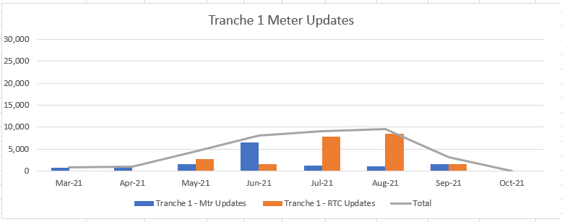
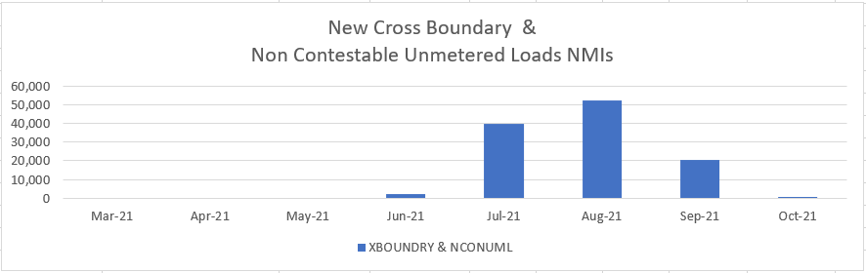
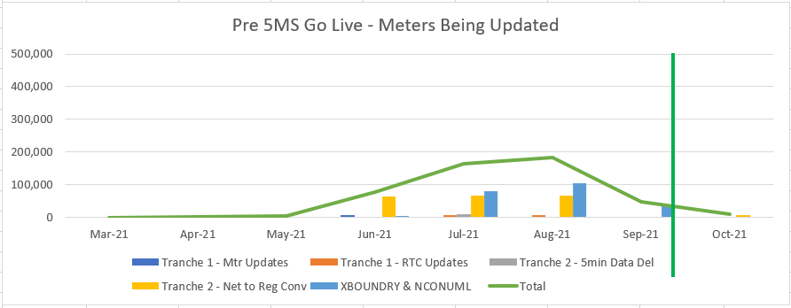
Tranche 1 Volumes
Consolidated Roll-out plan numbers
Tranche 1 - Meter updates Tranche 1 – NMI creations
Note: Graph ‘y’ axis = 30,000 Note: Graph ‘y’ axis = 60,000
Associated CR volumes:
Includes some Tranche 2 CRs
2 x CRs for NMI creations
Max Volume 185,000 (Aug-21)
74 Cross boundary NMIs
planned for post 5MS go-live
Note: Graph ‘y’ axis = 500,000

Slide 46
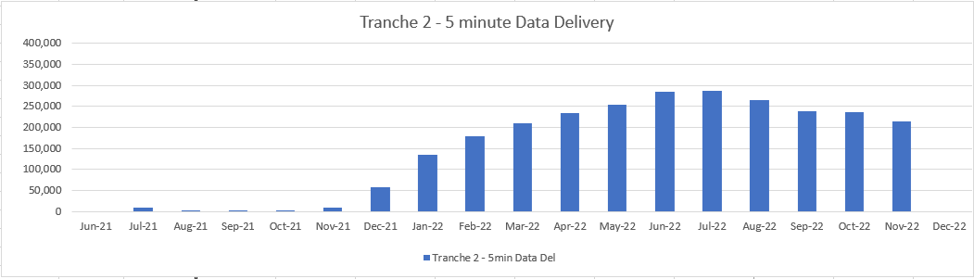
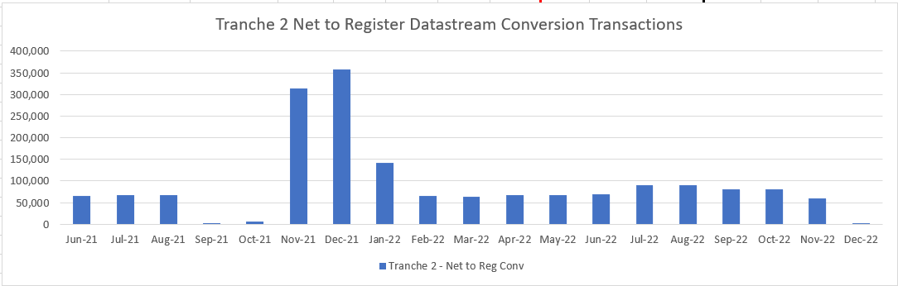
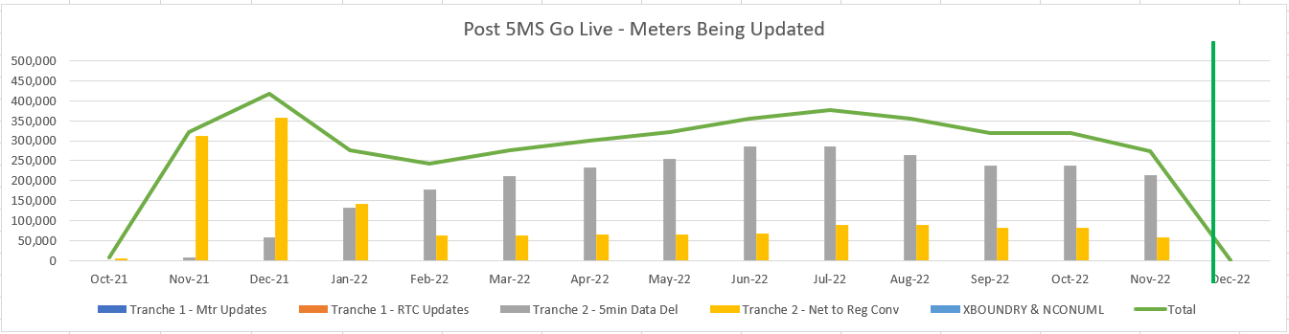
Tranche 2 Volumes
Consolidated Roll-out plan numbers
Tranche 2 – 5 min Data Delivery Tranche 2 – Net to Reg Conversions
Note: Graph ‘y’ axis = 400,000
Associated CR volumes:
Max Volume 420,000 (Dec-21)
MSDR volumes not included
2,500 Net to Reg conversions
planned for post 1 Dec 22
Note: Graph ‘y’ axis = 500,000

Slide 47
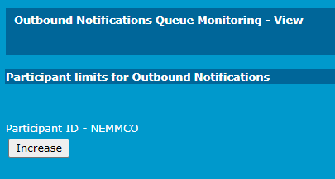
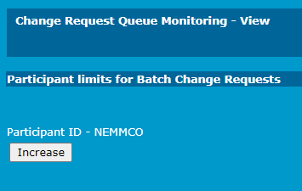
Notification and CR Limits
AEMO has had a number of enquiries relating to daily limit increases
Participants can increase there limits daily via the Menu Path:
  Reports and Alerts > Query Monitoring >
    Outbound Notification Queue Monitoring
    Change Request Queue Monitoring
Selecting the Increase button within the window will double the participant limit for the day
A permanent change to participant limits must be requested via the AEMO Support Hub
  Each request is assessed and prior to updating
  Participants will be informed of limit changes

Slide 48
MTP Update
Proposed Updates
Description | Date | Activity ID
AEMO to provide TNI2 values to LNSPs to support the updating of applicable TNI fields i.e. TNI fields associated to NMIs downstream of a cross boundary NMI (new activity) | By 31 August 2021 | A97a
LNSPs to update the TNI field, for NMIs downstream of a cross boundary NMI, with the AEMO provided TNI2 value(new activity) | By 31 August 2021 | A97b
Activities Now Deemed Completed or Late
Description | Date | Activity ID
MCs to provide visibility of the approach / timeframe for required meter replacement or reconfiguration of ‘unknown’ cross boundary meters | By 31 March 2021 | A23
MCs to ensure that details of the Inventory Table, calculation methodologies and Agreed Loads are agreed prior to implementation by relevant Registered Participants | By 31 March 2021 | A87
AEMO Metering Business to approve MDP NCONUML profiles/algorithms | By 1 May 2021 | A89
Provide AEMO estimated number of NMIs and associated energy volumes for each Unmetered Device category within calculation methodology | By 1 May 2021 | A89a
MCs to provide progress and amendments to forward plans for Type 1-3, subset of 4 and ‘known’ cross boundary meters to AEMO | By 1 May 2021 | A3a, A8a, A13a, A19a
MDPs to provide progress and amendments to forward plans for Type 1-3, subset 4, 4, 4A, VICAMI and Sample meters to AEMO | By 1 May 2021 | A52a, A58a, A64a, A70a
MDPs to provide progress and amendments to datastream conversion plans, to convert Net datastreams to register level | By 1 May 2021 | A32a, A37a, A42a, A52b, A58b, A64b, A70b, A82a
LNSPs to provide progress and amendments to Cross Boundary and NCONUMLs NMI Create plans | By 1 May 2021 | A95a, A99a

Slide 49
Upcoming Transition End Date Activities
Description | Transition End Date | Activity ID
Participants to establish agreements to allow the delivery of 5min metering data pre 1 Oct 2021 between NSP, Retailer, MDP and AEMO, as applicable | By 31 May 2021 | A32, A37, A42, A47, A53, A59, A65, A71, A84, A88

Slide 50
Upcoming Transition Start Date Activities
Description | Transition Start Date | Activity ID
MPs able to update the Meter Read Type code (RTC) with four-character values, resulting from BAU activities | From 1 May 2021 | A4a, A9a, A14a, A20a
MDPs able to create/convert export and import Active (kWh) and Reactive (kVarh) energy datastreams, where applicable, in the CNDS table | From 31 May 2021 | A36, A40, A45, A51, A57, A63, A69, A75
Participants able to create cross-boundary NMIs, datastreams and registers | From 31 May 2021 | A95, A96, A97
Participants able to create NCONUML NMIs, datastreams and registers | From 31 May 2021 | A99, A100, A101
MDPs able to send 15 and 30min metering data via MDFF to AEMO | From 31 May 2021 | A94
LNSPs able to apply new NMI classification codes | From 31 May 2021 | A103, A105, A107, A109, A111, A113, A115
MDPs able to provide 5min metering data to AEMO (MDFF) (Export and import (active (kWh) and reactive (kVarh)) energy metering data as applicable) | From 21 June 2021 | A35, A41, A46, A50, A56, A62, A68, A74, A86, A92

Slide 51
Procedure update
Simon Tu

Slide 52
5MS/GS-related procedure change log
Procedure issue | Status | Final Determination Date
Consolidation of Retail Electricity Procedures Phase 1 | Expected to be published by mid May-2021 Focusing on Oct-2021 requirements The consolidation of Procedures will not be a full consultation as the Procedures (BAU and 5MS/GS) have already gone through their respective formal consultations. | 30-Jun-2021
Consolidation of Retail Electricity Procedures Phase 2 | Expected to be published late 2021 Focusing on May-2022 requirements | 31-Jan-2022
Update to published settlement formulas* | Final report and determination has been published. 5MS/GS & Customer Switching B2M Consultation | 23-Apr-2021
Cross Boundary (CB) connections, inclusion of cross boundary energy formulas and a Change Request type for CB updates update * | Final report and determination has been published. 5MS/GS & Customer Switching B2M Consultation | 23-Apr-2021
MDFF Specification NEM12 & NEM13 update to clarify MDP obligation where a NULL exists in their systems | Final report and determination has been published. 5MS/GS & Customer Switching B2M Consultation Related to Endeavour Energy’s feedback of the Aug-2020 Metering ICF Package update of the MDFF Specification to remove the ‘N’ quality flag. | 23-Apr-2021
Clarification on existing requirements for the 5-minute load profile and RM reports | Final report and determination has been published. Retail Procedures (Wholesale Demand Response) consultation. | 15-Mar-2021
Changes since April RWG
*raised by the 5MS Program
# aseXML schema impact

Slide 53
5MS/GS-related procedure change log
Procedure issue | AEMO Retail Systems Impact | Available in Staging | Readiness Considerations
Consolidation of Retail Electricity Procedures. Closed. | No impact to 5MS Retail systems. | N/A | N/A
Update to published settlement formulas*. Closed. | No impact to 5MS Retail systems. | N/A | N/A
Cross Boundary (CB) connections, inclusion of cross boundary energy formulas*. Closed | No impact to 5MS Retail systems. | N/A | N/A
MDFF Specification NEM12 & NEM13 update to clarify MDP obligation where a NULL exists in their systems. Closed | No impact to 5MS Retail systems. | N/A | N/A
Clarification on existing requirements for the 5 minute load profile and RM reports | 5MLP included in RM20 and RM25 reports | R27 - 31-Oct-20 - Existing Settlements Reports @5-min: RM16, RM17, RM20, RM21, RM22, RM26 | N/A
Proposed procedural change to MDFF quality flag (N flag)* | Rejection of B2M MTRD MDFF meter reads where quality flag is ‘N’. Results in B2M MTRD Transactions with the status of ‘Partial’ or ‘Rejected’. | R1 - 1-Dec-19 - Support for new B2M MTRD validations. | Participant Mkt Systems must not send ‘N’ for B2B or B2M MTRDs.
Removal of end user details from inventory table | No impact to 5MS Retail systems. | N/A | N/A
Removal of register ID = suffix requirement | No impact to 5MS Retail systems. | N/A | Material participant readiness activity impact as the existing requirement is to be retained.
Changes since April RWG
*raised by the 5MS Program
# aseXML schema impact
53
Notes:
Removed:
10MB file size

Slide 54
5MS/GS-related procedure change log – no change
Procedure issue | AEMO Retail Systems Impact | Available in Staging | Readiness Considerations
Proposal for RWD | No impact to 5MS Retail systems. | N/A | ReadTypeCode amended from ‘Optional’ to ‘Required’. Fourth character added to identify whether a meter is capable of reading at five-minute granularity. 4th char field is already avail for data updates in PROD
TNI 2 for cross-boundary meters *# | CATS CR support for TNI2 field. MSATS Browser to support display TNI2 for NMI Discovery Transactions. aseXML schema support extension to support TNI2 inclusion (r39). | R18 and R19 - 31-Aug-20 - Support for TNI2 for CATS CRs. | TNI Code assigned, by AEMO, however Participants to undertake the generation of associated CR2xxx transactions, to register a cross boundary meter using TNI 2. Migration to r39 aseXML necessitated.
New NCONUML NMI Class codes available in list for SORD #​ | Likely B2B schema change. AEMO confirms that the Electricity B2B changes for v3.5 will be made available in pre-production in September or early October 2021. The changes will be in pre-production for a minimum of 4 weeks. 5MS will have to merge the changes from Electricity B2B for the GS May 2022 release. | TBD | 10-Nov-2021 effective date decided as part of the regulator implementation roadmap.
*raised by the 5MS Program
# aseXML schema impact
Notes:
Removed:
10MB file size

Slide 55
Staging Environment
Greg Minney

Slide 56
Staging Environment Closure
AEMO has maintained a staging environment across all delivery streams to allow participant testing of upcoming 5MS deliveries
In its current state Staging supports is in the following modes:
  Retail – 5 Minute
  Settlements – 30, 5 and GS statements are / have been available
  Bidding – 5 minute mode
This has supported 5 minute testing with Pre-prod reflecting the go-live state for each platform
AEMO is proposing to withdraw the staging environment following the deployment of the Retail Platform on 31 May
  Pre-prod will continue to be available to support participant testing
  Pre-prod will transition from 30 minute to 5 minute state in line with the Market trail period (from 5th July)
  Other programs e.g. Customer Switching, WDR do not plan to deploy in the current staging environment
  Readiness surveys indicate that the pre-prod environment is favoured for the conduct of bi-lateral and industry testing
AEMO requests feedback if participants expect adverse impacts on their programs

Slide 57
Settlements Update
Mark Hillaby

Slide 58
Systems Workstream – Settlements
Current as at 09-04-2021
Changes Highlighted
5 MINUTE SETTLEMENT SYSTEMS TRACKING | TIMING
 | Internal HLIA | Focus/Group | SWG Engagement | External HLIA | Draft Tech Spec | Final Tech Spec | User Guides | 5MS Staging | Preprod | Production
SETTLEMENTS
PACKAGE 1 - Reallocations
Reallocations | Dec-18 | Nov-18 | Dec-18 | Mar-19 | 31-Jul-19 | 15-Oct-19 | 1-Nov-19 | 1-Nov-19 | 1-Mar-20 | 1-Apr-20
PACKAGE 2 - Settlements and Billing
Settlements | Oct-18 | Nov-18 | Dec-18 | Mar-19 | 30-Aug-19 | 15-Dec-19 | - | 16-Mar-20 | 22-Mar-21 | 17-May-21
Billing | Oct-18 | Nov-18 | Dec-18 | Mar-19 | 30-Aug-19 | 15-Dec-19 | - | 16-Mar-20 | 22-Mar-21 | 17-May-21
PACKAGE 3 - Prudentials and Estimation
Prudentials | Sep-18 | Nov-18 | Dec-18 | Mar-19 | 31-Oct-19 | 31-Jan-20 | 15-May-20 | 15-May-20 | 22-Mar-21 | 17-May-21
Estimation | Oct-18 | Nov-18 | Dec-18 | Mar-19 | 31-Oct-19 | 31-Jan-20 | - | 15–May-20 | 22-Mar-21 | 17-May-21
Full Data Model | Refer DISPATCH

Slide 59
Settlements
Staging, Pre-production & Production timelines
No change
Supports 30MS, 5MS and GS modes
APIs for Settlements Direct and Prudential dashboard added
Staging
1 Oct 2021
Incl. UFE Reporting from 05/07/21
Pre-production
22 Mar 2021
5 Jul 2021
1 Feb 2022
Production
17 May 2021
1 Oct 2021
1 May 2022
Legend
Legacy | 30MS with New Settlement Platform | 5MS Rule | GS Rule
30-minute Settlements | The 5MS capable solution is available in the relevant environment, however 30-minute settlement will remain until the environment reflects the 5MS Rule solution | Five-minute settlement and Global Settlement soft-start - UFE Reporting | All Retailers become liable for UFE

Slide 60
Settlements Production Cutover

Slide 61
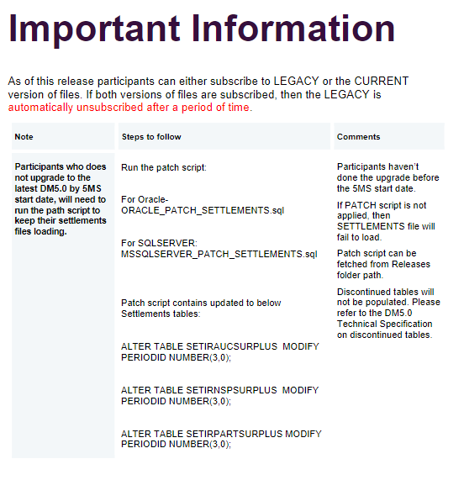
Data Model V5

Slide 62
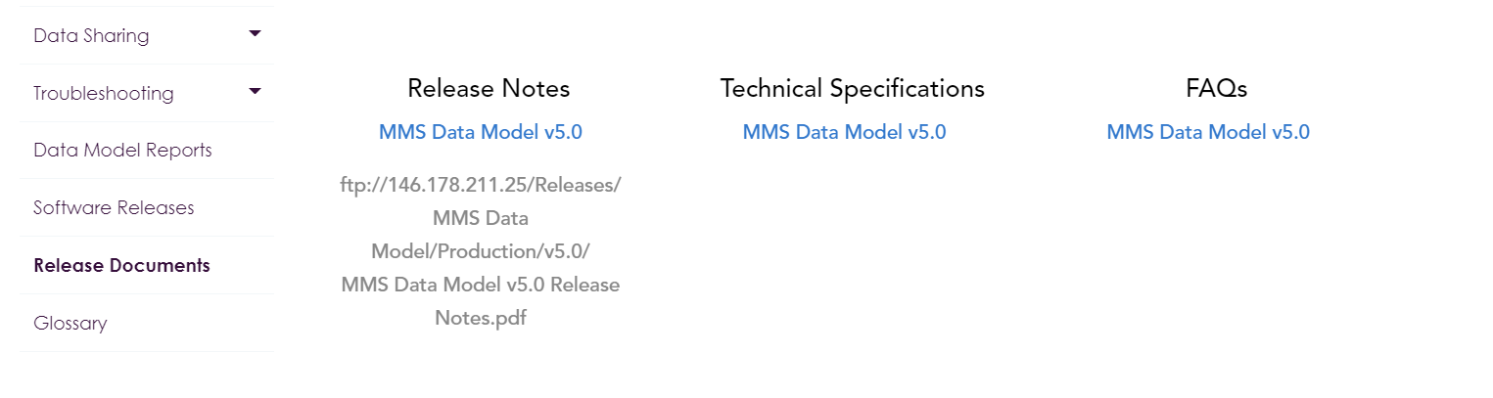
Participant Action following Cutover
Data Model V5 will be used, you don’t have to update to this data model until you want to make use of the 5MS Data model components.
You will need to apply the following script to obtain settlement reports
https://www.aemo.com.au/energy-systems/electricity/national-electricity-market-nem/data-nem/nemweb-help

Slide 63
Settlements Implementation Plan
Settlements Direct and Prudential dashboard API’s will be available from Monday 17th May. The latest versions of the guides for these are at:
Guide to Prudential Dashboard: Prudential Dashboard Guide
Guide to Prudential Dashboard: Settlements Direct Guide
Just a reminder of the full description of implementation principles is set out in the Industry transition and go-live strategy at: https://aemo.com.au/Electricity/National-Electricity-Market-NEM/Five-Minute-Settlement/Readiness-Workstream/Key-Readiness-Documents.
  Rules start dates must be met
  Operation of the NEM must be uninterrupted
  Flexibility in implementation must be maximised for Participants.
  Participants and AEMO are each responsible for their own transition and go-live planning.
In addition, the following principles are specific to this plan:
  AEMO must keep Participants informed with status updates during implementation.
  Participants must comply with directions from AEMO during implementation.

Slide 64
Retail/ Metering Readiness
Jim Agelopoulos

Slide 65
Retail Metering
Staging, Pre-production & Production timelines
No change
Date to be confirmed.
Staging
31 Oct 2020
01 Oct 2021
GS from 1st quarter 2021 - TBC
Pre-production
19 Apr 2021
5 Jul 2021
1 Feb 2022
Production
31 May 2021
1 Oct 2021
1 May 2022
Legend
Legacy | 30MS with new platform | 5MS Rule | GS Rule
30-minute meter reads | 30-min settlement 5-min reads supported Standing data updates for GS | UFE calculation and 5-min settlement | LR updated to GLOPOOL

Slide 66
Systems Workstream – Metering
Current as at 09-04-2021
Changes Highlighted
5 MINUTE SETTLEMENT SYSTEMS TRACKING | TIMING
 | Internal HLIA | Focus/Group | SWG Engagement | External HLIA | Draft Tech Spec | Final Tech Spec | User Guides | 5MS Staging | Preprod | Production
METERING
PACKAGE 1 - Metering Data & Metrology
MDFF • MDFF Specification NEM12 NEM13 v20 | Aug-18 | Oct-18 | Oct-18 | Nov-18 | Jan-19 | Apr-19 | - | 1-Dec-19 | 19-Apr-21 | 31-May-21
PACKAGE 2 - MSATS & SLPs
Transition • MSATS Technical Specification | Aug-18 | Sep-18 | Aug-18 | Nov-18 | 31-May-19 | 30-Sep-19 | - | - | - | -
Meter Data - MDFF and MDMF • MDM File Format and Load Process (User Guide) • MSATS Technical Specification | Aug-18 | Oct-18 | Sep-18 | Nov-18 | 31-May-19 | 30-Sep-19 | - | 1-Dec-19 | 19-Apr-21 | 31-May-21
PACKAGE 3 - Miscellaneous
B2M via API • MSATS Technical Specification | Oct-18 | - | Apr-19 | 9-May-19 | 31-May-19 | 30-Sep-19 | 01-Jun-20 (Draft) | 15-Jun-20 | 19-Apr-21 | 31-May-21
 |  |  |  |  |  |  | 14-Sep-20 (Final)
MSATS Browser (LVI) changes • MSATS Technical Specification | Aug-18 | - | May-19 | 9-May-19 | 28-Jun-19 | 30-Sep-19 | 10-Oct-20 | 15-Jun-20 | 19-Apr-21 | 31-May-21
MSATS Report changes • MSATS Procedures MDM Procedure • MDM File Format and Load Process (User Guide) • MSATS Technical Specification General Process & Document Clean-up | Oct-18 | - | Apr-19 | Apr-19 | 28-Jun-19 | 30-Sep-19 | - | 31-Aug-20 | 19-Apr-21 | 31-May-21

Slide 67
Cutover Phases - B2M and B2B Service State (Timings being confirmed)
 |  | 06:00 | 08:00 | 10:00 | 12:00 | 14:00 | 16:00 | 18:00 | 20:00 | 22:00 | 24:00 | 02:00 | 04:00 | 06:00 | 08:00 | 10:00 | 12:00 | 14:00 | 16:00 |  | 18:00 | 20:00 | 22:00 | 24:00 | 02:00 | 04:00 | 06:00 | 08:00 | 10:00
 |  | Saturday |  |  |  |  |  |  |  |  |  | Sunday |  |  |  |  |  |  |  |  |  |  |  |  | Monday
Cutover Phases
Service State
Data Migration
Deployment
TVT
IVT
BVT
PVM
Sun 30/05
15:00
Start
TVT
Sun 30/05
19:30
Start
IVT
Sun 30/05
22:00
Start
BVT
Go Decision
Comms All Market Participants
B2B Active
B2B Stopped
B2B Active
B2M Stopped
B2M Restart with Participants Inactive except NEMMCO, and PV participant
B2M active for all participants
Sat 29/05
6:00
Notify
Stop
B2M
+
Sat 29/05
6:15
B2M Batch
Handlers
Stopped
Sat 29/05
6:30
Access
to MSATS
Browser
Stopped
Sun
30/05
7:15
Notify/
Stop
B2B
Sun 30/05
19:00
Access to
Participant
File Share
Sun 30/05
19:00
Start
B2M Batch
Handlers
Mon 31/05
4:00
B2B And B2M Re-start
with all
Participants
Mon 31/05
08:00
Notify All Participants

Slide 68
Production cutover update – points for discussion
B2M outage – Including MSATS browser, commencing 6.00am Saturday
  Clear participant outboxes boxes by 6.00 am Saturday / move MDMT files in outbox to archive folder
  MSATS browser access stopped for duration of cutover
  B2B outage – Outage timeframe aligned with Go-Decision
  Total B2B outage time approx. 22 hours
  Impact on MDP Data Delivery to Retailers
  Retailer Billing impact based on B2B delivery resumption
  Participant B2B contingency measures during outage for Service Order, connections
    Retail expectations 8.00 am availability for service order processing
    Impact if MDM rollback is required (the rollback is expected to take 6 hours) and will require B2B outage
  Maximum B2B outage timeframe if issues are encountered during cutover
B2M and B2B Metering Data restart
  Processing of B2B backlog
    Staggered delivery
  Processing of B2M backlog
    Friday and Saturday metering data delivered for settlement run
    Staggered delivery of daily files
Commencing Delivery of MDFF files
Delivery of data to NEMMCO not VPXP
MDMT validations – file naming standards
  Meter data response and report response
  File name and length validation for participant generated MDMT Requests (MeterDataREquest and ReportRequest)
    Work underway to increase valid file length

Slide 69
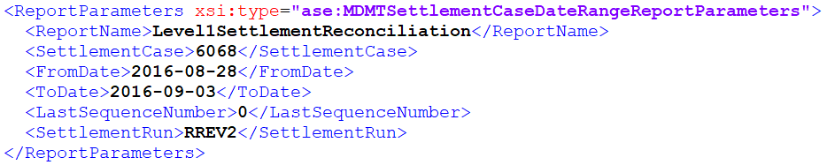
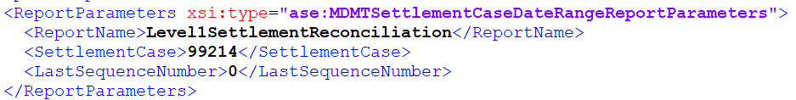
Go Live Scenario: RM Report Response Schema
As part of System Testing AGL has highlighted a variance to the report parameters within the RM Report Response Schema
Currently Automatically generated RM report responses include optional fields in the report parameter section of the aseXML schema (example of reports impacted RM16, RM27 and RM20)
RM report response parameters include the field and values provided for the report response.
It was identified by AGL that AEMOs new Enterprise MDM is only passing the SettlementCase and therefore producing a limited set of report parameters:
Work to remediate has commenced but retesting will be required prior to deployment and may not be in place at go-live.
5MS would like to understand the impact on market participants if the Optional Report Parameters at not provided.

Slide 70
Go Live Scenario: NONCONUML
Industry Understanding
As part of the build, AEMO discovered a defect where the NCOMUML changes were added to the PAE within the eMDM solution, and therefore would impact PAE as soon as created in an active state. Nonconuml is to be reported as a component of UFE from 1 October but not included into settlement prior to May 2022
This was discovered during testing. The remediation is to ensure the inclusion is forward-dated to kick in from the GS go live in May 2022.
The fix has been delivered and has passed SIT. However the program struggling to pass all remaining UAT cases before the Go Live cut-off.
  Please note this scenario is not confirmed, but if the decision came between delaying go live and not having NCOMUML NMI creation available on Day 1, the program’s preference would be to proceed with the Go Live.
A production workaround is for participants to delay the creation of new NCONUML NMI’s until this passes UAT. The estimate would be 1-2 weeks after the 31 May go live.
Planed volume of NONCONUML NMIs to be created is approx. 115K based on participant rollout plans
Initial assessment of participant NCONUML rollout plans shows majority of population are planned for July – September with < 2000 NMI planned for June at present
5MS would like to understand the impact on market participants of delaying the creation of NCONUML NMIs

Slide 71
Dispatch / Bidding Update
Ian Devaney

Slide 72
Bidding / Dispatch
Staging, Pre-production & Production timelines
No change
For business continuity reasons, 30-mins offers and bids will be accepted until 01 Oct 21
STAGING
01 Oct 2021
PRE-PRODUCTION
29 Nov 2020
05 Jul 2021
PRODUCTION
01 Apr 2021
01 Oct 2021
LEGEND
LEGACY | BIDDING TRANSITION | 5MS RULE
30-minute bidding only via: FTP (txt) Web Bidding (Legacy) | 30-minute bidding via: FTP (txt) Web Bidding (Legacy) 5-minute bidding* via: FTP (JSON) Web Bidding (5MS) API *Each 5-minute bid within each half hour must be identical, giving the same effect as the submission of a 30-minute bid. | 5-minute bidding* only via: FTP (JSON) Web Bidding API *30-minute bid emulation restriction lifted

Slide 73
Systems Workstream – Dispatch & Operations
Current as at 09-04-2021
Changes Highlighted
5 MINUTE SETTLEMENT SYSTEMS TRACKING | TIMING
 | Internal HLIA | Focus/Group | SWG Engagement | External HLIA | Draft Tech Spec | Final Tech Spec | User Guides | 5MS Staging | Preprod | Production
DISPATCH and OPERATIONS
PACKAGE 1 - Bidding FTP and API
Transition | Aug-18 | Oct-18 | Aug-18 | Nov-18 | Dec-18 | 2-Apr-19 | 31-Oct-19 | 29-Nov-19 | 30-Nov-20 | 01-Apr-21
Bidding Data Model | Aug-18 | - | Sep-18 | Mar-19 | Dec-18 | 2-Apr-19 | 31-Oct-19 | 29-Nov-19 | 30-Nov-20 | 01-Apr-21
Bidding Format | Aug-18 | - | Sep-18 | Nov-18 | Dec-18 | 2-Apr-19 | 31-Oct-19 | 29-Nov-19 | 30-Nov-20 | 01-Apr-21
PACKAGE 2 - Bidding Web UI
Bidding Web UI and APIs | Aug-18 | Nov-18 | Dec-18 | Jan-19 | Mar-19 | 31-Jul-19 | 16-Dec-19 | 29-Nov-19 | 30-Nov-20 | 01-Apr-21
PACKAGE 3 - Dispatch, Pre-dispatch and PASA
Dispatch | Aug-18 | - | Oct-18 | Nov-18 | Oct-18 | 2-Apr-19 | - | 29-Nov-19 | 30-Nov-20 | 01-Apr-21
Predispatch P30/7DAY | Aug-18 | - | Oct-18 | Nov-18 | Oct-18 | 2-Apr-19 | - | 29-Nov-19 | 30-Nov-20 | 01-Apr-21
Pre-dispatch P5 - Fast Start Inflexibility Profile | Nov-18 | Jan-20 | Nov-18 | Jan-20 | May-20 | 10-Nov-20 | - | - | 01-Apr-21 | TBC
5MPD - Price Sensitivities | - | Jan-20 | Nov-18 | Jan-20 | May-20 | 10-Nov-20 | - | - | TBC | TBC
ST and PD PASA | Aug-18 | - | Oct-18 | Nov-18 | Oct-18 | 2-Apr-19 | 31-Oct-19 | 29-Nov-19 | 30-Nov-20 | 01-Apr-21
PACKAGE 4 - Pricing and Miscellaneous
Trading Price / Price Revision | Aug-18 | - | Feb-19 | Nov-18 | Mar-19 | 31-Jul-19 | - | 15-May-20 | 05-Jul-21 | 01-Oct-21
Administered Pricing and CPT | Aug-18 | - | Feb-19 | Dec-18 | Mar-19 | 31-Jul-19 | - | 15-May-20 | 05-Jul-21 | 01-Oct-21
Suspension Pricing | Sep-18 | - | Feb-19 | Dec-18 | Mar-19 | 31-Jul-19 | - | 15-May-20 | 05-Jul-21 | 01-Oct-21
Negative Residue Management | Sep-18 | - | Feb-19 | Dec-18 | Jun-19 | 31-Jul-19 | - | 15-May-20 | - | -
RERT | Oct-18 | - | - | - | - | - | - | - | - | -
PACKAGE 5 - Full Data Model
Full Data Model | Sep-18 | Ongoing | Ongoing | Apr-19 | Ongoing | 31-Jan-20 | 16-Mar-20 | 29-Nov-19 | 30-Nov-20 | 01-Apr-21

Slide 74
Feedback on Origin’s GS Market Trial Proposal
Greg Minney

Slide 75
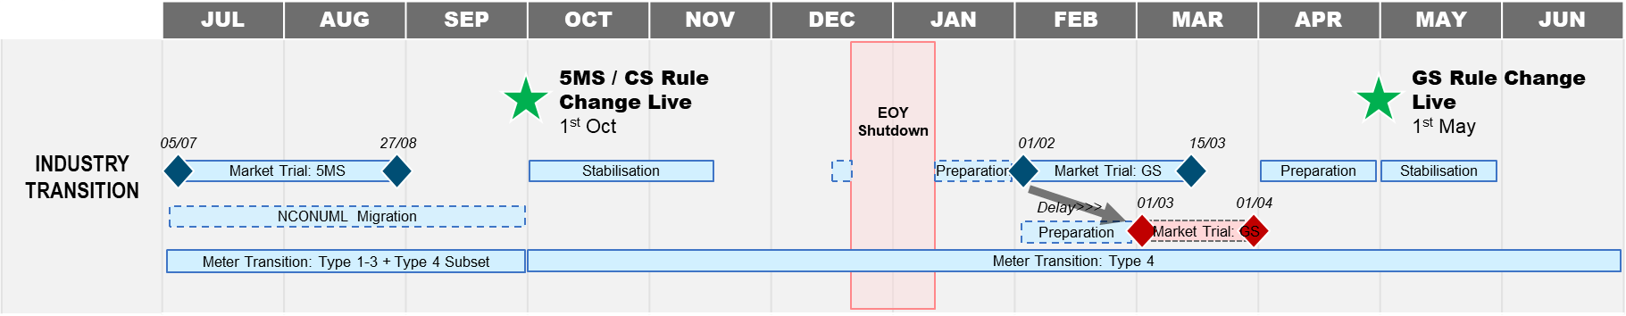
Reminder: Origin proposal - GS Market Trials
Origin proposes AEMO delays and reduce the window of GS Market Trials highlighted in pink/red below
RATIONALE
1) OFF MARKET BASED UPDATES:
The bulk volumes of updates will be processed via off market processes, therefore significantly reducing the necessity for market testing / verification for Retailers (minimum regression testing is required).
2) SCHEDULE & RESOURCE OPTIMISATION
The delay and reduction of market trial window will allow schedule and resource optimisation permitting 5MS / Industry resources to be repointed to other initiatives (for example as MSDR).

Slide 76
Summary of Feedback
Three responses received:
Three in support of GS Market Trial taking place 01-Mar-21 to 01-Apr-21
Two participants noted that the Market Trial should be executed on the latest B2M schema to incorporate functionality for MSDR & MCPI changes to avoid having to retest.
One noted that they will run Bilateral testing in pre-prod concurrently with the GS Market Trials
There are current no plans for Market Trials for MCPI or MSDR which will be going live at around the same time

Slide 77
Next Steps
Feedback from participants in general agreement with the position provided by Origin
  Noting need to have schema version aligned during period of testing
  Intention for bi-lateral testing to be conducted once pre-prod environment has been updated to reflect GS e.g, GLOPOOL update performed on Data
AEMO to incorporate feedback into Test Approach and Regulatory roadmap
AEMO to progress update of 5MS / GS milestone plan to reflect planning considerations
  Updates to be evaluated post 1 October to introduce further certainty into planning

Slide 78
Forward Plan and Other Business
Greg Minney

Slide 79

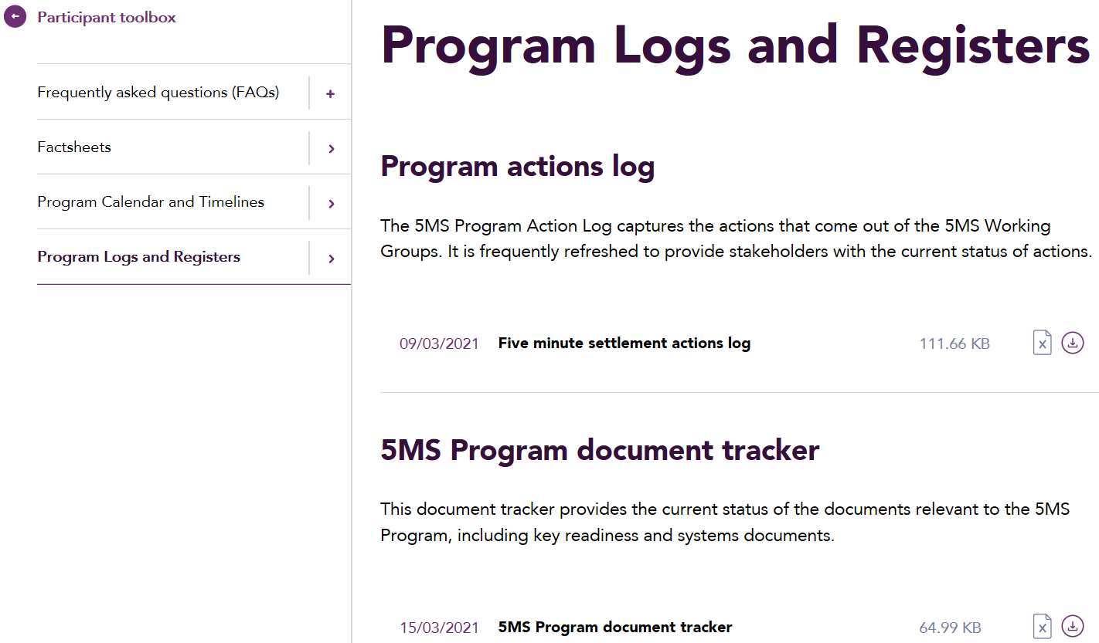
Document tracker updates
This page will appear in all RWG packs moving forward to represent the updates that were made to 5MS and GS documents for the preceding month.
This information is also captured within the document tracker, with recently updated documents highlighted in yellow.
Document/ Item | Version | Status | Type
Industry go-live plan: Settlements | 1.00 | Final | Readiness
EMMS Release FAQ - October 2020 - Data Model v5.00 | 0.02 | Draft | Systems
Cross Boundary Supply Guideline | 1.00 | Final | Readiness
Where is the document tracker located?
The document tracker is located in the Participant toolbox under the Program Logs & Register menu option.

Slide 80
RWG 2021 Proposed Topics
*Dates depend on Checkpoint outcomes
Month | Topics | Month | Topics
January | Preparing for Retail Invitation Industry Test Platform Go Lives criteria Market Commencement criteria Risk Review | 02-June | Preparing for Market Trial Metering rollout progress Risk review – any Market Trial risks? Approach to Global Settlements engagement
09-February | Update on Retail systems go-live changes Metering Transition Preparation | 06-July | Market Trial progress, Readiness Reporting #8 Market Commencement Criteria
02-March | Retail Go-Live Update Preparing for 5MS Bidding Cutover Settlements Industry Test Readiness Reporting #6 5MS Market Trial – planning approach | 03-August | Market Trial progress Go-Live risks
06-April | Retail Go-Live Update – checkpoint outcomes Debrief on Bidding go-live Debrief on Settlements Industry Test commencement 5MS Market Trial – planning update Metering provider implementation planning Risk review | 07-September | Results of Market Trial, Preparing for 1 Oct – Ind Go-Live Plan review Readiness Reporting #9
04-May | Retail Go-Live Update and preparing for cutover Readiness Reporting #7 Preparing for Settlements Cutover Approach to Global Settlements engagement 5MS Market Trial approach Industry Go-Live plan approach | TBC-October | Debrief and reconfirmation of approach for Global Settlements

Slide 81
Upcoming meetings
https://aemo.com.au/initiatives/major-programs/nem-five-minute-settlement-program-and-global-settlement
Current as at 28/04/2021

Slide 82
Questions

