Slide 1
5MS & GS Transition Focus Group #16
Thursday, 15 July 2021 – Meeting Notes included
This meeting is recorded for the purpose of minute taking.
Please disconnect from your workplace VPN for the WebEx call

Slide 2

AEMO Competition Law
Meeting Protocol
AEMO is committed to complying with all applicable laws, including the Competition and Consumer Act 2010 (CCA). In any dealings with AEMO regarding proposed reforms or other initiatives, all participants agree to adhere to the CCA at all times and to comply with this Protocol. Participants must arrange for their representatives to be briefed on competition law risks and obligations.
Participants in AEMO discussions must:
Ensure that discussions are limited to the matters contemplated by the agenda for the discussion
Make independent and unilateral decisions about their commercial positions and approach in relation to the matters under discussion with AEMO
Immediately and clearly raise an objection with AEMO or the Chair of the meeting if a matter is discussed that the participant is concerned may give rise to competition law risks or a breach of this Protocol
Participants in AEMO meetings must not discuss or agree on the following topics:
Which customers they will supply or market to
The price or other terms at which Participants will supply
Bids or tenders, including the nature of a bid that a Participant intends to make or whether the Participant will participate in the bid
Which suppliers Participants will acquire from (or the price or other terms on which they acquire goods or services)
Refusing to supply a person or company access to any products, services or inputs they require
Under no circumstances must Participants share Competitively Sensitive Information. Competitively Sensitive Information means confidential information relating to a Participant which if disclosed to a competitor could affect its current or future commercial strategies, such as pricing information, customer terms and conditions, supply terms and conditions, sales, marketing or procurement strategies, product development, margins, costs, capacity or production planning.

Slide 3
Welcome
Greg Minney

Slide 4
Agenda
NO | Indicative Time | AGENDA ITEM | Responsible
1 | 10:30 - 10:40 | Welcome and Introduction | Greg Minney
2 |  | July Rollout Plan Overview | Blaine Miner
3 |  | CATS Transaction Analysis Update | Blaine Miner
4 |  | Transitional Arrangements Refresher | Blaine Miner
5 |  | Readiness Reporting | Greg Minney
6 |  | Contingency Planning | Blaine Miner
7 |  | MTP Update – key call-outs e.g. NCC updates (NREG), etc. | Blaine Miner/David Ripper
8 |  | Next Steps and General Business | Greg Minney

Slide 5
July Rollout Plan Overview
Blaine Miner

Slide 6
Rollout Plan Responses
Organisation | MC/MP Tranche 1 | MDP Tranche 1 | MDP Tranche 2 | MP RTC Tranche 2 | MDP Net to Reg T1 and T2 | LNSP NCONUML and Cross Boundary | Explicit Consent Provided
AusNet Services |  |  | Yes | Yes | Yes | Yes | Yes
Ausgrid | Yes |  |  |  |  | Yes | Yes
Citipower/ Powercor | Yes |  | Yes | Yes | Yes | Yes | Yes
ElectraNet | Yes |  |  |  |  |  | Yes
Endeavour Energy |  |  |  |  | Yes | Yes | Yes
Essential Energy | Yes | Yes |  | Yes | Yes | Yes | No
Energex |  |  | Yes | Yes | Yes | Yes | Yes
Ergon |  |  | Yes | Yes | Yes | Yes | Yes
EvoEnergy | Yes |  |  |  | Yes | Yes | No
Intellihub | Yes | Yes | Yes | Yes | Yes |  | No
Jemena |  |  | Yes | Yes | Yes | Yes | Yes
Metropolis | Yes | Yes | Yes | Yes | Yes |  | No
Mondo | Yes | Yes | Yes |  |  |  | No
Organisation | MC/MP Tranche 1 | MDP Tranche 1 | MDP Tranche 2 | MP RTC T2 | MDP Net to Reg T1 and T2 | LNSP NCONUML and Cross Boundary | Explicit Consent Provided
Origin | Yes |  |  |  |  |  | No
PlusES | Yes | Yes | Yes | Yes | Yes |  | Yes
Powerlink | Yes |  |  |  |  |  | Yes
Powermetric | Yes | Yes | Yes | Yes | Yes |  | No
SAPN |  |  |  |  | Yes | Yes | Yes
Secure Meters |  | Yes | Yes | Yes | Yes |  | No
TasNetworks (DNSP) |  |  |  |  | Yes | Yes | Yes
TasNetworks (TNSP) | Yes |  |  |  |  |  | Yes
TransGrid | Yes |  |  |  |  |  | Yes
United Energy | Yes |  | Yes | Yes | Yes | Yes | Yes
Vector |  |  | Yes | Yes | Yes |  | No
Yurika | Yes | Yes | Yes | Yes | Yes |  | Yes
Received rollout plan updates from 25 organisations, 4 more than last round

Slide 7
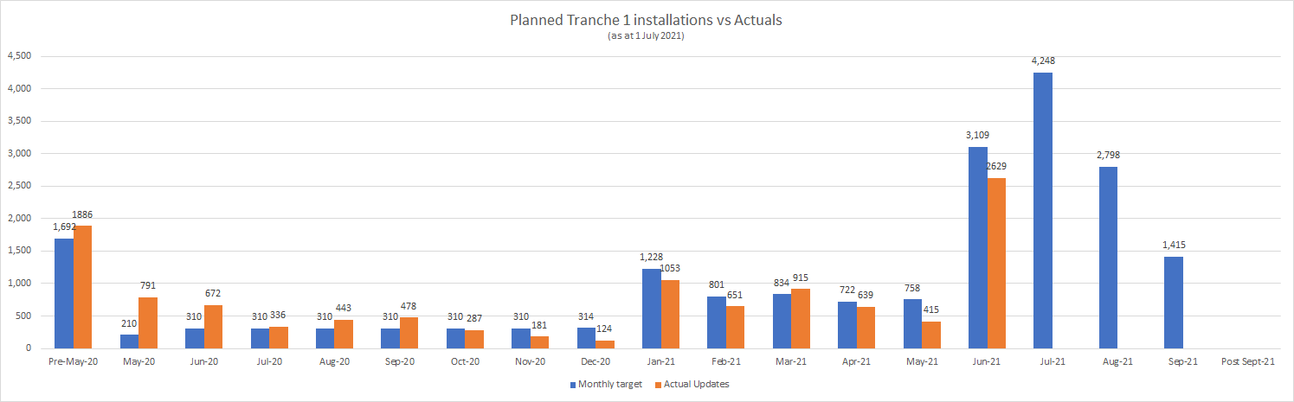
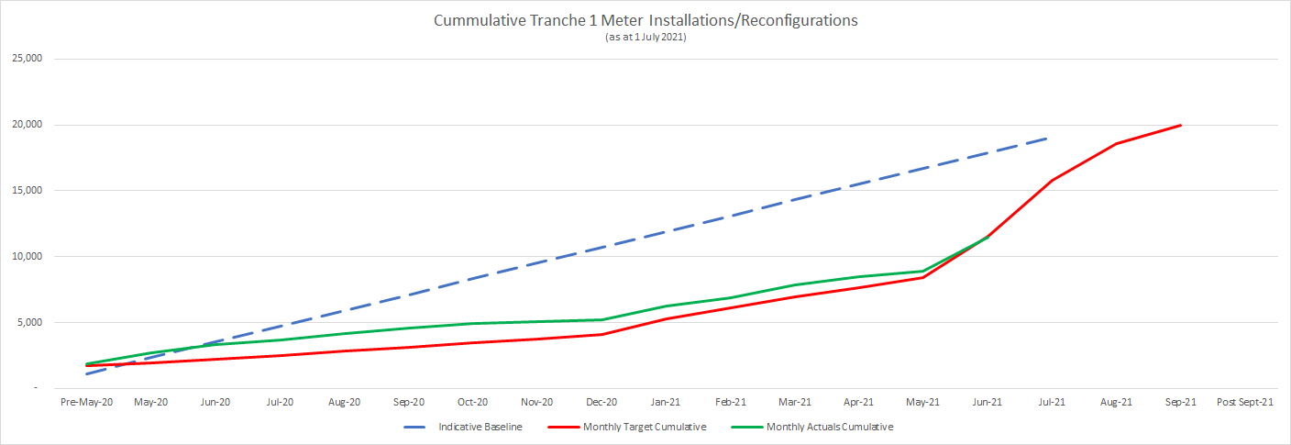
Tranche 1 Installation/Reconfiguration Status
Actual updates during May and June were less than previously planned
Plans have been updated between revisions to reflect later implementation timeframes
Over 4,200 meters currently planned to become 5min capable during the MTP contingency window i.e. Aug and Sept

Slide 8
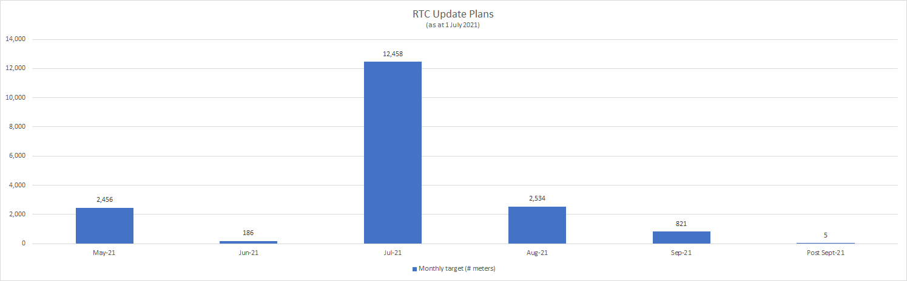
Tranche 1 Read Type Code Status
AEMO and Industry has been unable to leverage the four character RTC field, as an early means of confirming 5min capability, due to delays in MPs updating this field

Slide 9
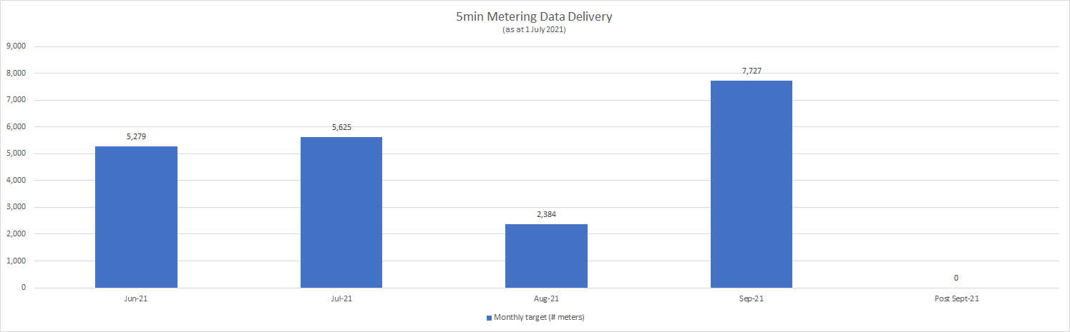
Tranche 1 5min Metering Data Delivery Status
MDPs reporting that 5min metering data will not be delivered to AEMO for ~35% of tranche 1 meters until Sept, post the current MTP transition end date of 31 August 2021
Timing indicates a subset of MDPS will commence delivery of all tranche 1 meters as at 1 Oct in parallel with B2B delivery

Slide 10
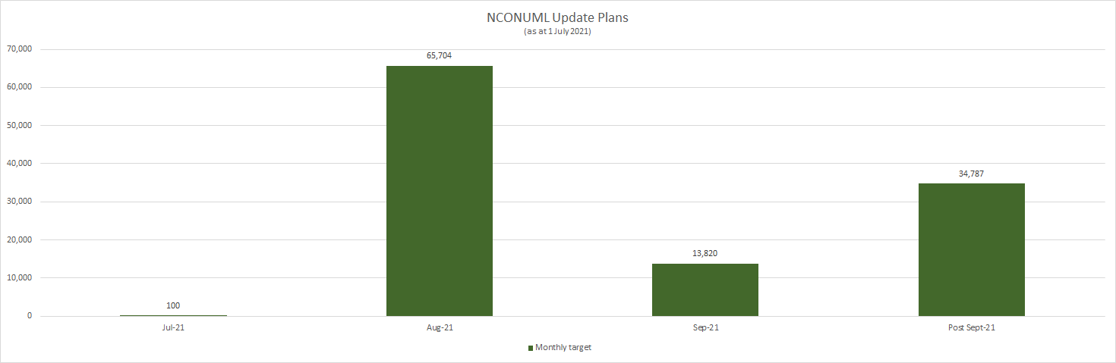
NCONUML Metering Data Delivery Status
DNSPs reporting that they have engaged LRs to discuss any expected delays in creating NCONUML NMIs by 1 Oct 2021
One DNSP calling out that they may no be able to create their NCONUML NMIs until Nov 2021, potentially leading to a gap in NCONUML metering data for the month of Oct 2021

Slide 11
CATS Transaction Analysis Update
Blaine Miner

Slide 12
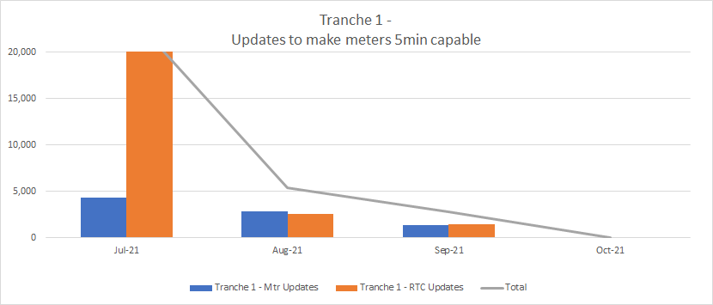
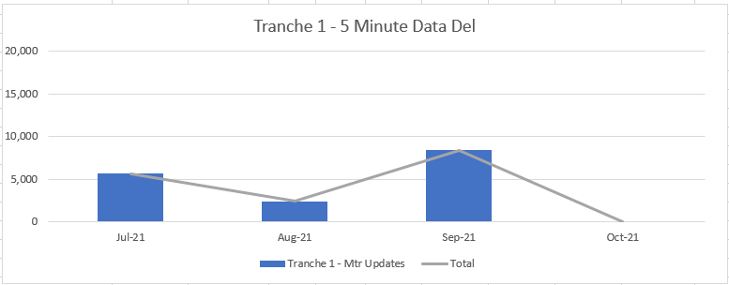
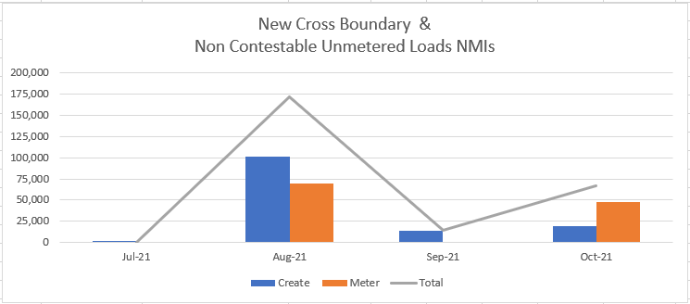
Tranche 1 – Consolidated Plan Results
Approx. ¼ of Tranche 1 meters to be made 5min capable this month
Backlog of RTC code updates occurring this month
Approx. ¼ of Tranche 1 Meters to start delivering B2M 5min reads this month
A material number of 5min reads has been pushed back to commence from September
Overall, the installation and creation of Cross Boundary and Non-Contestable Unmetered Loads have been pushed back 1 month
4 participants reporting updates will not be completed until October (after GS go live)

Slide 13
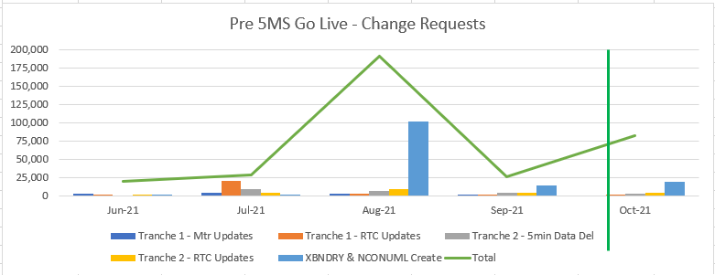
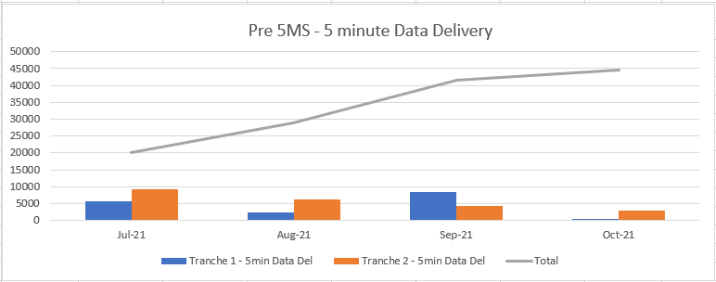
Pre 5MS Consolidated Plan Summary
Consolidated Tranche 1 & 2 change requests
Estimated Peak from July have moved into August with an estimated 191,000 CRs to be raised
CR volumes include:
  RTC updates
  Cross Boundary NMI, register(s) and datastream(s)
  Non-Contestable NMI, register(s) and datastream(s)
Consolidated Tranche 1 & 2 5min metering data delivery
A total of 41,500 meters estimated to be providing 5min reads by end of September

Slide 14
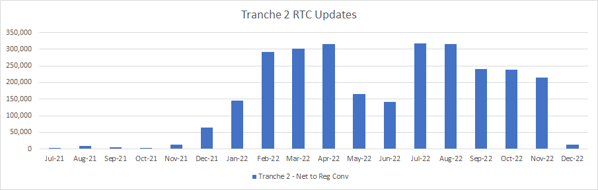
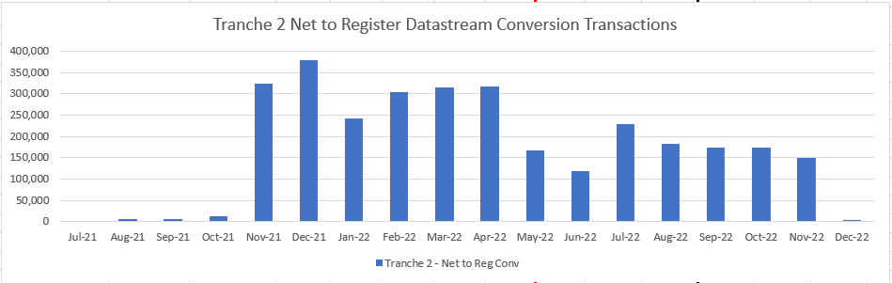
Tranche 2 – Consolidated Plan Results
Consolidated RTC Code changes
Peak month is currently expected to be July 2022, with ~316,900 CRs expected to be initiated
No material change from May plans
Consolidated Net to Register conversions
Peak month is currently expected to be December 2021, with ~378,000 CRs expected to be initiated
No material change from May plans

Slide 15
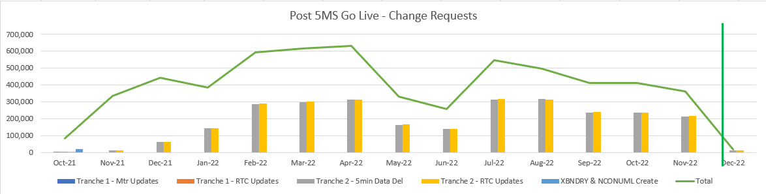
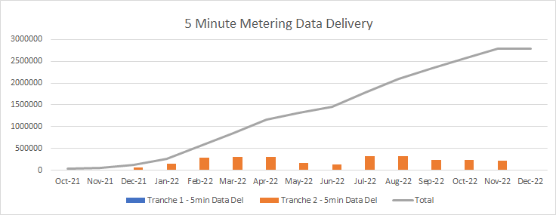
Post 5MS Consolidated Plan Summary
Consolidated Tranche 1 & 2 Change requests
Estimated Peak to be in April 2022 with ~631,800 CRs expected to be initiated
Numbers include:
  RTC updates
  Net to Register datastream conversions
No material change from May plans
Consolidated Tranche 1 & 2 5min metering data delivery
A total of ~2,796,000 meters estimated to be providing 5min reads by December 2022
No material change from May plans

Slide 16
Transitional Arrangements Refresher
Blaine Miner

Slide 17
Transitional Arrangements Refresher
Just wanted to share and discuss a few observations we have noticed since AEMO Retail go-live re CNDS records and MDFF register level metering data delivery
The following slides are direct extracts from the ‘AEMO 5MS/GS CNDS & Meter Data Delivery Clarifications’ document which was published on AEMO’s website on the 5th Aug last year
  https://www.aemo.com.au/-/media/files/electricity/nem/5ms/readiness-workstream/2020/5ms-cnds-and-meter-data-delivery-clarifications-v1-1.pdf?la=en&hash=83B74534459297EA4CC385E18098D8F0
Please also note that MDMF will not be accepted by AEMO for interval meter reads from 1 Oct 2021

Slide 18
Interval Register Level CNDS Records
In accordance with the new 5MS Service Level Procedure: MDP, the following CNDS records must be created (to match the capabilities of the meter) and maintained accurately in a timely manner where required to support the following critical processes.
For the avoidance of doubt:
A Register Level Interval CNDS record must not be replaced by a Net CNDS record
Register Level Interval CNDS records must reflect a DatastreamType code of ‘I’, ‘P’ or ‘N’
  Refer to Section ‘CNDS DataStreamType Codes’ for further details
Once a Register Level Interval CNDS record has been created, an MDP must send AEMO meter data in MDFF from its effective date
  Refer Section ‘CNDS & Meter Data Delivery’ for further details
AEMO’s preference is for MDPs to transition Net records to Interval Register level CNDS records as soon as possible from the date AEMO introduces its MDFF capability
AEMO Process | Mandatory CNDS Records (as per NMI Procedures)
NEM Settlements | DatastreamSuffix = ‘E’ & ‘B’ or ‘A’ & ‘D’
UFE Analysis | DatastreamSuffix = ‘Q’ & ‘K’ or ‘P’ & ‘J’
VIC TUoS: NEM Settlements | DatastreamSuffix = ‘E’ & ‘B’ or ‘A’ & ‘D’
VIC TUoS: UFE analysis | DatastreamSuffix = ‘Q’ & ‘K’ or ‘P’ & ‘J’
VIC TUoS: Billing | DatastreamSuffix = ‘E’, ‘B’, ‘Q’ & ‘K’ or ‘F’, ‘C’, ‘L’ & ‘R’ or ‘A’, ‘D’, ‘P’ & ‘J’

Slide 19
DataStreamSuffix and DataStreamType ‘Combination’ validations
‘Combination’ validations will be limited due to complexities associated to physical metering installations and the sequential processing of CNDS records by the CATS system.
An example of these complexities is:
  Metering Installation type 1 or type 2 metering
    Where records are created in separate CRs for DataStreamSuffix ‘A’, ‘D’, ‘E’ and ‘B’
      And where all 4 DataStreamSuffix have a DatastreamType code of ‘I’
Proposed system validations would not be able to identify that 2 valid ‘sets’ of datastream suffixes (A&D or B&E) have been created with a DatastreamType code of ‘I’. In these instances, MDPs will be responsible for ensuring that should these datastream suffixes need to be created, that only one ‘set’ has a DatastreamType of ‘I’ at any point in time.
Within the “StandingDataQualityReport” (RM29) reporting, AEMO will identify unexpected combinations across all active CNDS records for a NMI.
Refer to ‘Appendix A: Scenarios - Net & Register level CNDS records’ which provide further details regarding these ‘combination’ scenarios.

Slide 20
CNDS & Meter Data Delivery Matrix
From the AEMO MDFF Go-Live, AEMO will manage CNDS, MDFF and MDMF combinations as per the following table.
Note: Accumulation metering data has been excluded from this table, as no changes have been introduced for these metering installations.
 | CNDS = Interval Register Level | CNDS = Net
AEMO receive NEM12 MDFF (i.e. 5, 15 or 30 min, Register level) | NEM12 MDFF and CNDS records are both at Register level. Meter data is accepted, processed and loaded into the database. | Where meter reads are received at the register level but the CNDS record are at the Net level, MSATS would calculate the required Net meter reads at time of Settlements by referencing the content in the NEM12 200 line. Where the 200 line is populated correctly, Net reads would be generated by the system and applied to Settlement calculations. Where the NEM12 MDFF 200 line is not populated correctly, i.e. Contributory Suffix = ‘N’, the system would: Substitute the kWh reads Report missing data in the RM11 and MDP Quality and Quantity reports Report Data Mismatch in the RM39 report
AEMO receive MDMT (i.e. 30-min, Net) | MDMT at Net level and CNDS records at Register level. Meter data is accepted, processed and loaded, however, AEMO’s systems would: Substitute the kWh reads Report missing data in RM11 and MDP Quality and Quantity reports Report Data Mismatch in the RM39 report | MDMT and CNDS records are both at Net level. Meter data is accepted, processed and loaded. However, where an MDP sends an MDMT file after 5MS commencement and the IntervalReadDate is greater than the 5MS commencement date, AEMO’s system would: Substitute the kWh reads Report missing data in the RM11 and MDP Quality and Quantity reports Report the Data Mismatch in the RM39

Slide 21
Scenario 1:
An interval metered NMI for NEM Settlement calculations
 | Physical Meter | CATS_Meter_Register, ‘Suffix’ | CATS_NMI_Data_Stream
 |  |  | ‘DataStreamSuffix’ | ‘DataStreamType’ | ADL
Current State | Ex Bx | Ex Bx | Nx | I | 15
Final State | Ex Bx | Ex Bx | Ex Bx | I I | 16 -1
* The summation of all ADL values shall result in the Total ADL for the NMI. E.g. 16 + (-1) = 15

Slide 22
Scenario 8:
An interval metered NMI with Master, Check and Logical Meters
 | Physical Meter | CATS_Meter_Register, ‘Suffix’ | CATS_NMI_Data_Stream
 |  |  | ‘DataStreamSuffix’ | ‘DataStreamType’ | ADL
Current State – Master Meter | Ex Bx Qx Kx | Ex Bx Qx Kx | Nx | I | 14,400
Current State – Check Meter | Fx Cx Rx Lx | Fx Cx Rx Lx | N/A | N/A | N/A
Current State – Logical Meter | Dx Ax Px Jx | Dx Ax Px Jx | N/A | N/A | N/A
Final State – Master Meter | Ex Bx Qx Kx | Ex Bx Qx Kx | Ex Bx Qx Kx | N N N N | 1 1 1 1
Final State – Check Meter | Fx Cx Rx Lx | Fx Cx Rx Lx | Fx Cx Rx Lx | N N N N | 1 1 1 1
Final State – Logical Meter | Dx Ax Px Jx | Dx Ax Px Jx | Dx Ax Px Jx | I I N N | 15,003 -603 1 1
* The summation of all ADL values shall result in the Total ADL for the NMI. E.g. 15,003 + (-603) = 14,400

Slide 23
Readiness Reporting
Greg Minney

Slide 24
Industry Readiness – Round 8
(as at 22 June)
 | On track | On track for commencement date
 | Risk 1 – Risk to major milestones or deliveries | Remediation or contingency activation required to ensure on track delivery for Rule Commencement
 | Risk 2 – Risk to rule commencement | Cannot be addressed with available contingencies to be on track for commencement date
Activity | Status | Trend | Comments
AEMO Business Readiness for 5MS and GS (Part A) | On-track | Up | Status: On-track All AEMO platforms are now in Production operating at 30 minute Settlement. Retail Platform deployed 21 June Market Trial scheduled for 19th July commencement Trend: Up AEMO’s last platform (Retail) went live on the 21st June
Essential Industry Capabilities for 5MS commencement (Part A) | At-risk |  | Status: At-risk Multiple MSPs plans reflect 10% tranche 1 meters made 5-minute capable post MTP completion date of 31 July, providing little schedule contingency for Metering Data delivery. Current plans satisfy compliance obligations but are late against MTP dates AEMO to engage the RWG to conduct detailed contingency planning for metering scenarios Generators “on-track” with individual program risks reported Trend: Down Multiple MSPs with limited contingency for meter capability upgrade and metering data delivery
Summary: Part A 5MS Rule Commencement Essential Industry Capability | On-track |  | Status: On-track AEMO’s Retail platform went live on the 21st June. All key 5ms platforms now in production Tranche 1 metering plans meet compliance obligations but have reduced schedule contingency in event of delayed delivery Trend: Down AEMO’s Retail platform is now live, however, MSP time contingency has reduced with heightened risk profile
Other industry capabilities for 5MS and GS (Part B) | On-track |  | Status: On-track Majority of Participants reporting their overall programs as on-track, but some Participants are now reporting some non-essential capabilities as at-risk or late Metering transition activities have heightened risk profile Trend: Down Increase in Participants reporting items at-risk or late compared to the previous readiness reporting round

Slide 25
Part A 5MS Essential Capability
(as at 22 June)
 | On track | On track for commencement date
 | Risk 1 – Risk to major milestones or deliveries | Remediation or contingency activation required to ensure on track delivery for Rule Commencement
 | Risk 2 – Risk to rule commencement | Cannot be addressed with available contingencies to be on track for commencement date
Responsible Participant | Essential Criteria | Status | Trend | Comments
Generator | Generators and MNSPs are able to submit 5-min offers | On-track |  | Status: On-track 18 Generators and MNSPs representing 93% of NEM volume reporting on-track Important participant previous not reporting status has commenced reporting against industry timelines Participants to consider contingency options in event of Trend: Neutral All respondents intend to participate in 5MS Market Trials 2 participants have now implemented their 5-minute bidding service, with 13 out of 16 generators intending to commence their implementations within the bidding transition period
MP, MC, MDP | All essential meters* are able to produce and store and deliver 5-min data | At-risk |  | Status: At-risk 4 MSPs are reporting late against MTP transition end dates regarding the installation and delivery of essential metering data, however on track for meeting compliance requirements Trend: Down Reduced time contingency associated to the installation and metering data delivery of essential meters
AEMO | The 5-minute bidding and dispatch solution, including the web bidding interface is deployed | On-track |  | Status: On-track Platform deployed in ‘Bidding Transition’ configuration Additional capability on track for implementation prior to 1 October Trend: Neutral
 | The Metering Data Management (MDM) solution is deployed | On-track |  | Status: Retail Platform deployed into Production on 21st June 5-minute metering processes to be verified during 5MS Market trial Trend: Up Retailer platform deployed successfully
 | The 5-minute settlements solution is deployed | On-track |  | Status: On-track AEMO’s Settlement Platform successfully deployed 17th May, to support 30-minute settlement 5-minute settlement processes to be verified during the 5MS Market trial Trend: Neutral
Summary - Essential Criteria |  | On-track |  | Overall, essential criteria to support the 5MS rule commencement is considered to be on track. Trends reflect the reduced time contingencies for the installation and delivery of Tranche 1 5-minute metering data

Slide 26
Part B – Other Industry Capabilities
(as at 22 June)
 | On track | On track for commencement date
 | Risk 1 – Risk to major milestones or deliveries | Remediation or contingency activation required to ensure on track delivery for Rule Commencement
 | Risk 2 – Risk to rule commencement | Cannot be addressed with available contingencies to be on track for commencement date
Responsible Participant | Criteria | Status | Trend | Comments
Retailer | Receive and process 5-minute metering data. Receive and process 5-minute settlement data. | On-track |  | Status: On-track 18 out of 20 retailers reporting their overall programs as on-track 17 out of 20 retailers planning on participating in the 5MS Market Trial, with 2 reporting participation at risk Trend: Down 2 retailers reporting late for the processing of 5-minute metering data and 2 for the processing of 5-minute settlement data
DNSP | Receive and process 5-minute metering data. | At-risk |  | Status: At-risk Multiple DNSPs are reporting at risk or late for numerous GS related items, including: Cross boundary supplies, 2 reporting at-risk or late NCONUML, 3 reporting at-risk or late There will be an impact on the UFE values initially published for those profile areas, overall impacts to be established and remediation options developed Trend: Down Increased occurrence of at-risk or late items being reported
 | Provide GS metering and standing data updates (incl. NCONUML).
TNSP | Receive and process 5-minute metering data | On-track |  | All TNSPs reporting their overall programs as on track 2 out of 6 have the intention to receive 5-minute metering data prior to the Rule commencement date
 | Provide GS metering and standing data updates |  |  | 5 out of 6 reporting as on-track, 1 response not received (noting that their Round 7 response showed them as on-track)
MDP | Provide 5-minute metering data T1-3 distribution connected meters, type 7 meters. | On-track |  | Status: On-track 13 out of 16 MDPs reporting as on-track, representing approx. 95% coverage of Tranche 1 meters 16 out of 16 MDPs reporting on-track for the delivery of 5-minute metering data by 1 October Trend: Neutral
 | Provide type 4, 4A, Vic Ami metering data at 5-minute granularity by 1 December 2022
 | Provide basic metering data for tier 1 NMIs to AEMO.
MP, MC | All T1-3,4* meters are able to produce and store 5-minute data. | On-track |  | 19 MPs servicing tranche 1 meters reporting as on-track Approx. 40% of tranche 1 meters currently 5-minute capable, expecting a large increase in this percentage once rollout plan updates, due 1 July, are provided by Participants
Summary – Other Industry Capabilities |  | On-track |  | Overall, on-track for 5MS rule commencement. Trending down due to the increased number of at-risk and late activities being reported

Slide 27
Contingency Update
Blaine Miner

Slide 28
Contingency Plan
In June 2020, AEMO published the ‘Final Industry Readiness Contingency Plan (spreadsheet)’
  https://www.aemo.com.au/initiatives/major-programs/nem-five-minute-settlement-program-and-global-settlement/industry-working-groups-and-readiness/industry-readiness-strategy
As we approach the 5MS Rule commencement date, it would be prudent for the RWG to confirm that the triggers, monitoring response and contingency responses associated to the following scenarios are still ‘fit for purpose’
Scenario | Content Basis | Trigger(s) | Monitoring | Contingency Response(s)
C2 - Essential meter(s) installation and reconfiguration not fully compliant at 5MS commencement | Previous Content | Final round of Industry Readiness Reporting (May 2021) shows that applicable MTP activities are running late resulting in a number of Essential meters not being fully compliant at 5MS Rule commencement | Industry Readiness report | MDPs to provide 5 minute subs until affected meters are compliant or MDPs do not send through reads and AEMO profiled supported substitutes until affected meters are complaint Escalate issue, recommend actions and seek guidance from the PCF and EF as appropriate
 | Proposed Content | Participant provided information shows that applicable MTP activities are running late resulting in a number of Essential meters not being fully compliant at 5MS Rule commencement | Industry Readiness report Rollout plans and reports | MDPs to provide AEMO subs based on SCADA data were available Escalate issue, recommend actions and seek guidance from the PCF and EF as appropriate

Slide 29
Contingency Plan
Scenario | Content Basis | Trigger(s) | Monitoring | Contingency Response(s)
C3 - MDP(s) not providing 5-minute data for Essential meter(s) as required at 5MS commencement resulting in short term financial volatility | Previous Content | Ongoing monitoring of Industry Readiness Reporting shows that applicable MTP activities are running late resulting in 5min metering data not being provided for a number of Essential meters at 5MS Rule commencement | Industry Readiness report | Response dependent on the underlying issues (consider duration and materiality) MDP to confirm rectification plan BAU MDP processes, including manually loading data into MSATS or finding alternative pathways to MSATS using different sites AEMO to generate subs at time of Settlement until issue resolved (BAU process) AEMO and Participants to provide support as required (alternative mechanism to provide data) Escalate issue, recommend actions and seek guidance from the PCF and EF as appropriate As a last resort, MC to transfer NMIs to alternative MDP
 | Proposed Content | Participant provided information shows that applicable MTP activities are running late resulting in 5min metering data not being provided for a number of Essential meters at 5MS Rule commencement | Industry Readiness report Rollout plans | BAU MDP processes, including manually loading data into MSATS or finding alternative pathways to MSATS using different sites Escalate issue, recommend actions and seek guidance from the PCF and EF as appropriate

Slide 30
Essential Meter Monitoring
To help manage the risk associated to essential meters not being 5min capable by 1 Oct, AEMO will:
  Work with MPs to confirm the specific status and timing of individual metering installations/reconfigurations
    Spreadsheet of individual essential meters has been circulated to applicable MPs
      Initial information required by next Monday (19 July)
      Where meters are not 5min capable – regular updates will be requested
    Aim is to ensure priority given to those meters providing greatest level of market operations risk
    Cross Reference rollout plans to essential meters list as basis for AEMO follow up
  Continue to consider and develop contingency approaches for identifies classifications of essential meters:
    Compliance and technical aspects to be considered

Slide 31
MTP Update
Blaine Miner/David Ripper

Slide 32
MTP Update
Proposed Changes
Type | Activity Description | Proposed Date
Amendment to Transition Start Date | Create NCONUML NMIs in MSATS (A99) Create Datastreams (A100) and Registers (A101)in MSATS | From 31 July 2021
Activities Now Deemed Completed
Description | Date | Activity ID
Agreement to allow the delivery of 5min metering data pre 1 Oct 2021 between NSP, Retailer, MDP and AEMO | By 31 May 2021 | A89
MDPs to provide AEMO estimated number of NMIs and associated energy volumes for each Unmetered Device category within calculation methodology | By 1 May 2021 | A32, A37, A42, A47, A53, A59, A65, A71, A84, A88
Delivery of tier 1 basic meter metering data (Actuals, Subs and Forward Estimates) to AEMO | By 30 June 2021 | A93
Convert 'SASCALE NMI’: Make existing 'Bulk' NMI extinct in MSATS and create individual controlled load datastreams and registers | By 30 June 2021 | A101a, A101b, A101c
Ensure capability to receive and process new NMI classification codes | By 30 May 2021 | A102, A104, A106, A108, A110, A112, A114
Tier 1 basic meter datastreams | By 30 June 2021 | A117, A118

Slide 33
Upcoming MTP Transition End Dates
Description | Date | Activity ID
MPs to install or reconfigure meters as required (tranche 1) | By 31 July 2021 | A4, A9, A14, A20
MPs to update the Meter Read Type codes with RWDA | By 31 July 2021 | A4a, A9a, A14a, A20a
MPs to apply for data storage exemptions as required | By 31 July 2021 | A5, A10, A15, A21
DNSPs to provide cross boundary information to AEMO to enable the determination of TNI2 values | By 31 July 2021 | A97c
MCs, for any registered ‘Special Site’ (as defined in the ‘Special Sites and Technology Related conditions within the National Electricity Market Version 1.2) or any Logical NMI, update and distribute algorithms adjusted for introduction of 5 minute interval length to AEMO, FRMP and LNSP for approval. | By 31 August 2021 | A31
MDPs to create/activate export and import (active (kWh) and reactive (kVarh)) energy datastreams in CNDS table | By 31 August 2021 | A36, A40, A45, A51
MPs to complete data cleanse to ensure, the RegisterID matches the content of the ‘Suffix’ within the CATS_REGISTER_IDENTIFIER table. E.g. ‘E1’, ‘B1’, ‘Q1’, ‘K1’, etc. | By 31 August 2021 | A36a, A40a, A45a
MDPs to update Type 7 datastreams in MSATS | By 31 August 2021 | A83

Slide 34
Upcoming MTP Transition End Dates
Description | Date | Activity ID
DNSPs and AEMO - Cross boundary supplies: create cross boundary NMIs, datastreams and registers; DNSPs to provide cross boundary information to AEMO; AEMO to provide TNI2 values; DNSPs to update TNI fields with TNI2 values | By 31 August 2021 | A95, A96, A97, A95b, A97a, A97b
DNSPs, MDPs and MPs - Create NCONUML NMIs, datastreams and registers | By 31 Aug 2021 | A99, A100, A101
DNSPs and AEMO - Update NMIs with new NMI Classification codes | By 31 August 2021 | A103, A105, A107, A109, A111, A113, A115
MDPs to ensure all Sample meters have a Datastream type code of 'P' and are attached to a Profile | By 31 August 2021 | A119
MDPs to update VIC TUoS Datastream type codes from 1-4 to 'I' or 'N' as required | By 31 August 2021 | A120

Slide 35
How to apply new NMI Classification Codes
The MTP activities associated to the application of the New NMI Classification codes, to support Global Settlement and UFE reporting, are due to be completed by 31 August
This is an opportunity for the TFG to ask any questions regarding their application
  Noting that some participants have commenced this process

Slide 36
Next steps and General Business
Greg Minney

Slide 37
Next steps and General Business
Next TFG scheduled for Thursday 12 August

Slide 38
Industry Risks and Issues
Blaine Miner

Slide 39
Purpose of this risk review
Review open issues
Review risks that have changed as a result of the 5MS Retail IT Platform Go-Live
Review risks relating to AEMO and Industry readiness

Slide 40
Open Risks for TFG Consideration
ID | Description | Rating | Comments
R14 | Metering implementation activities affecting participant business functions during transitional period Potential for disconnect between Procedure effective dates and required transitional activities. Need to consider interdependencies between Participants (e.g. MDPs and Retailers) | Critical | Continues to be managed through MTP and monitored through readiness reporting. Trend changed to Worsened at RWG as a result of Retail Go-Live delay and assessment of meting rollout plans
R35 | Compression of window for transition 5-min metering data delivery There is a risk that the compression of the Metering Transition Plan results in the transition of NMIs to 5-min granularity at an unsustainable rate | Significant | Added as a result of the delay to Retail go-live Reviewed by RWG and TFG. Adjustment to participant programs reflected in MTP. No change to rating.
R36 | Compressed MTP transition windows for the population of NCONUML NMIs impacts the accuracy of UFE Reporting Risk that a subset of the MTP standing data and NCONUML population activities are dependent on capability made available by the deployment of the Retail Platform, will not be completed prior to the UFE soft start on 1/10/21 resulting in less available data to calculate UFE accurately | Significant | Added as a result of the delay to Retail go-live Reviewed by RWG and TFG. Adjustment to participant programs reflected in MTP. No change to rating.

Slide 41
Thank you for your attendance and participation!

