Slide 1
5MS & GS Transition Focus Group #18
Thursday, 12 August 2021
This meeting is recorded for the purpose of minute taking.
Please disconnect from your workplace VPN for the WebEx call

Slide 2
AEMO Competition Law Meeting Protocol
AEMO is committed to complying with all applicable laws, including the Competition and Consumer Act 2010 (CCA). In any dealings with AEMO regarding proposed reforms or other initiatives, all participants agree to adhere to the CCA at all times and to comply with this Protocol. Participants must arrange for their representatives to be briefed on competition law risks and obligations.
Participants in AEMO discussions must:
Ensure that discussions are limited to the matters contemplated by the agenda for the discussion
Make independent and unilateral decisions about their commercial positions and approach in relation to the matters under discussion with AEMO
Immediately and clearly raise an objection with AEMO or the Chair of the meeting if a matter is discussed that the participant is concerned may give rise to competition law risks or a breach of this Protocol
Participants in AEMO meetings must not discuss or agree on the following topics:
Which customers they will supply or market to
The price or other terms at which Participants will supply
Bids or tenders, including the nature of a bid that a Participant intends to make or whether the Participant will participate in the bid
Which suppliers Participants will acquire from (or the price or other terms on which they acquire goods or services)
Refusing to supply a person or company access to any products, services or inputs they require
Under no circumstances must Participants share Competitively Sensitive Information. Competitively Sensitive Information means confidential information relating to a Participant which if disclosed to a competitor could affect its current or future commercial strategies, such as pricing information, customer terms and conditions, supply terms and conditions, sales, marketing or procurement strategies, product development, margins, costs, capacity or production planning.

Slide 3
Welcome
Greg Minney

Slide 4
Agenda
NO | Indicative Time | AGENDA ITEM | Responsible
1 | 10:30 - 10:40 | Welcome and Introduction | Greg Minney
2 |  | Essential Metering Update | Blaine Miner
3 |  | Contingency Planning | Blaine Miner
4 |  | MTP Update | Blaine Miner
5 |  | Industry Readiness Survey & 5MS Start Notice | Greg Minney
6 |  | Cross boundary Supplies | David Ripper
7 |  | NMI Classification Definitions | David Ripper
8 |  | Next Steps and General Business | Greg Minney

Slide 5
Essential Metering Update
Blaine Miner

Slide 6
Current Situation as at 6/8/2021
There are ~3,800 meters which have been classified as ‘essential’ for the introduction of the 5MS Rule, they comprise:
Bulk Supply Points (connecting transmission and distribution networks)
Cross boundary connections
Generators
Interconnectors
SGAs
Transmission connected Market Customers
764 (~20%) of these meters are currently being reported as not being 5min capable
73 - Bulk supply point meters
3 - Cross boundary
41 - Generator meters
639 – SGAs
8 – Market Customers
98 of these meters still require a physical site visit
14 of which are currently not accessible due to ongoing COVID restrictions
5 out of the 12 MPs, servicing essential meters, are now reporting that all of their essential meters are 5min capable
Notes:
Meter numbers will change due to the removal, reclassification and/or installation of applicable meters
Should one or more of the remaining meters not be 5min capable by 1 Oct, AEMO’s ability to settle the wholesale market may be compromised

Slide 7
Current Situation by ‘Category’ (Based on meter level plans provided by MPs 6 August 2021)
Category | Total Meters | 5min Capable | Scheduled for August | Scheduled for September | TBC
Bulk Supply Point | 2094 | 2021 | 66 |  | 7
Cross Boundary | 6 | 3 | 3
Generators | 949 | 908 | 39 | 2
Interconnectors | 9 | 9
SGAs | 715 | 76 | 639
Transmission Connected Market Customers | 56 | 48 |  |  | 8
Total Meters | 3829 | 3065 | 747 | 2 | 15
% of Total Meters |  | 80.05% | 19.50% | 0.05% | 0.40%

Slide 8
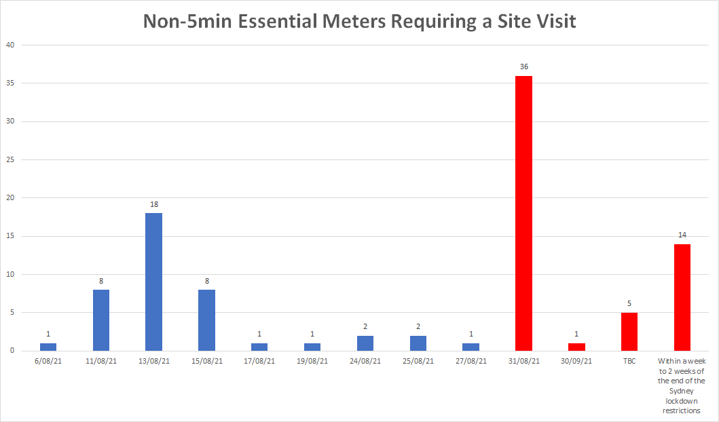
Non-5min Capable Essential Meters Requiring Site Visits
98 meters
65 Bulk Supply
15 Generators
8 Market Customers
7 SGAs
3 Cross boundary
56 meters comprise the red columns
28 Bulk Supply
13 Generators
8 Market Customers
7 SGAs

Slide 9
Contingency Planning
Blaine Miner

Slide 10
Contingency Planning
Scenario | Content Basis | Trigger(s) | Monitoring | Contingency Response(s)
C2 - Essential meter(s) installation and reconfiguration not fully compliant at 5MS commencement | Proposed Content | Participant provided information shows that applicable MTP activities are running late resulting in a number of Essential meters not being fully compliant at 5MS Rule commencement | Industry Readiness report Rollout plans and reports | MCs to engage the AER to discussion potential compliance issues MCs to provide contingency plans to AEMO and the AER Plans may need to include agreements with effected Participants re the creation and delivery of permanent substitutions Escalate issue, recommend actions and seek guidance from the PCF and EF as appropriate
MCs should engage AEMO and the AER, as early as possible, to discuss potential compliance issues
MCs must establish and provide AEMO with a contingency plan where:
A type 1-3 or subset of 4 meter is not expected to be 5min capable by 31 August 2021
For MC consideration:
Contingency plans may need to consider gaining agreements between effected Participants (FRMP, LR, LNSP and AEMO) where permanent substitutions may be required from 1 Oct 2021 until the meter is 5min capable/compliant

Slide 11
Contingency Planning
Scenario | Content Basis | Trigger(s) | Monitoring | Contingency Response(s)
C3 - MDP(s) not providing 5-minute data for Essential meter(s) as required at 5MS commencement resulting in short term financial volatility | Proposed Content | Participant provided information shows that applicable MTP activities are running late resulting in 5min metering data not being provided for a number of Essential meters at 5MS Rule commencement | Industry Readiness report Rollout plans | MCs to engage the AER to discussion potential compliance issues MCs to provide contingency plans to AEMO and the AER Escalate issue, recommend actions and seek guidance from the PCF and EF as appropriate
MCs should engage AEMO and the AER, as early as possible, to discuss potential compliance issues
MCs must establish and provide AEMO with a contingency plan where:
They are not confident that their MDP will be able to deliver 5min metering data by 1 Oct 2021
MDPs have not commenced delivering 5min metering data to AEMO by 31 August 2021 (MTP transition end date)
Contingency plans to include alternative processes/channels to ensure the successful delivery of 5min metering data to AEMO and market participants from 1 Oct 2021

Slide 12
MTP Update
Blaine Miner

Slide 13
MTP Update
Activities Now Deemed Completed
Description | Date | Activity ID
MPs to install or reconfigure meters as required (tranche 1) | By 31 July 2021 | A4, A9, A14, A20
MPs to update the Meter Read Type codes with RWDA | By 31 July 2021 | A4a, A9a, A14a, A20a
MPs to apply for data storage exemptions as required | By 31 July 2021 | A5, A10, A15, A21
DNSPs to provide cross boundary information to AEMO to enable the determination of TNI2 values | By 31 July 2021 | A97c

Slide 14
Upcoming MTP Transition End Dates
Description | Date | Activity ID
MCs, for any registered ‘Special Site’ (as defined in the ‘Special Sites and Technology Related conditions within the National Electricity Market Version 1.2) or any Logical NMI, update and distribute algorithms adjusted for introduction of 5 minute interval length to AEMO, FRMP and LNSP for approval. | By 31 August 2021 | A31
MDPs to create/activate export and import (active (kWh) and reactive (kVarh)) energy datastreams in CNDS table | By 31 August 2021 | A36, A40, A45, A51
MPs to complete data cleanse to ensure, the RegisterID matches the content of the ‘Suffix’ within the CATS_REGISTER_IDENTIFIER table. E.g. ‘E1’, ‘B1’, ‘Q1’, ‘K1’, etc. | By 31 August 2021 | A36a, A40a, A45a
MDPs to update Type 7 datastreams in MSATS | By 31 August 2021 | A83
DNSPs and AEMO - Cross boundary supplies: create cross boundary NMIs, datastreams and registers; DNSPs to provide cross boundary information to AEMO; AEMO to provide TNI2 values; DNSPs to update TNI fields with TNI2 values | By 31 August 2021 | A95, A96, A97, A95b, A97a, A97b
DNSPs, MDPs and MPs - Create NCONUML NMIs, datastreams and registers | By 31 August 2021 | A99, A100, A101
DNSPs and AEMO - Update NMIs with new NMI Classification codes as required | By 31 August 2021 | A103, A105, A107, A109, A111, A113, A115
MDPs to ensure all Sample meters have a Datastream type code of 'P' and are attached to a Profile | By 31 August 2021 | A119
MDPs to update VIC TUoS Datastream type codes from 1-4 to 'I' or 'N' as required | By 31 August 2021 | A120
5min metering data delivered to AEMO (MDFF) | By 31 August 2021 | A35, A41, A46, A50

Slide 15
Industry Readiness Survey & 5MS Start Notice
Greg Minney

Slide 16
Readiness reporting – 2021 schedule
Readiness reporting | Survey released | Survey responses due | Distribute results | Discuss at RWG meeting | Discuss at PCF | Discuss at EF
Round #9 | 04-Aug-21 | 13-Aug-21 | 27-Aug-21 | 07-Sep-21 | 19-Aug-21 | 30-Aug-21
Responses to the final pre-Rule commencement readiness survey are due by COB this Friday (13 August)
As this is the last readiness assessment prior to the 1 October 2021 Rule commencements, we have added, modified and removed questions to ensure we focus on what’s most important to support the 5MS start notice process
Readiness results will be a key input into the 5MS start notice decision-making process

Slide 17
Readiness assessment
ESSENTIAL CAPABILITY
CRITERIA
SUPPORTING ASSESSMENT
AEMO Capability
Metering Platform: Is deployed and has stable business operation
Metering Platform:
Receive and process 5 minute metering data.
Support 5 Minute Profiling / UFE
Market Trial
Production Operation
Settlements Platform: Is deployed and has stable business operation
Settlements Platform: Support 5 Minute Settlement processes
Independent Certification
Market Trial
Production Operation
Bidding Platform: The 5-minute bidding and dispatch solution, including the web bidding interface is deployed and has stable business operation.
Bidding Platform:
Support 5 Minute Bidding Services
Provide 5 Minute Bidding interface
Market Trial
Production Operation
Essential metering
All essential meters* are able to produce and store 5-min data
MP's upgraded ensured that essential meters are capable of providing 5 minute metering data
Market Trial
Metering Data Delivery
Meter Rollout Plans & reports, MTP delivery
Participant Readiness Reporting
All essential meters* are able to deliver 5-min metering data
MDPs are able to provide 5 minute metering data for essential meters for settlement
Bidding
Generators are capable of providing 5 minute bids
Generators and MNSPs are able to submit 5-min offers
Market Trial
“Transition bidding”
Participant Readiness Reporting

Slide 18
OTHER PARTICIPANT CAPABILITY
CRITERIA
SUPPORTING ASSESSMENT
Retailer
Receive and process 5-minute metering data Receive and process 5-minute Settlement statements
Participant Readiness - Reporting
Market Trial
Bi Lateral Testing
Capability to operate retail functions in place
DNSP
Metering and Standing Data capability in place to support GS and 5MS
Receive and process 5-minute metering data
Provide GS Metering and Standing Data updates (inc. NCONUML)
Participant Readiness - Reporting
Bi Lateral Testing
Market Trial
Rollout Plans & reports, MTP delivery
TNSP
Metering and Standing Data capability in place to support GS and 5MS
Participant Readiness - Reporting
Market Trial
Rollout Plans & reports, MTP delivery
Bi Lateral Testing
MDP
Metering Data delivery compliance requirements met
Provide 5-minute Data T1-3 Distribution connected metering data Provide T1 Basic Metering Data Provide MDFF Interval Data / Inc
Market Trial
Rollout Plans & reports, MTP delivery
Bi Lateral Testing
Participant Readiness - Reporting
MP
Meter upgrade compliance requirements
Provide 5 Minute metering Data (type 4, 4A, VicAMI) T1-3 distribution connected meters capable of producing 5-minute Data
Participant Readiness - Reporting
Market Trial
Rollout Plans & reports, MTP delivery
Generator
Generators and MNSPs are able to submit 5-min offers
Submit 5-minute bids Process 5-minute settlement and metering data
Participant Readiness - Reporting
Market Trial
“Transition bidding”

Slide 19
Key Criteria for 5MS Start Notice
The 5MS start notice will consider the following readiness items:
AEMO’s 5min readiness, including system stability and market trial
Critical Participant capability
Metering installation & metering data delivery readiness
Based on participant reporting, market trial, rollout plans and established contingency plans
Generation/bidding readiness
Based on participant reporting, market trial and transitional bidding
‘Other’ Participant capability
Will be taken into account to consider broader industry readiness

Slide 20
Cross Boundary Supplies
David Ripper

Slide 21
Cross Boundary Supplies
Emergency connections
Cross boundary connection point information collated by DNSPs has identified that emergency connections are metered and unmetered
Cross Boundary Supply Guideline only included requirements for unmetered emergency connections
Cross Boundary Supply Guideline to be amended to include:
Requirements for both metered and unmetered emergency connections.
Condition when downstream NMI TNI field to be populated with TNI2 (>5 business days)

Slide 22
Cross Boundary Supplies
Requirements – Unmetered emergency connections (currently 3.4(c))
Identification of each emergency connection
Frequency of operation of the emergency connection
Description of each energy transfer incident
Start and end dates and times of energy transfer incident
Energy transfer direction (example from LNSP A to LNSP B, and TNI1 to TNI2)
Identification of metering installation requirements
Available forms of energy measurement
Measured or estimated quantity of transferred electrical energy and basis for determination
NMIs impacted by the energy transfer
Identify MDP(s) with capability to collate energy transfer volumes into TI metering data.
NMI status and data stream status when emergency connection in use and not in use
Metering data quality flags when emergency connection in use and not in use.

Slide 23
Cross Boundary Supplies
Requirements – Metered emergency connections (proposed)
Identification of each emergency connection
Frequency of operation of the emergency connection
Description of each energy transfer incident
Start and end dates and times of energy transfer incident
Energy transfer direction (example from LNSP A to LNSP B, and TNI1 to TNI2)
NMIs impacted by the energy transfer
NMI status and data stream status when emergency connection in use and not in use
Metering data quality flags when emergency connection in use and not in use.

Slide 24
NMI Classification Definitions
David Ripper

Slide 25
NMI Classification Definitions
NREG and GENERATR definition clarification
NREG:
Connection point associated with a stand-alone non-registered embedded generator at which:
the embedded generating unit is classified by a Market Small Generation Aggregator as a market generating unit; or
the embedded generating unit is owned, operated and controlled by a person who meets the requirements of NER 5.3.1A(c)(2) or (3), or
the non-registered embedded generator, defined in NER 5A.A.1, meets the requirements of NER 5A.A.2.
GENERATR:
Connection point associated with a generating system classified by as a Market Generator by AEMO. This NMI Classification is to be assigned by AEMO from the Generator registration approval date.

Slide 26
NMI Classification Code Definitions
DWHOLSAL
How to identify DWHOLSAL NMIs
LR Participant ≠ POOL% (distribution connected NMI)
NMI Class Code = WHOLSAL
NSP2 Participant Id does not exist (not Cross Boundary)
Embedded Network Code does not exist (distribution connected NMI)

Slide 27
Next steps and General Business
Greg Minney

Slide 28
Next steps and General Business
Next TFG scheduled for Thursday 9 September
5MS Start Notice
Market Trial
Readiness Survey Results
Essential and Tranche 1 meter update
Industry readiness responses due by COB this Friday, 13 August

Slide 29
Thank you for your attendance and participation!

