Slide 1
5MS/GS Transition Focus Group #13:
Thursday 11th March 2021
WebEx only [details in calendar invitation]
**Please disconnect from your workplace VPN for the WebEx call**
PLEASE NOTE THIS MEETING WILL BE RECORDED FOR THE PURPOSE OF PREPARING MINUTES

Slide 2
AEMO Competition Law
Meeting Protocol
AEMO is committed to complying with all applicable laws, including the Competition and Consumer Act 2010 (CCA). In any dealings with AEMO regarding proposed reforms or other initiatives, all participants agree to adhere to the CCA at all times and to comply with this Protocol. Participants must arrange for their representatives to be briefed on competition law risks and obligations.
Participants in AEMO discussions must:
Ensure that discussions are limited to the matters contemplated by the agenda for the discussion
Make independent and unilateral decisions about their commercial positions and approach in relation to the matters under discussion with AEMO
Immediately and clearly raise an objection with AEMO or the Chair of the meeting if a matter is discussed that the participant is concerned may give rise to competition law risks or a breach of this Protocol
Participants in AEMO meetings must not discuss or agree on the following topics:
Which customers they will supply or market to
The price or other terms at which Participants will supply
Bids or tenders, including the nature of a bid that a Participant intends to make or whether the Participant will participate in the bid
Which suppliers Participants will acquire from (or the price or other terms on which they acquire goods or services)
Refusing to supply a person or company access to any products, services or inputs they require
Under no circumstances must Participants share Competitively Sensitive Information. Competitively Sensitive Information means confidential information relating to a Participant which if disclosed to a competitor could affect its current or future commercial strategies, such as pricing information, customer terms and conditions, supply terms and conditions, sales, marketing or procurement strategies, product development, margins, costs, capacity or production planning.

Slide 3
Agenda
**Please disconnect from your workplace VPN for the WebEx call**
NO | Indicative Time | AGENDA ITEM | Responsible
1 | 10:30 - 10:40 | Welcome and introduction | Greg Minney
3 | 10:40 - 11:00 | Readiness report summary | Austin Tan
4 | 11:00 - 11:20 | Roll-out plans overview | Blaine Miner
5 | 11:20 - 11:40 | RTC transition approach | Blaine Miner
6 | 11:40 - 12:00 | Upcoming MTP Activities | Blaine Miner
7 | 12:00 - 12:10 | MSDR Data Transition WG Update | Blaine Miner
8 | 12:10 - 12:25 | GLOPOOL planning | Paul Lyttle
9 | 12:25 - 12:30 | Next steps and general business | Greg Minney

Slide 4
Readiness report summary
Austin Tan

Slide 5
5MS Rule Commencement – Round 6- Draft
 | On track | On track for commencement date
 | Risk 1 – Risk to major milestones or deliveries | Remediation or contingency activation required to ensure on track delivery for Rule Commencement
 | Risk 2 – Risk to rule commencement | Cannot be addressed with available contingencies to be on track for commencement date
On track
Risk 1
Risk 2
Activity | Status | Comments
AEMO Business Readiness for 5MS and GS (Part A) |  | Bidding platform operating successfully in Industry test, on schedule for 1 April Go-live Retail Platform go-live rescheduled to 31 May, Settlements platform rescheduled to 17 May Rescheduling of platform deliveries is not expected to impact 5MS Rule commencement nor 5MS market trials
Essential Industry Capabilities for 5MS commencement (Part A) |  | On track for 1 Oct 21 commencement MDPs and MPs reporting on track with minor exceptions Generators reporting on-track
Summary: 5MS Rule Commencement |  | Overall Industry and AEMO components of essential capability currently on track for 5MS Rule commencement
Other industry capabilities for 5MS and GS (Part B) |  | Other Participant readiness activities proceeding in line with 5MS Rule commencement Individual participant readiness risks noted in regards to Global Settlement standing data maintenance activities., no systemic issues noted
Risk 1
On track
On track
On track
*** As At 22 Feb 2021

Slide 6
Part A 5MS Essential Capability - Draft
 | On track | On track for commencement date
 | Risk 1 – Risk to major milestones or deliveries | Remediation or contingency activation required to ensure on track delivery for Rule Commencement
 | Risk 2 – Risk to rule commencement | Cannot be addressed with available contingencies to be on track for commencement date
On track
Risk 1
Risk 2
Responsible Participant | Essential Criteria | Status | Comments
Generator | Generators and MNSPs are able to submit 5-min offers |  | 16/17 Generators representing 95% of NEM volume reporting on-track 15/17 intending to participate in Market Trials Average program completion 50-74% 12/17 intending to commence 5-minute bidding within transition period
MP, MC | All essential meters* are able to produce and store 5-min data |  | 9/10 MPs reporting on track 1 MP reporting “late”, remediation in place
MDP | All essential meters* are able to deliver 5-min metering data |  | 3/3 MDPs servicing Essential meters are reporting programs on track Rollout plans to be used to support responses
AEMO | The 5-minute bidding and dispatch solution, including the web bidding interface is deployed |  | AEMO bidding platform deployed for Industry testing, on track for 1 April production deployment.
 | The Metering Data Management (MDM) solution is deployed |  | Mitigation Action: Retail Platform Deployment rescheduled to 31 May, criteria rated Amber to reflect the increase in delivery risk
 | The 5-minute settlements solution is deployed |  | Mitigation Action: AEMO Settlement Platform deployment rescheduled to 17th May. Industry test period extended to reflect changed order of platform deployment. Certification testing of platform completed
Summary - Essential Criteria | - | - | All components on track for delivery at 5MS rule commencement, AEMO Metering and Settlement rating reflects shift in planned go-lives and subsequent compression of transitional activity
On track
On track
On track
On track
Risk 1
Risk 1
On track
*** As At 22 Feb 2021

Slide 7
Part B – Other Industry Capabilities - Draft
Responsible Participant | Criteria | Status | Comments
Retailer | Receive and process 5-minute metering data. Receive and process 5-minute settlement data. |  | All responding retailers (18, representing 95% of retail load) reporting ‘On track’. 17/18 retailers plan to participate in Market trials. 6/18 intend to perform in Bi-Lateral Testing. 18/18 ‘On-track’ for 5-min settlement data, with 2 reporting late for UFE Allocation
DNSP | Receive and process 5-minute metering data. |  | 10/10 DNSPs reporting ‘On track’ to receive 5-min metering data and planning on participating in market trials.
 | Provide GS metering and standing data updates (incl. NCONUML). |  | 10/10 DNSPs reporting ‘On track’ with average program completion of 50-74% GS Standing Data updates generally reported as ‘On track’ (including NCONUML). 1 Participant reporting ‘At-risk’ for the delivery of NCONUML, Type 7 5-min metering data “On Track”
TNSP | Receive and process 5-minute metering data |  | 6/6 TNSPs reporting ‘On track' to receive 5-min metering data 2/6 have the intention to receive 5-min metering data prior to the Rule commencement date
 | Provide GS metering and standing data updates |  | 6/6 reporting ‘On track’.
MDP | Provide 5-minute metering data T1-3 distribution connected meters, type 7 meters. |  | 16/17 MDPs reporting ‘On track’, representing 100% coverage of Tranche 1 NMIS 1 participant ‘At risk’, recovery plan is in place 17/17 MDPs report ‘On track’ for the delivery of 5-min metering data by 1 October, including 1 MDP flagging “A risk” for delivery of T1-3 customer meters
 | Provide type 4, 4A, Vic Ami metering data at 5-minute granularity by 1 December 2022 |  | Majority of tranche 2 rollouts scheduled to commence from 3rd quarter of 2021. 100% of MDPs reporting ‘On track’ for interval meter delivery by Rule commencement.
 | Provide basic metering data for tier 1 NMIs to AEMO. |  | 3 MDPs reporting ‘Completed’, 6 MDPs reporting “On Track” 1 MDP reporting ‘Late’ against the MTP with a plan to commence data delivery prior to 1 Oct
MP, MC | All T1-3,4* meters are able to produce and store 5-minute data. |  | 18 /19 MPs representing tranche 1 meters reporting ‘On track’ 1 reporting ‘Late’ with a stated remediation plan
Summary | - | - | Overall summary “on track” , no systemic issues identified, individual exceptions noted
On track
On track
On track
On track
On track
On track
*** As At 22 Feb 2021

Slide 8
Readiness report summary
Reporting against MTP Dates
  Participants are to report status and progress against transition end dates, not Rule dates
    If a MTP transition end date cannot/will not be met, a remediation plan must be provided
Approach to reporting MTP activities as ‘Late’ or ‘At Risk’
  Activities to be reported as ‘Late’ only where:
    The MTP transition end date has passed, and the activity has not been completed
    The MTP activity will not be completed by the MTP transition end date even with remediation
      The remediation plan is to be provided with the readiness survey, including expected completion date
      NB A ‘Late’ status is to be based on the MTP transition end dates, not on a Participant’s internal program dates
  Activities to be reported ‘At Risk’ only where:
    A Participant’s progress towards a MTP transition end date indicates that the completion date may not be met
      The remediation plan is to be provided with the readiness survey, including expected completion date
Impact Assessments
  For activities that are ‘Late’, industry impact assessments may be required
    Note, this is not being requested for compliance purposes but instead to enable other participants to assess potential impacts on their own programs and preparations

Slide 9
Rollout plans overview
Blaine Miner

Slide 10
Roll-out plans overview
Objective
  Rollout plans are to be provided to AEMO to assist in confirming:
    Tranche 1 meters becoming 5min capable (MTP by 31 July 2021 and Rule by 1 Oct 2021)
    Tranche 2 meters delivering 5min metering data (MTP by 30 Nov 2022 and Rule by 1 Dec 2022)
    Tranche 1 and 2 datastreams being converted from Net to register level
    NCONUML and ‘unknown’ cross boundary NMIs being created
AEMO’s validations
  AEMO will mainly scrutinise Tranche 1 meter rollout plans, using MSATS Prod values as a gauge
  AEMO is considering the development of reports to validate RTC code population and 5min metering data delivery for Tranche 1 meters (emphasis will initially be on essential meters)
General observations
  Good coverage across all plan types
  Several Participants have not consented to sharing their rollout plans with Industry
  AEMO proposing to request Tranche 1 Metering Data Delivery plans from 1 May
Next steps
  AEMO to circulate rollout plans where explicit consent has been provided
  AEMO to circulate updated rollout plan templates to ensure reporting is at the meter level, excluding NCONUML and ‘unknown cross boundary NMI creation plans
  AEMO to update its CATS transaction volume analysis and share the updated results with the TFG

Slide 11
Provided Plans’ Summary
Organisation | MC/MP Tranche 1 | MDP - Tranche 2 | MDP Net to Register | LNSP NCONUML and CB | Explicit Consent Provided
AusGrid​ | Yes | Yes | Yes | Yes | Yes
Ausnet Services​ |  | Yes | Yes | Yes | Yes
CitiPower Powercor​ | Yes | Yes | Yes | Yes | Yes
ElectraNet | Yes |  |  | Yes | Yes
Endeavour |  |  | Yes | Yes | Yes
Energex DB |  | Yes | Yes | Yes | Yes
Ergon DB |  | Yes | Yes | Yes | Yes
Essential Energy​ | Yes | Yes | Yes | Yes | No
EvoEnergy | Yes |  | Yes | Yes | No
Intellihub​ | Yes | Yes | Yes |  | No
Jemena | Yes | Yes | Yes | Yes | Yes
Mondo​ | Yes | Yes | Yes |  | No
Origin | Yes |  |  |  | No
Organisation | MC/MP Tranche 1 | MDP - Tranche 2 | MDP Net to Register | LNSP NCONUML and CB | Explicit Consent Provided
PLUS ES | Yes | Yes | Yes |  | Yes
Powermetric​ | Yes |  |  |  | No
SAPN |  |  | Yes | Yes | Yes
Secure Meters​ | Yes | Yes | Yes |  | No
TasNetworks (LNSP) |  |  | Yes | Yes | Yes
TasNetworks (TNSP) | Yes |  |  |  | Yes
Transgrid | Yes |  |  |  | Yes
United Energy​ | Yes | Yes | Yes | Yes | Yes
Vector​ |  | Yes | Yes |  | No
Yurika​ | Yes | Yes | Yes |  | No

Slide 12
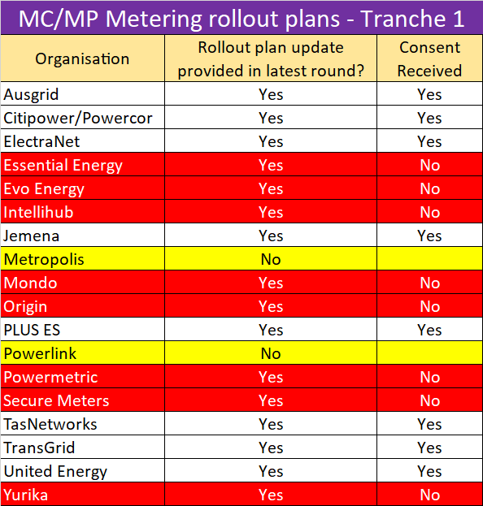
MC/MP Metering rollout plans
Tranche 1 meters
16 Rollout plans received
  8 Participants consented to sharing their plans
Over 93% tranche 1 meter coverage
Over 25% Tranche 1 meters reported as been 5min capable

Slide 13
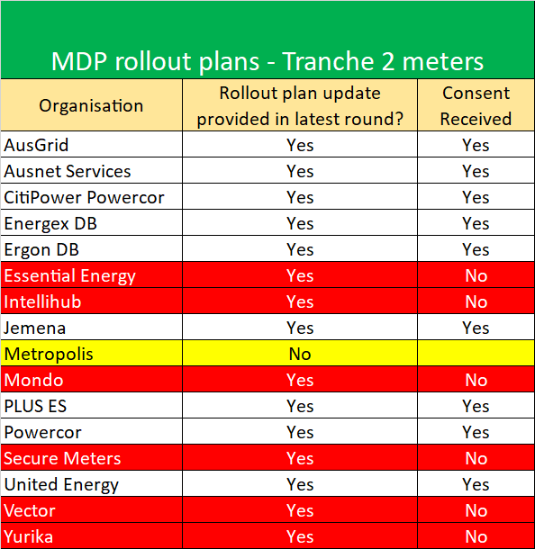
MDP 5min Metering Data Delivery rollout plans
Tranche 2 meters
15 Rollout plans received
  9 Participants consented to sharing their plans
Over 2.5 million meters in total
Conversions mainly commencing from Q1 2022

Slide 14
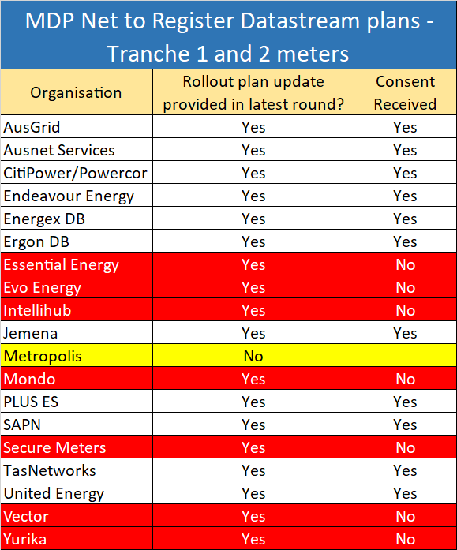
MDP Net to Register Datastream Conversion plans
Tranche 1 and 2 meters
18 conversion plans received
  11 Participants consented to sharing their plans
Over 2.7 million meters in total
Conversions to commence from Q3 this year

Slide 15
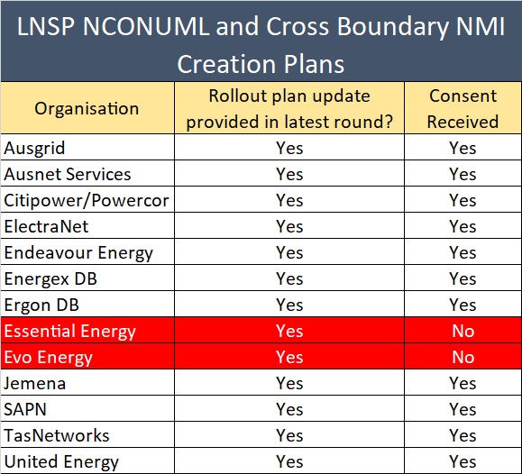
LNSP NCONUML and Cross Boundary
NMI Creation Plans
13 plans received
  11 Participants consented to sharing their plans
~115k NCONUML NMIs expecting to be created

Slide 16
RTC transition approach
Blaine Miner

Slide 17
RTC Draft Transition Approach
By 1 Oct 2021
  All Tranche 1 meters (type 1-3, subset of 4 and cross boundary) to have their RTC updated with a fourth character of ‘A’ or ‘D’ (de-energisation scenarios only)
From 1 Oct 2021 to 30 Nov 2022
  All Tranche 2 meters (new and replacement type 4, 4A, VICAMI, etc.) to have their RTC updated with a fourth character of ‘A’ or ‘D’ (de-energisation scenarios only)
From 1 Dec 2022 onwards
  All other meters (e.g. basic meters) to have their RTC updated with a fourth character
The allowance of MPs to update the other RTC combinations with the appropriate 4 character code, resulting from BAU activities only, from 1 May 2021
‘Mass’ updating of this field should be discouraged without the prior engagement of effected Participants.
The MSDR Data Transition WG will take carriage of finalising these arrangements

Slide 18
Upcoming MTP Activities
Blaine Miner

Slide 19
Upcoming v1.7 MTP Activities
Description | Date | Activity ID
MCs to provide visibility of the approach / timeframe for required meter replacement or reconfiguration of ‘unknown’ cross boundary meters | By 31 March 2021 | A23
MCs to ensure that details of the Inventory Table, calculation methodologies and Agreed Loads are agreed prior to implementation by relevant Registered Participants | By 31 March 2021 | A87
AEMO to have the capability to provide 5-min metering data based on SCADA data | By 1 April 2021 | A30
MPs to update the Meter Read Type code with RWDA or RWDD, as applicable, as per the transitional arrangements | From 1 May 2021 | A4a, A9a, A14a, A20a, A25a, A26a, A27a, A28a
AEMO Metering Business to approve MDP NCONUML profiles/algorithms | By 1 May 2021 | A89
MDPs to provide AEMO with NMI lists associated with each NCONUML profile/algorithm | By 1 May 2021 | A89a
MCs to provide progress and amendments to forward plans for Type 1-3, subset of 4 and ‘known’ cross boundary meters to AEMO | By 1 May 2021 | A3a, A8a, A13a, A19a
MDPs to provide progress and amendments to forward plans for Type 1-3, subset 4, 4, 4A, VICAMI and Sample meters to AEMO | By 1 May 2021 | A52a, A58a, A64a, A70a
MDPs to provide datastream conversion plans to convert Net datastreams to register level | By 1 May 2021 | A32a, A37a, A42a, A52b, A58b, A64b, A70b, A82a
LNSPs to provide NMI Create plans for Cross Boundary and NCONUMLs to AEMO | By 1 May 2021 | A95a, A99a

Slide 20
Upcoming v1.7 MTP Activities
Description | Date | Activity ID
Participants to establish agreements to allow the delivery of 5min metering data pre 1 Oct 2021 between NSP, Retailer, MDP and AEMO, as applicable | By 31 May 2021 | A32, A37, A42, A47, A53, A59, A65, A71, A84, A88
MDPs to create/convert export and import Active (kWh) and Reactive (kVarh) energy datastreams, where applicable, in the CNDS table | From 31 May 2021 | A36, A40, A45, A51, A57, A63, A69, A75
Participants to create cross-boundary NMIs, datastreams and registers | From 31 May 2021 | A95, A96, A97
Participants to create NCONUML NMIs, datastreams and registers | From 31 May 2021 | A99, A100, A101
MDPs able to send 15 and 30min metering data via MDFF to AEMO | From 31 May 2021 | A94
LNSPs to apply new NMI classification codes | From 31 May 2021 | A103, A105, A107, A109, A111, A113, A115
MDPs to provide 5min metering data to AEMO (MDFF) (Export and import (active (kWh) and reactive (kVarh)) energy metering data as applicable) | From 21 June 2021 | A35, A41, A46, A50, A56, A62, A68, A74, A86, A92
SAPN to make existing 'Bulk' NMI extinct in MSATS and create/activate individual controlled load datastreams and registers | By 30 June 2021 | A101a, A101b, A102c
MDPs to deliver tier 1 basic meter metering data (Actuals, Subs and Forward Estimates) to AEMO | By 30 June 2021 | A93
MPs Install or reconfigure 5min meters as required | By 31 July 2021 | A4, A9, A14, A20, A24
MPs to apply for data storage exemptions as required | By 31 July 2021 | A5, A10, A15, A21,

Slide 21
MSDR Data Transition WG Update
Blaine Miner

Slide 22
MSDR Data Transition WG Update
Initial MSDR WG meeting scheduled for Tues 30 March 2021
Indicative approach to the workshop and outputs
  Objective
    To establish transitional arrangements, where appropriate, to enable an orderly data transition
      Participants should be prepared to propose and explain preferred holiday/transitional arrangements
  Approach
    A pack will be sent out prior to the meeting, which is expected to outline AEMO’s draft plan for the data transition
    Participants will be asked to provide indicative CR volumes (including notifications) to help inform the discussions on the day
    Suggested prioritisation based on volumes of data (CR and Notifications) being rated highest to lowest
    Planning to break up the workshop attendees into smaller groups (virtually using the Teams "Breakout groups" function) to discuss lower-level field details
    Second workshop will be used to finalise transitional arrangements

Slide 23
GLOPOOL Planning
Paul Lyttle

Slide 24
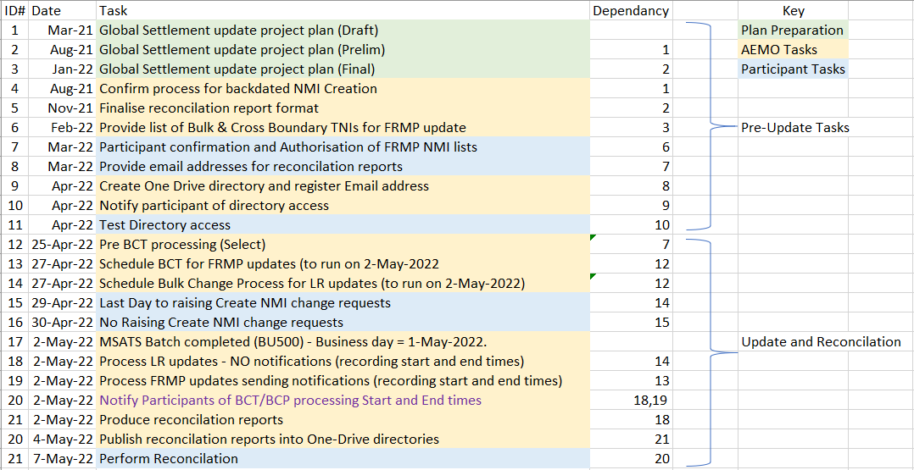
GLOPOOL Update
AEMO’s suggested time frames
  What additional information are participants looking to be included in plan?
  Timeframes are for discussion.

Slide 25
Next steps and general business
Greg Minney

Slide 26
Next steps & general business
AER interested in Participant 5MS/GS readiness
  Have engaged AEMO to understand current status
  Confidential information not being shared, information is being aggregated e.g. Industry Readiness Reports
Cross boundary guidelines update
Next TFG scheduled for 15 April 2021
  Agenda items for next meeting
    Updated CATS Volume analysis
    Debrief from MSDR DT WG
    ??

Slide 27
Thank you for your attendance and participation!

