Slide 1
5MS & GS Readiness Working Group #23 (incl. Systems Working Group)
Thursday, 13 May 2021
This meeting is recorded for the purpose of minute taking.
Please disconnect from your workplace VPN for the WebEx call

Slide 2

AEMO Competition Law
Meeting Protocol
AEMO is committed to complying with all applicable laws, including the Competition and Consumer Act 2010 (CCA). In any dealings with AEMO regarding proposed reforms or other initiatives, all participants agree to adhere to the CCA at all times and to comply with this Protocol. Participants must arrange for their representatives to be briefed on competition law risks and obligations.
Participants in AEMO discussions must:
Ensure that discussions are limited to the matters contemplated by the agenda for the discussion
Make independent and unilateral decisions about their commercial positions and approach in relation to the matters under discussion with AEMO
Immediately and clearly raise an objection with AEMO or the Chair of the meeting if a matter is discussed that the participant is concerned may give rise to competition law risks or a breach of this Protocol
Participants in AEMO meetings must not discuss or agree on the following topics:
Which customers they will supply or market to
The price or other terms at which Participants will supply
Bids or tenders, including the nature of a bid that a Participant intends to make or whether the Participant will participate in the bid
Which suppliers Participants will acquire from (or the price or other terms on which they acquire goods or services)
Refusing to supply a person or company access to any products, services or inputs they require
Under no circumstances must Participants share Competitively Sensitive Information. Competitively Sensitive Information means confidential information relating to a Participant which if disclosed to a competitor could affect its current or future commercial strategies, such as pricing information, customer terms and conditions, supply terms and conditions, sales, marketing or procurement strategies, product development, margins, costs, capacity or production planning.

Slide 3
Agenda
NO | Indicative Time | AGENDA ITEM | Responsible
1 | 10:30 - 10:40 | Welcome and Introduction | Greg Minney
2 | 11:00 - 11:20 | May Rollout plan overview (inc CATS transaction update) | Blaine Miner / Paul Lyttle
3 | 11:20 - 11:40 | MTP Update | Blaine Miner
4 | 11:40 - 12:00 | Next Steps and General Business | Greg Minney

Slide 4
Welcome
Greg Minney

Slide 5
Attendees (1/2)
Organisation​ | Attendee​ | Organisation​ | Attendee​
Greg Minney | AEMO (Chair) | Ramesh Khadka | Electranet
Blaine Miner | AEMO | Steve Smith | Energex
Anne-Marie McCague | AEMO | Nicole Bright | Energy Queensland
David Ripper | AEMO | Ingrid Farah | Ergon
Liz Bernhardt | AEMO | Ben Donnelly | Essential Energy
Paul Lyttle | AEMO | Noel Petrie | Essential Energy
Peta Hatzikides | AEMO | Steve Blair | Essential Energy
Sarah Pearson | AEMO | Jeff Roberts | Evoenergy
Tui Grant | AEMO | Victor Sanchez | Infigen Energy
Collette Reedy | Actew AGL | Rob Mcneur | Intellihub
Pieter Wijtzes | AGL | Warren Van Wyk | IntelliHUB
Shaun Cupitt | Alinta Energy | Chantal Wright | Jemena
Kevin Boutchard | Aurora Energy | Joseph Lyttleton | Jemena
Wayne Turner | Ausgrid | Leon Vilfand | Jemena
Con Michailides | AusNet Services | Matthew Mullen | Jemena
Keith Powell | AusNet Services | Rajiv Kumar Balasubramanian | Jemena
Vicki Grant | CleanCo | Deena Sri | Mondo

Slide 6
Attendees (2/2)
Organisation​ | Attendee​ | Organisation​ | Attendee​
Dev Kanda | Mondo | Sandra Ho | Snowy Hydro
Jay Summers | Mondo | Adam Neilson | Stanwell
Richard Metherell | Mondo | Elizabeth Keogh | Stanwell
Mario Iogha | Origin Energy | Michael Flynn | Stanwell
Linda Brackenbury | PlusES | Rossi Mangano | Stanwell
Mark Pilkington | Powercor | Sudeshna Nanda | Stanwell
Dean Knight | Powerlink | Adrian Honey | TasNetworks
Karel Mallinson | Powerlink | Joanna Ford | TasNetworks
Mark Reid | Red / Lumo | Adam Hoare | Transgrid
Christophe Bechia | Red Energy | Christian Solis | United Energy
Nick Gustafsson | Red/ Lumo | Paul Greenwood | Vector Metering
David Woods | SAPN | Cindy Matthews | Yurika
Kam Vessali | Secure Meters | Kellie Brooker
Eileen Hayes | Snowy Hydro

Slide 7
May Rollout Plan Overview
Blaine Miner / Paul Lyttle

Slide 8
Rollout Plan Responses
Organisation | MC/MP Tranche 1 | MDP Tranche 1 | MDP Tranche 2 | MP RTC T2 | MDP Net to Reg T1 and T2 | LNSP NCONUML and Cross Boundary | Explicit Consent Provided
AusNet Services |  |  | Yes | Yes | Yes | Yes | Yes
Ausgrid | Yes |  |  |  |  | Yes | Yes
Citipower/ Powercor | Yes |  | Yes | Yes | Yes | Yes | Yes
ElectraNet | Yes |  |  |  |  |  | Yes
Endeavour Energy |  |  |  |  | Yes | Yes | Yes
Energex |  |  | Yes | Yes | Yes | Yes | Yes
Ergon |  |  | Yes | Yes | Yes | Yes | Yes
EvoEnergy | Yes |  |  |  | Yes | Yes | No
Intellihub | Yes | Yes | Yes | Yes | Yes |  | No
Jemena |  |  | Yes | Yes | Yes | Yes | Yes
Mondo | Yes | Yes | Yes |  |  |  | No
Organisation | MC/MP Tranche 1 | MDP Tranche 1 | MDP Tranche 2 | MP RTC T2 | MDP Net to Reg T1 and T2 | LNSP NCONUML and Cross Boundary | Explicit Consent Provided
Origin | Yes |  |  |  |  |  | No
PlusES | Yes | Yes | Yes | Yes | Yes |  | Yes
Powerlink | Yes |  |  |  |  |  | Yes
SAPN |  |  |  |  | Yes | Yes | Yes
TasNetworks (DNSP) |  |  |  |  | Yes | Yes | Yes
TasNetworks (TNSP) | Yes |  |  |  |  |  | Yes
TransGrid | Yes |  |  |  |  |  | Yes
United Energy | Yes |  | Yes | Yes | Yes | Yes | Yes
Vector |  |  | Yes | Yes | Yes |  | No
Yurika | Yes | Yes | Yes | Yes | Yes |  | Yes
Received rollout plan updates from 21 organisations
Over 40% of tranche 1 meters reported as being installed/reconfigured

Slide 9
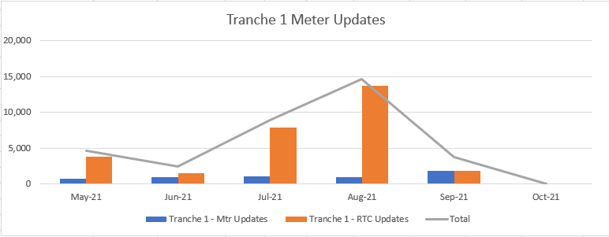
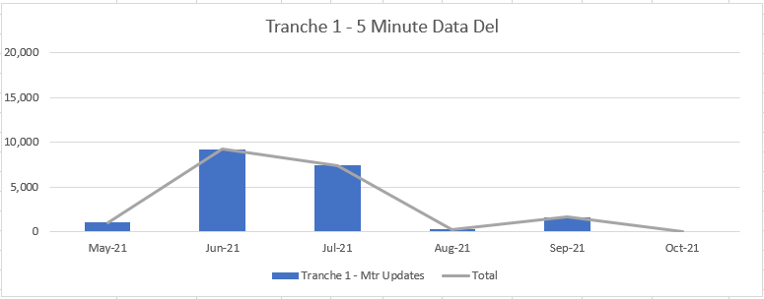
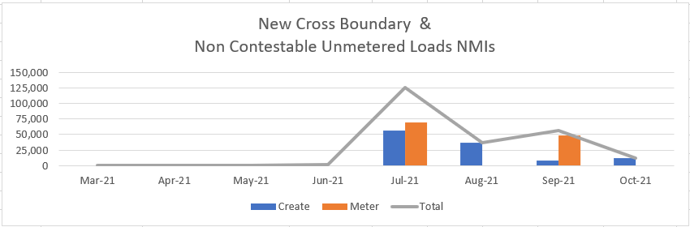
Tranche 1 – Consolidâtes Plan résulta
Consolidated Meter Replacement and Reconfigurations
Consolidated RTC code changes
Peak month is August with 14,645 CRs to be raised
Numbers of Meters to start delivering Data in 5 minute intervals
A total of 19,370 meters to be providing 5 minute reads by end of September
Consolidated Cross Boundary and Non-Contestable Unmetered Load creation and metering.
Peak month is July with 126,008 CRs to be raised

Slide 10
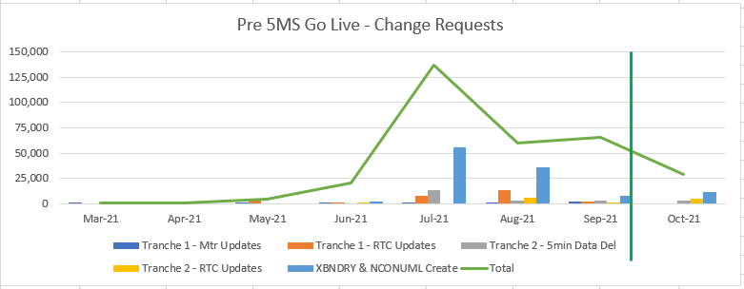
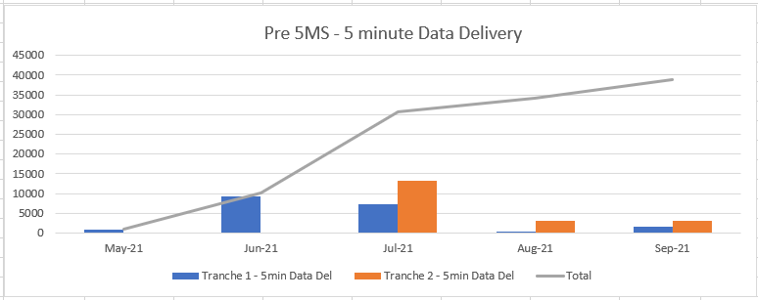
Pre 5MS Consolidâtes Plan Sim mary
Consolidated Tranche 1 & 2 Change requests
Estimated Peak in July with 136,543 CRs to be raised
Numbers include:
  Meter Replacement & Reconfigurations
  RTC updates
  Cross Boundary registration and metering
  Non-Contestable registration and metering
Consolidated Tranche 1 & 2 Meter data delivery in 5 minutes.
A total of 38,964 meters estimated to be providing 5 minute reads by end of September

Slide 11
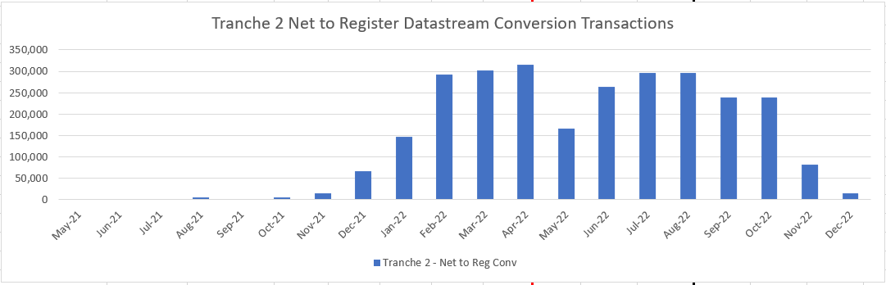
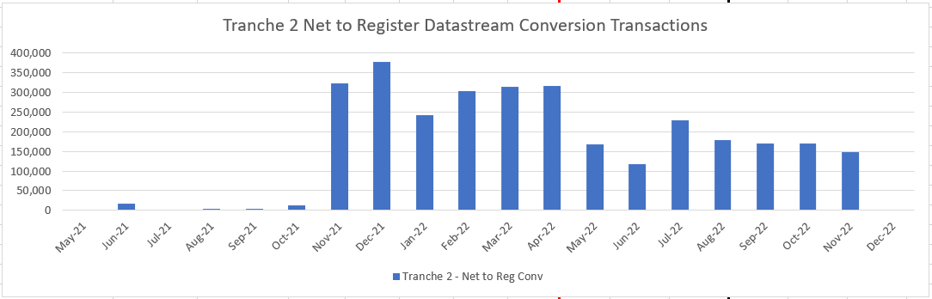
Tranche 2 – Consolidâtes Plan résulta
Consolidated RTC Code changes
Peak month is April 2022 with 315,000 CRs to be raised
Consolidated Net to Register conversions
Peak month is December 2021 with 378,500 CRs expected to be initiated

Slide 12
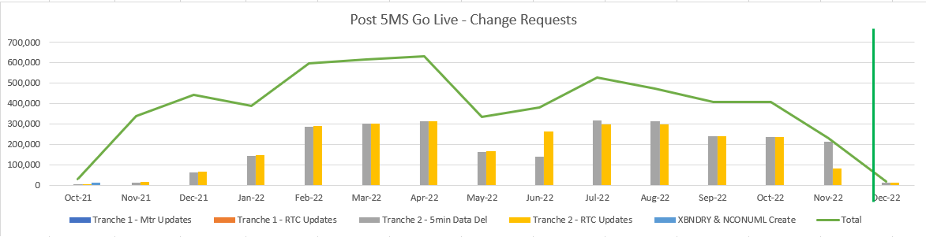
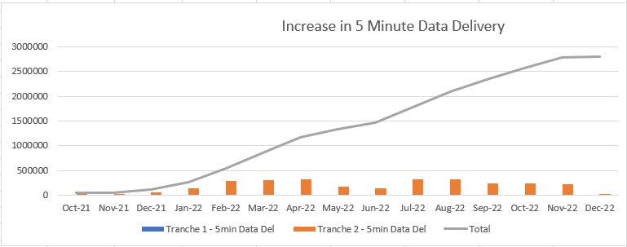
Post 5MS Consolidâtes Plan Summary
Consolidated Tranche 1 & 2 Change requests
Estimated Peak in April with 632,500 CRs to be raised
Numbers include:
  RTC updates
  Net to Register Conversion
Consolidated Tranche 1 & 2 meter data delivery in 5 minutes.
A total of 2,803,964 meters estimated to be providing 5 minute reads by December 2022

Slide 13
Notes
AEMO provided a summary of the rollout plans that had been received associated to the 1 May 2021 MTP deliverable
AEMO went through the latest consolidated transaction volume analysis resulting from the application of the these plans
AEMO answered a number of questions relating to this analysis, including:
  That the 5min metering data delivery volumes are in relation to the delivery of 5min metering data to AEMO via B2M, not Participants via B2B
  The application of NSP2 and TNI2 values associated to cross boundary NMIs, including the updating of the TNI field for the corresponding TNIs values for downstream NMIs
AEMO reminded the TFG that the next round of rollout plans are due by 1 July 2021

Slide 14
MTP Update
Blaine Miner

Slide 15
New Values in Existing MSATS Fields
Examples of effected fields:
  NMI Classification Code e.g. NCONUML, NREG, etc.
  Datastream Type Code – introduction of the ‘non-settlement’ code of ‘N’
  Read Type Code – 4 character codes e.g. RWDA
Schema considerations
  Do you need to go onto the new schema?
    No, both current and superseded schemas support existing fields i.e. new values don’t require a schema change
    ‘New’ schema required for new fields e.g. TNI2 code and new RM reports
Participant system considerations:
  Processing
  Validations
  Application

Slide 16
MTP Update
Proposed Updates
Description | Date | Activity ID
AEMO to provide TNI2 values to LNSPs to support the updating of applicable TNI fields i.e. TNI fields associated to NMIs downstream of a cross boundary NMI (new activity) | By 31 August 2021 | A97a
LNSPs to update the TNI field, for NMIs downstream of a cross boundary NMI, with the AEMO provided TNI2 value (new activity) | By 31 August 2021 | A97b
Provide AEMO estimated number of NMIs and associated energy volumes for each Unmetered Device category within calculation methodology (change in wording) | By 1 May 2021 | A89a
Activities Now Deemed Completed or Late
Description | Date | Activity ID
AEMO Metering Business approve MDP NCONUML profiles/algorithms | By 1 May 2021 | A89
MDPs to provide AEMO estimated number of NMIs and associated energy volumes for each Unmetered Device category within calculation methodology | By 1 May 2021 | A89a

Slide 17
Upcoming Transition End Date Activities
Description | Transition End Date | Activity IDMDPs
Participants to ensure capability to receive and process new NMI classification codes | By 30 May 2021 | A102, A104, A106, A108, A110, A112, A114
Participants to establish agreements to allow the delivery of 5min metering data pre 1 Oct 2021 between NSP, Retailer, MDP and AEMO, as applicable | By 31 May 2021 | A32, A37, A42, A47, A53, A59, A65, A71, A84, A88
SAPN - Convert 'SASCALE NMI’ Make existing 'Bulk' NMI extinct in MSATS Create individual controlled load Datastreams in MSATS Create individual controlled load Registers in MSATS | By 30 June 2021 | A101a, A101b, A101c
MDPs - Create/activate tier 1 basic meter datastreams as required | By 30 June 2021 | A117, A118
MDPs - Delivery of tier 1 basic meter metering data (Actuals, Subs and Forward Estimates) to AEMO | By 30 June 2021 | A93
MPs - Install or reconfigure meters as required | By 31 July 2021 | A4, A9, A14, A20
MPs - Update Meter Read Type code with RWDA | By 31 July 2021 | A4a, A9a, A14a, A20a
MPs - Apply for data storage exemptions as required | By 31 July 2021 | A5, A10, A15, A21

Slide 18
Upcoming Transition Start Date Activities
Description | Transition Start Date | Activity ID
MPs able to update the Meter Read Type code (RTC) with four-character values, resulting from BAU activities | From 1 May 2021 | A4a, A9a, A14a, A20a
MDPs able to create/convert export and import Active (kWh) and Reactive (kVarh) energy datastreams, where applicable, in the CNDS table | From 31 May 2021 | A36, A40, A45, A51, A57, A63, A69, A75
Participants able to create cross-boundary NMIs, datastreams and registers | From 31 May 2021 | A95, A96, A97
Participants able to create NCONUML NMIs, datastreams and registers | From 31 May 2021 | A99, A100, A101
MDPs able to send 15 and 30min metering data via MDFF to AEMO | From 31 May 2021 | A94
LNSPs able to apply new NMI classification codes | From 31 May 2021 | A103, A105, A107, A109, A111, A113, A115
MDPs able to provide 5min metering data to AEMO (MDFF) (Export and import (active (kWh) and reactive (kVarh)) energy metering data as applicable) | From 21 June 2021 | A35, A41, A46, A50, A56, A62, A68, A74, A86, A92

Slide 19
Notes
AEMO presented:
  Examples and considerations associated to new values being added to existing MSATS fields
    In response to member questions:
      AEMO confirmed that Participants would not need to move to the new schema unless they wanted access the new TNI2 field and various new RM reports (mainly supporting UFE calculation outcomes)
      AEMO confirmed that there is no new NMI Class Code for VIC TUoS NMIs/meters, however, the new datastream type code of ‘N’ would be applicable, where required, in the CNDS table
  Information regarding the proposed changes, deemed completions, upcoming transition start and end date MTP activities
    In response to member questions:
      AEMO agreed that a new activity should be added to the MTP associated:
        To LNSPs providing AEMO required cross boundary information (new activity ID A97c in v1.8) so that AEMO can in turn provide the applicable TNI2 values to the LNSPs (A97a)
        To LNSPs providing evidence of the agreement between neighbouring LNSPs associated to Cross Boundary connection point LNSP and NSP2 roles (A95b)

Slide 20
Next steps and General Business
Greg Minney

Slide 21
Next steps and General Business
Next TFG scheduled for Thursday 10 June

Slide 22
Notes
AEMO confirmed the next TFG meeting date
AEMO noted that should the there be a delay in AEMO’s Retail solution go-live date that AEMO would update the impacted MTP activities and circulate them to the TFG for comment
  Update since the meeting – the AEMO Retail Solution go-live has been officially delayed to 21 June 2021, as promised, AEMO has updated the impacted MTP activities in v1.8 of the MTP and has sought feedback from the TFG
AEMO flagged that as significant MTP milestones and Rule commencement dates are fast approaching, we will likely consider recommended contingencies in future TFG meetings as a precaution

Slide 23
Thank you for your attendance and participation!

